Slide 1

Dr.Morsed Zaman Miah
MBBS, MCPS
FCPS(Haematology)
Associate Professor & Head
Rajshahi Medical College.
www.drmzaman.com
With nearly 20 years of clinical, laboratory, teaching, and research experience, he specializes in Clinical Haematology, Hemato-Oncology, Haematopathology, Hemophilia, Thalassemia, and Advanced Hematology Diagnostics. He leads the Hemophilia Treatment Center (HTC) and Thalassemia Management Centre at RMCH and has published widely in national and international scientific journals. His research focuses on digital hematology, artificial intelligence, hematological malignancies, and laboratory innovation.

Slide 2

Next-Generation
Hematology Diagnostics
Evidence, Innovation & Clinical Impact
CBC + ESR + Morphology Workflow
For Pathologists • Clinicians • Clinic Owners • Technologists

Slide 3
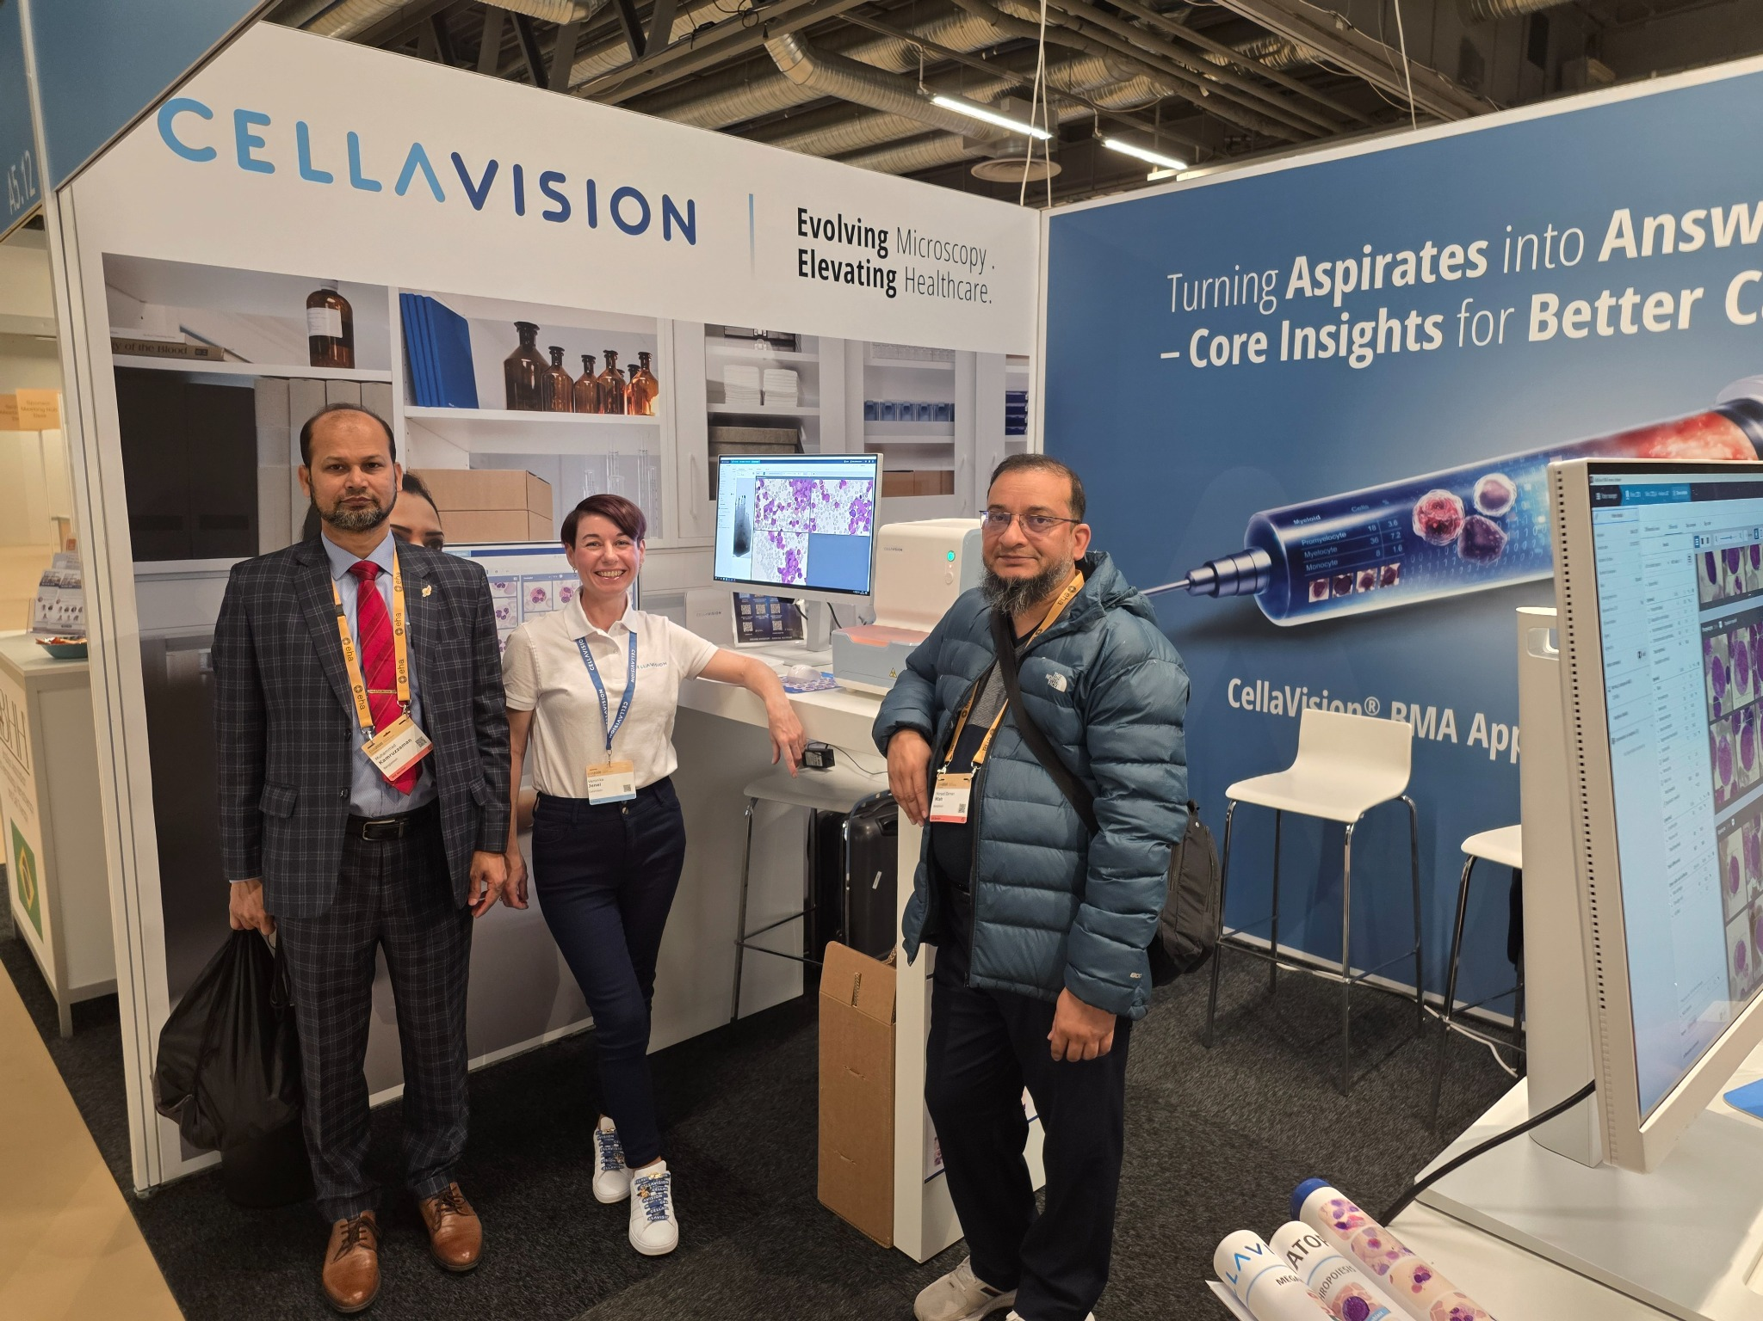

Slide 4
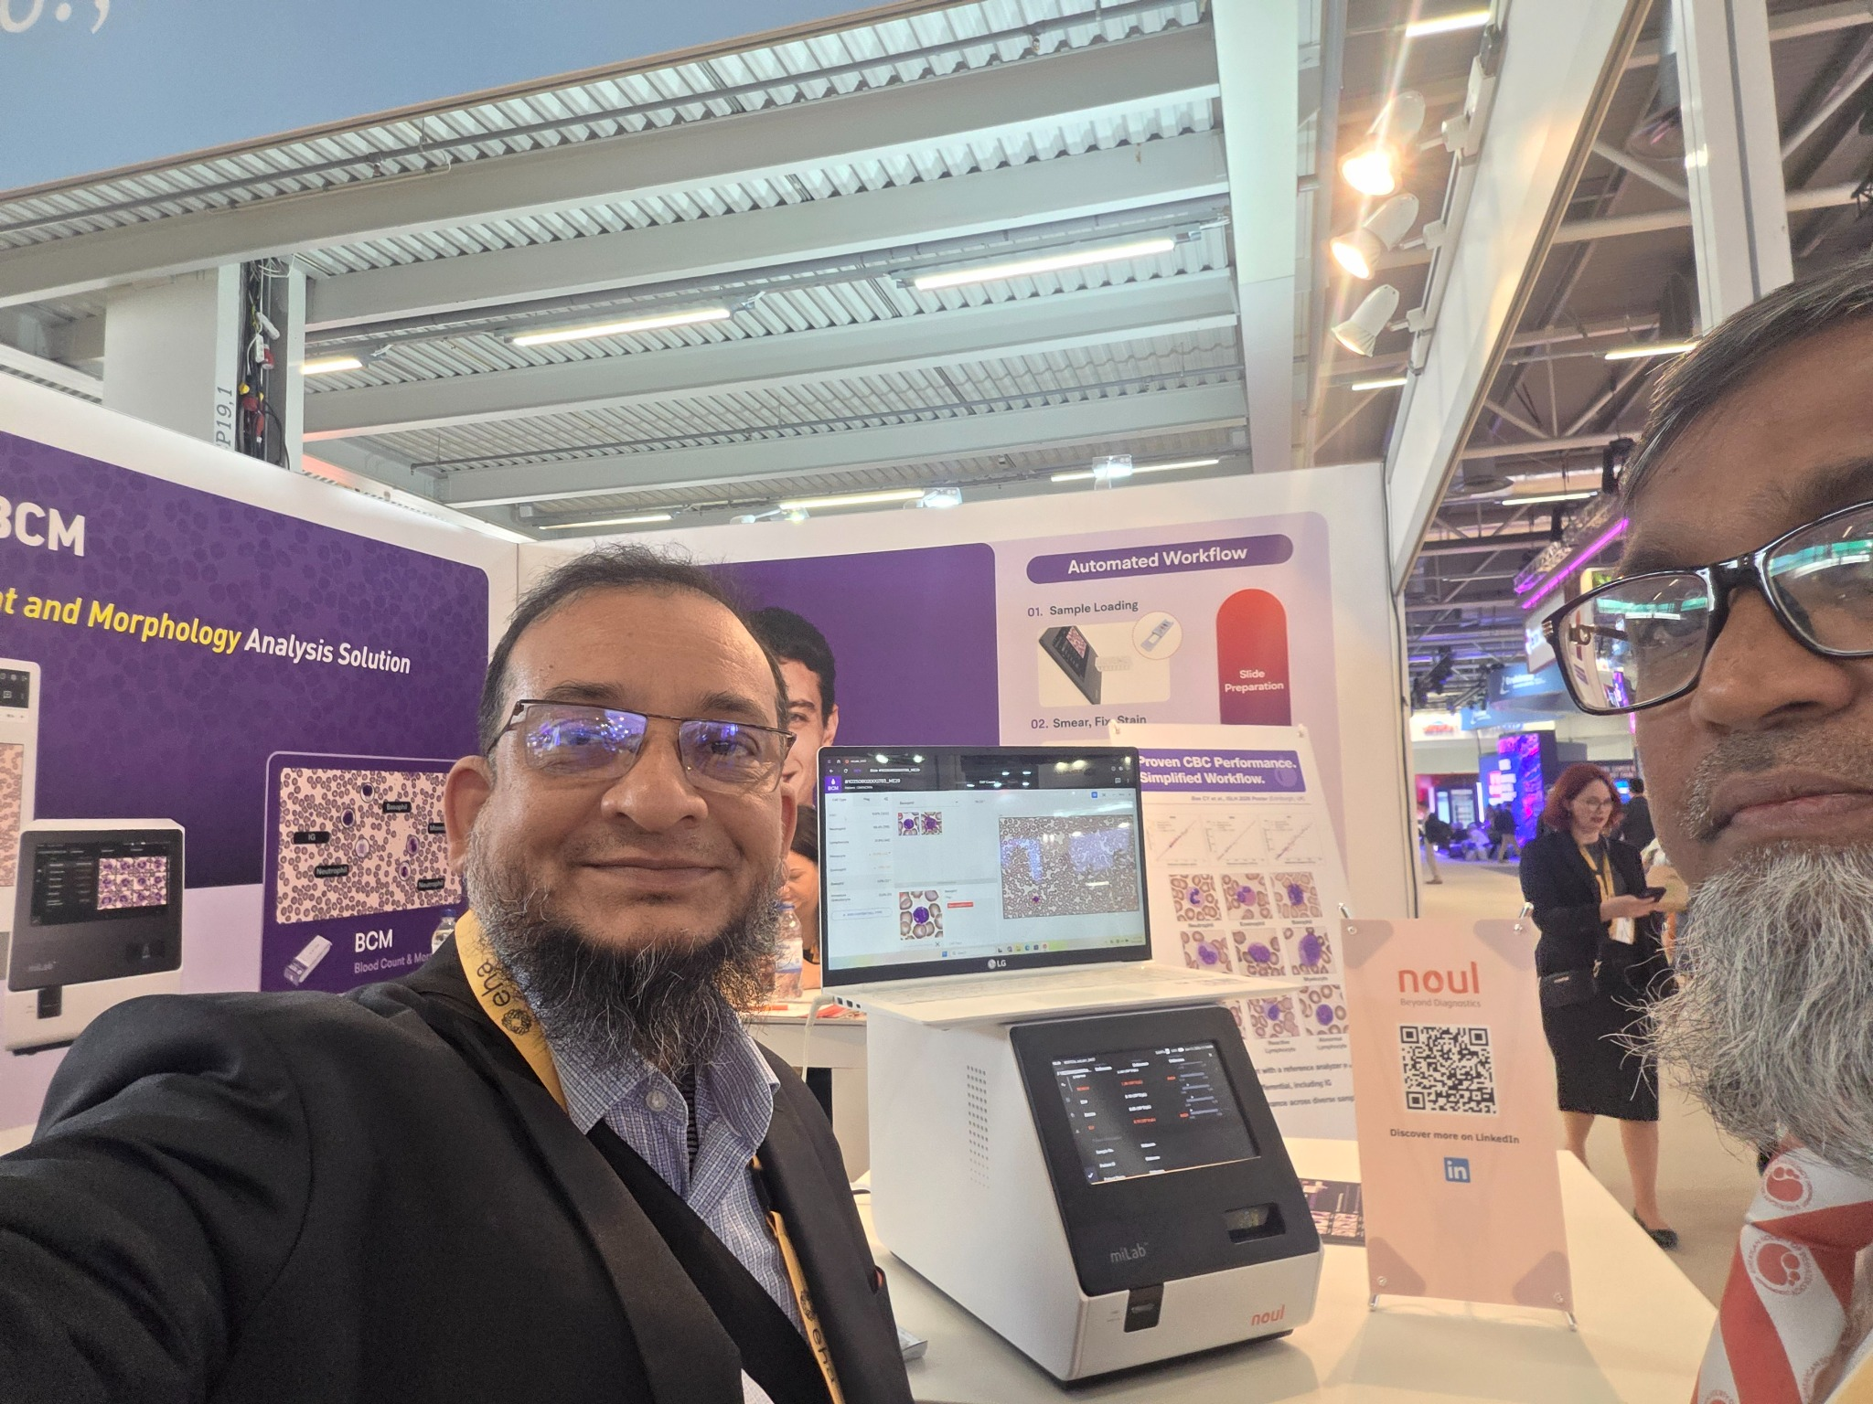

Slide 5
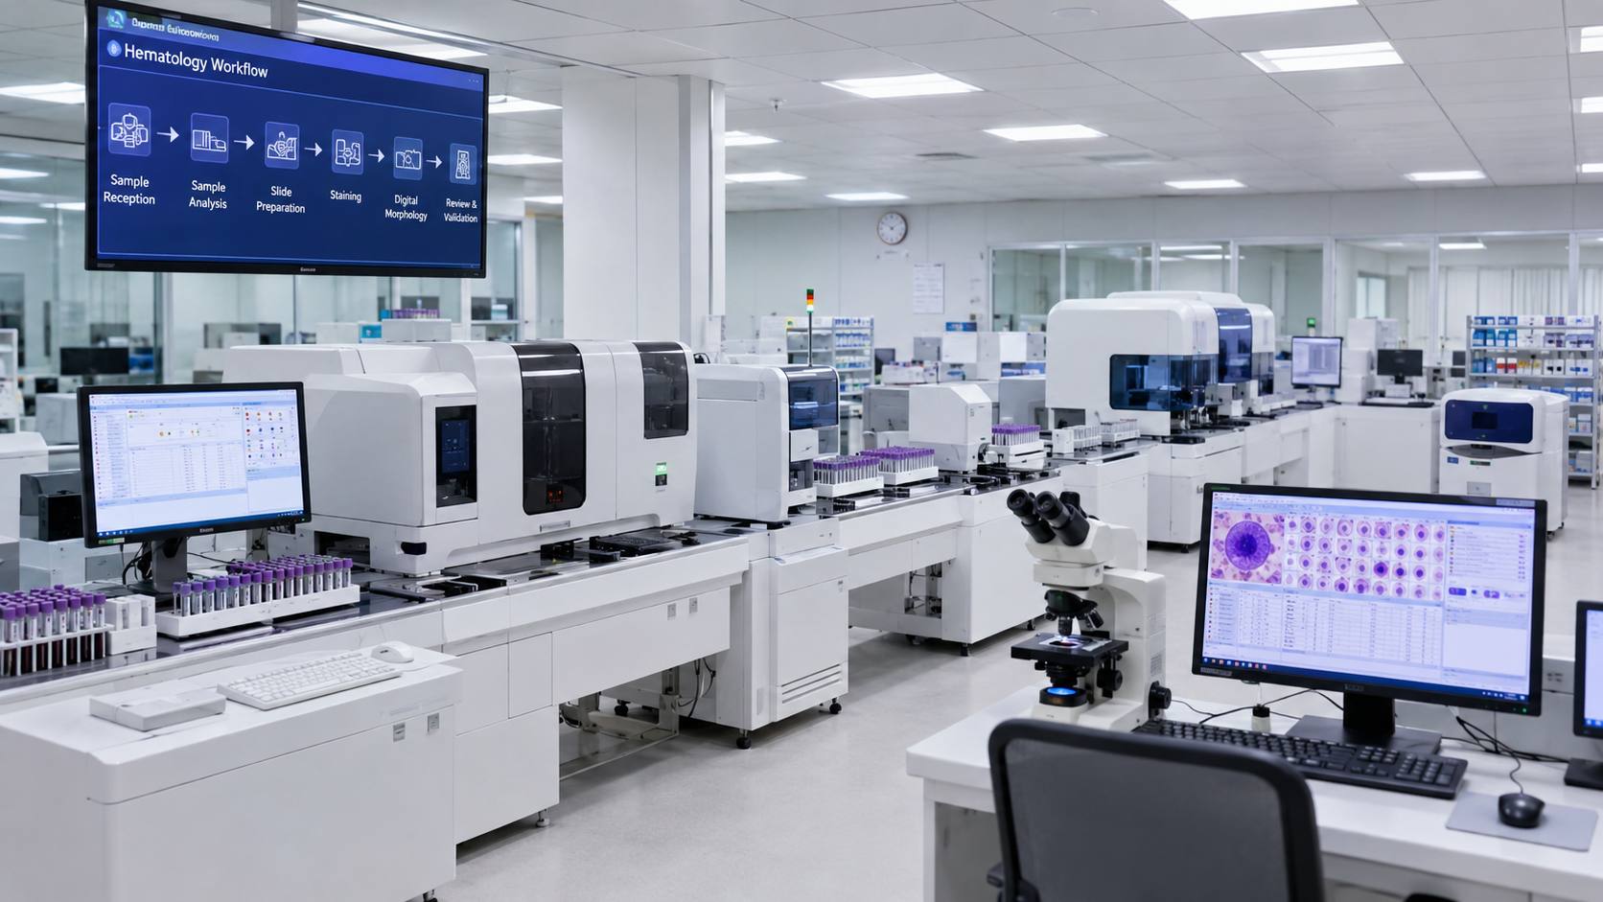
Why hematology diagnostics is changing
Modern laboratories need more than a CBC number: they need faster, safer and more clinically meaningful interpretation.
Old workflow
CBC analyzer → separate ESR → manual slide → delayed morphology review
Next-generation workflow
One EDTA tube → CBC + ESR/advanced parameters → reflex smear → digital morphology review
The goal is not to replace expertise — it is to focus expertise where it matters most.
Literature base: ICSH digital morphology recommendations; Kim et al., Diagnostics 2025; Xing et al., BMC Med Inform Decis Mak 2023.

Slide 6
Meeting purpose and audience value
A practical introduction for decision makers and laboratory users.
P
C
O
T
Pathologists
Clinicians
Clinic owners
Technologists
Reliable flags, morphology correlation and defensible review policy.
CBC + ESR + morphology gives faster diagnostic direction.
Space, cost, throughput and service differentiation for the lab.
Automation reduces repetitive work and standardizes slide quality.
Customer message: “A smarter hematology platform improves reporting confidence, turnaround time and patient care.”

Slide 7
Platform at a glance: from count to clinical interpretation
A connected approach combining automated analysis, reflex smear preparation and digital morphology.
BC-760 / BC-780
CAL-7000 concept
Clinical report
5-part hematology analyzer with integrated ESR concept, advanced WBC/PLT/reticulocyte information and automated flags.
Modular cellular analysis line: sample handling, analyzer modules, slide maker/stainer and digital morphology connectivity.
CBC + ESR + advanced parameters + smear/morphology correlation for more complete decision support.
Smear
Digital review
Report
Sample
CBC/ESR
Flags
Product concepts based on Mindray public materials for BC-700 series and CAL cellular analysis lines.

Slide 8
Literature evidence: automation supports accuracy and consistency
The evidence supports a hybrid model: automated pre-classification plus expert validation.
+15%
−215s
ICSH
Hybrid
average time saved per smear with AI-assisted morphology review
automation improves workflow, while expert review remains essential for complex/rare cells
accuracy gain for abnormal leukocyte differentiation in junior technologists with AI assistance
recommends validation, verification and appropriate use of digital morphology analyzers
• Digital morphology can automate blood cell pre-classification and reduce inter-observer variability.
• Performance is dependent on smear/stain quality, validation rules and operator review.
• Rare cells, dysplasia, parasites and pediatric samples need cautious expert oversight.
Sources: Kratz et al. ICSH review/recommendations; Xing et al. 2023; Kim et al. Diagnostics 2025.

Slide 9
Innovation 1: CBC + ESR from one workflow
A practical solution for inflammation, infection, malignancy follow-up and chronic disease monitoring.
Why it matters
Traditional ESR is slow, manual and needs separate workflow. Integrated ESR with CBC reduces sample handling and accelerates decision support.
Clinical use cases
Anemia + inflammation, autoimmune disease, infection monitoring, malignancy follow-up, chronic inflammatory states.
Operational benefit
One tube, less space, fewer manual steps, lower biosafety exposure, easier QC discipline.
Mindray public materials describe CBC & ESR results in one test on BC-700 series; validation against local method remains essential.

Slide 10
Innovation 2: advanced cellular parameters and flags
Beyond counts: the analyzer highlights where the microscope should focus.
WBC differential
Platelet support
SF-Cube / fluorescence-based classification and flags for abnormal populations.
Optical platelet channels and flags help in low-count or interference-prone samples.
Reticulocyte insight
NRBC / immature cells
Reticulocyte parameters support anemia workup and marrow response monitoring.
Automated flags support earlier review of critical samples.
CBC
ESR
Retic
PLT-H
DM
Advanced parameters create a triage map for targeted expert microscopy.

Slide 11
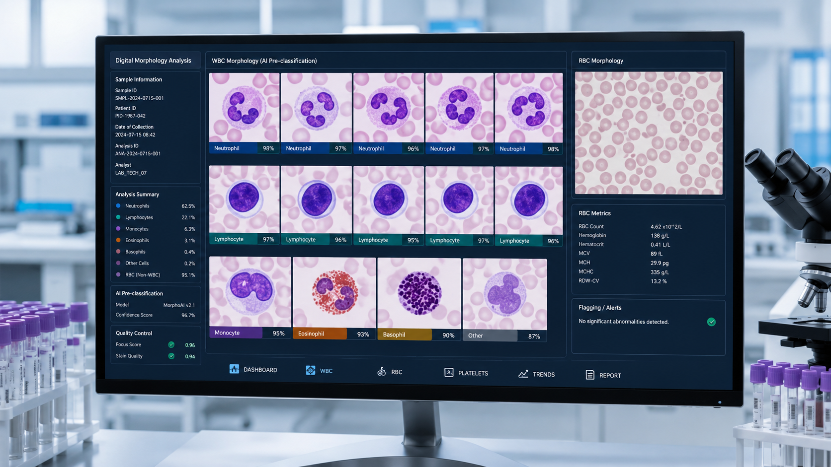
Innovation 3: automated smear + digital morphology
Standardized slides, AI pre-classification and remote review create a connected morphology service.
Auto slide making and staining improve consistency.
Digital images enable review, teaching, archiving and tele-morphology.
AI pre-classification helps technologists work faster and flags suspicious cells for expert review.
Final responsibility remains with trained laboratory professionals.
Digital morphology is best presented as “expertise amplified”, not “expertise replaced”.
Sources: Kim et al. 2025; Xing et al. 2023; ICSH recommendations.

Slide 12
Clinical impact: where reports become more actionable
CBC + ESR + morphology correlation can improve early direction and reduce missed opportunities.
Anemia
Reticulocyte response, RBC morphology, inflammation context
Infection / inflammation
CBC pattern + ESR trend + neutrophil/IG flags
Thrombocytopenia
Platelet flags, clumps, low-count confidence, smear confirmation
Leukemia / lymphoma suspicion
Abnormal WBC flags → urgent smear review and referral
Analyzer flags plus smear/digital morphology and expert confirmation
Malaria / hemoparasite endemicity
Clinical claims should be locally validated and integrated with clinical context and manual microscopy policy.

Slide 13
Workflow and business impact for clinics and laboratories
The value proposition is clinical quality plus operational efficiency.
Turnaround time
Faster sample-to-report cycle; less waiting for separate ESR and smear processes.
Human resource efficiency
Technologists spend less time on repetitive manual tasks and more on abnormal review.
Quality and standardization
Consistent smear/staining quality, reflex rules, QC traceability and report reproducibility.
Customer differentiation
Modern lab branding: “CBC report with smarter interpretation and morphology support.”

Slide 14
Implementation roadmap: safe adoption in real practice
A disciplined validation plan builds confidence among doctors, owners and technologists.
1
2
3
4
5
6
Needs assessment
Method validation
SOP & reflex rules
Training
Go-live monitoring
Audit & improvement
• Validate CBC, ESR and key flags against current methods and local patient mix.
• Define when a smear is mandatory: blasts, NRBC, platelet clumps, abnormal lymphocytes, critical counts, analyzer flags.
• Create a technologist-to-pathologist escalation policy and reporting template.

Slide 15
Take-home message
Next-generation hematology is a connected diagnostic workflow — not just a machine.
Evidence
Automation and AI-assisted morphology improve efficiency and consistency when properly validated.
Innovation
CBC + ESR + advanced parameters + automated smear + digital morphology create a stronger workflow.
Clinical impact
Better triage, faster review, more confident reporting and improved patient care.
Discussion: How can we adapt this platform to our local laboratory needs?
Key references: Kratz et al., Int J Lab Hematol 2019; Xing et al., BMC Med Inform Decis Mak 2023; Kim et al., Diagnostics 2025; Mindray product literature.

