Slide 1
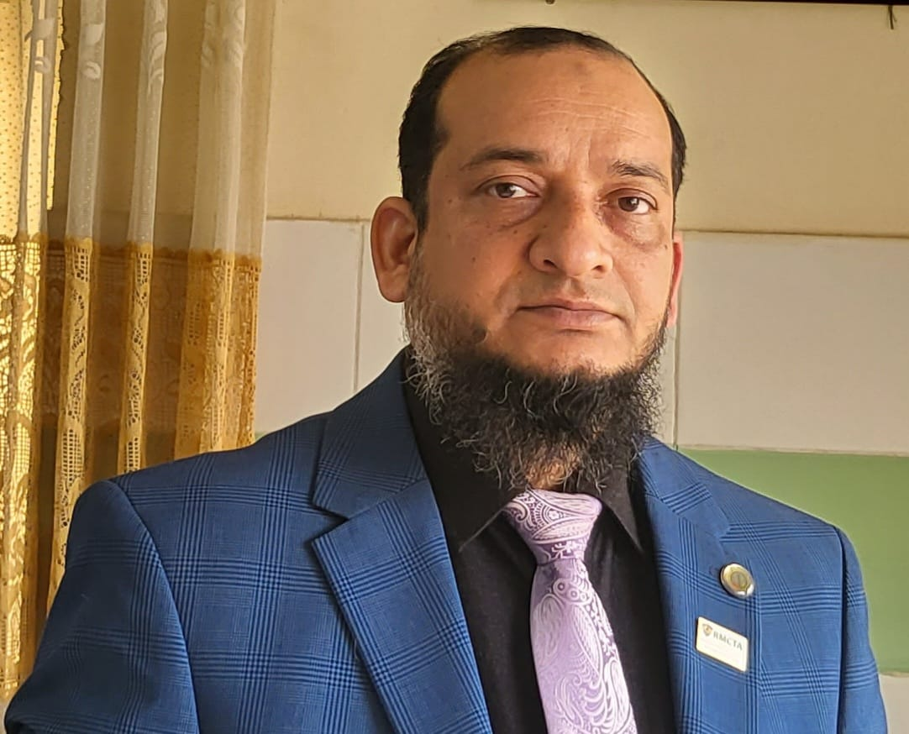
Dr.Morsed Zaman Miah
MBBS, MCPS
FCPS(Haematology)
Associate Professor & Head
Rajshahi Medical College.
www.drmzaman.com
With nearly 20 years of clinical, laboratory, teaching, and research experience, he specializes in Clinical Haematology, Hemato-Oncology, Haematopathology, Hemophilia, Thalassemia, and Advanced Hematology Diagnostics. He leads the Hemophilia Treatment Center (HTC) and Thalassemia Management Centre at RMCH and has published widely in national and international scientific journals. His research focuses on digital hematology, artificial intelligence, hematological malignancies, and laboratory innovation.

Slide 2
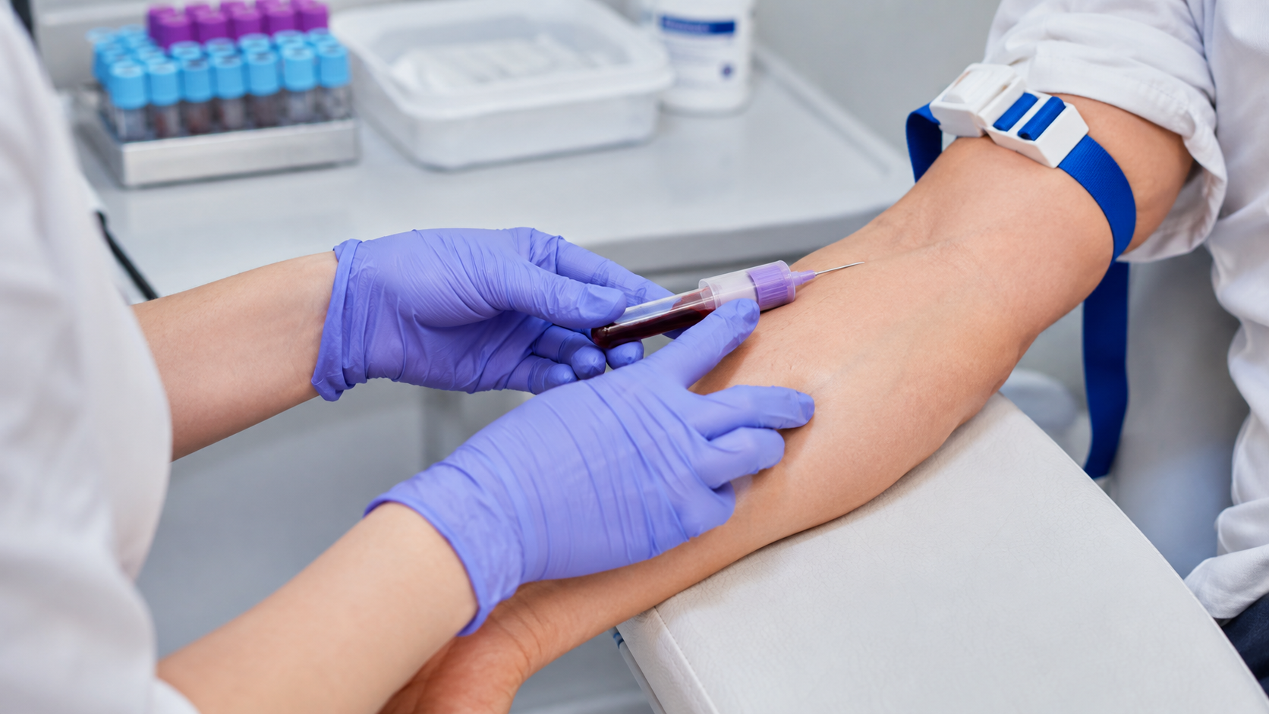

CBC Test: Pre-Analytical Errors
How to prevent sample rejection and improve hematology test quality
01

Slide 3
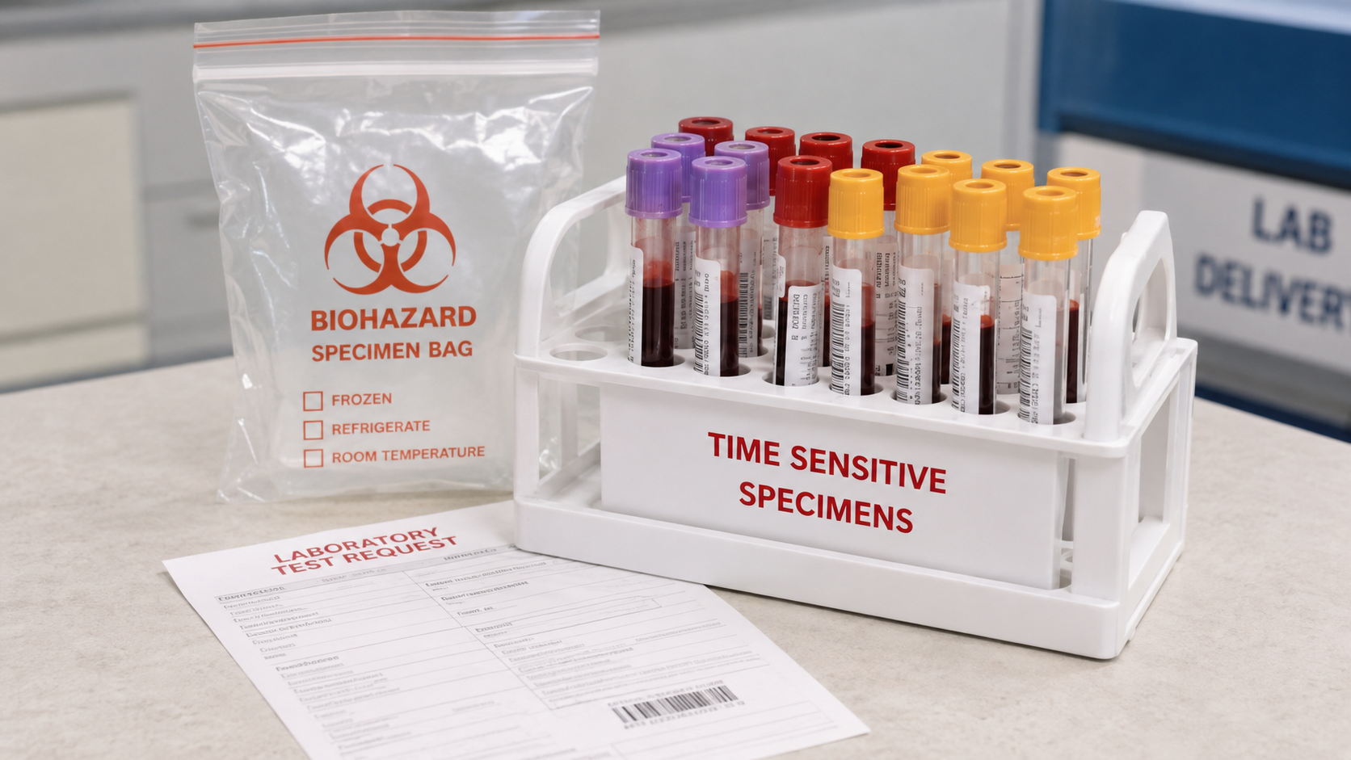
What is the pre-analytical phase?
All steps before the analyzer starts measuring the CBC.
Test request
Patient identification
Blood collection
Tube labelling
Mixing & handling
Transport & storage
Most CBC mistakes happen here — before the sample reaches the hematology analyzer.
CBC QUALITY STARTS BEFORE ANALYSIS
02

Slide 4
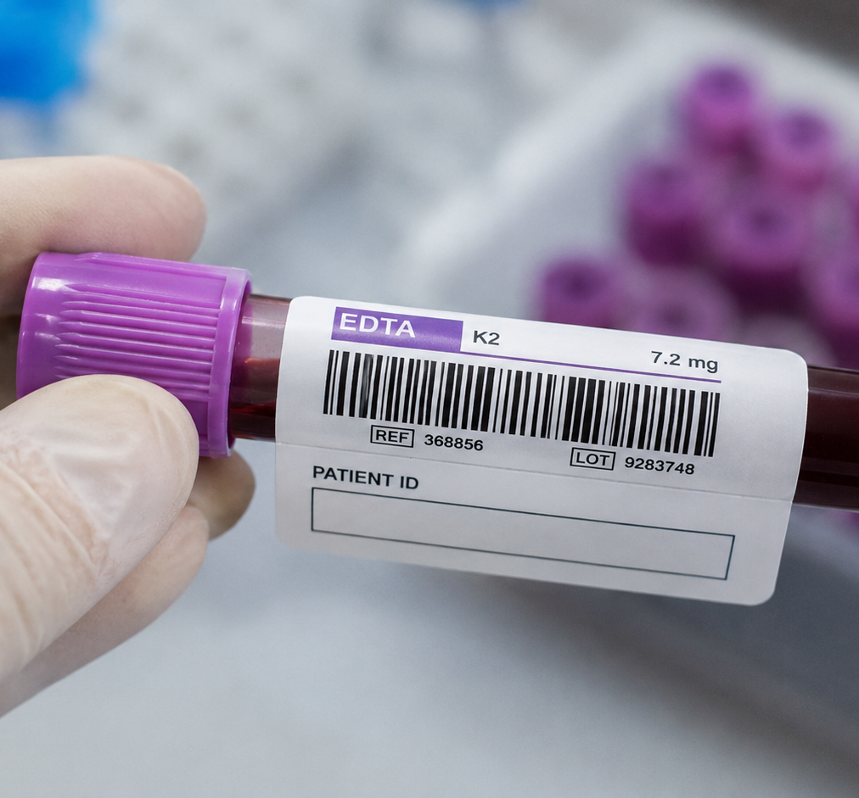
Wrong patient or incomplete request form
A correct result on the wrong patient is a serious clinical risk.
Missing two identifiers: name + ID/age/registration number
Mismatched tube label and request form
Unclear test name, ward, doctor, date or time of collection
Sample labelled away from the patient bedside
Corrective action
Label immediately after collection at bedside; verify two identifiers and barcode before dispatch.
ERROR 1
03

Slide 5
Wrong tube or wrong order of draw
CBC requires a properly filled lavender/purple EDTA tube.
High-risk mistakes
Using serum, citrate or heparin tube for CBC
Drawing EDTA before chemistry tubes can contaminate other tests
No discard tube when required by local policy
Expired or damaged tube
Prevention
Use tube guide charts at collection station and train staff on order of draw.
ERROR 2
04

Slide 6
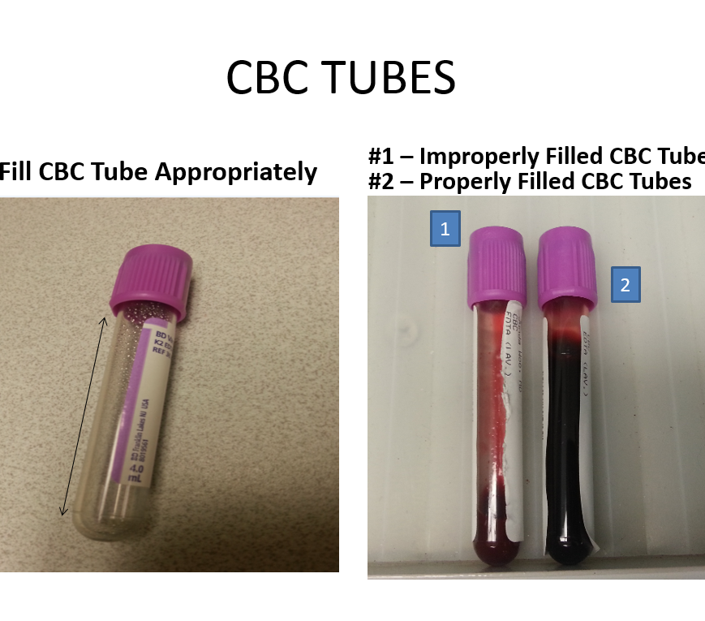
Incorrect fill volume in EDTA tube
Underfilling changes the blood-to-anticoagulant ratio.
Underfilled tube: excess EDTA effect may shrink cells and alter indices
Overfilled tube: inadequate anticoagulant mixing may cause microclots
Very small paediatric samples need approved micro-collection tubes
Corrective action
Fill to the manufacturer’s mark; reject or recollect if volume is unacceptable.
ERROR 3
05

Slide 7
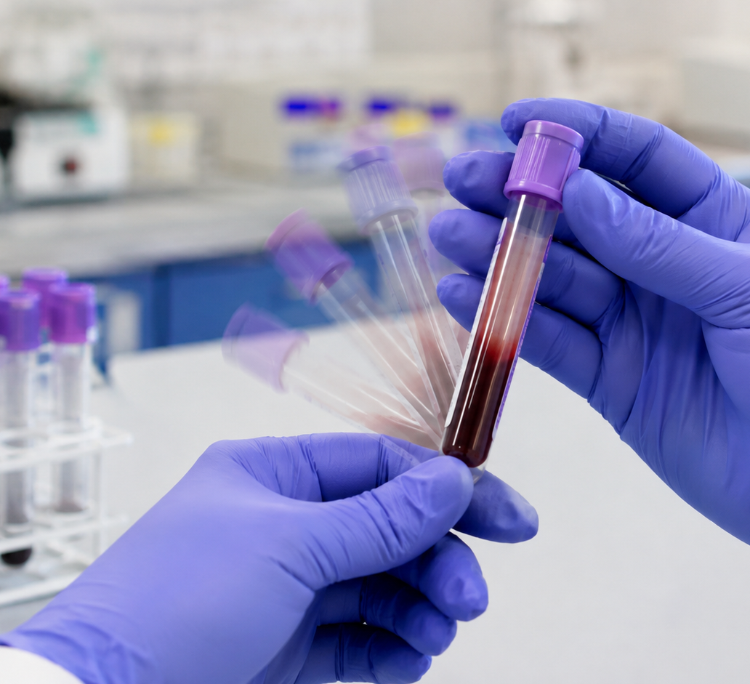
Poor mixing: clots and platelet errors
Clots are a common cause of sample rejection in CBC.
Not inverting the EDTA tube soon after collection
Vigorous shaking causing cell damage or hemolysis
Small clots reduce platelet count and block analyzer aspiration
Clot fragments may falsely increase WBC or flags
Correct technique
Gently invert EDTA tube 8–10 times; do not shake.
ERROR 4
06

Slide 8
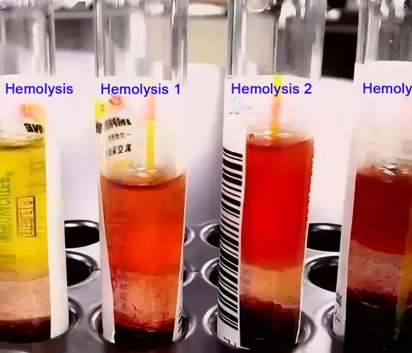
Hemolysis or traumatic collection
Severe hemolysis can interfere with Hb-related parameters and sample quality.
Difficult venipuncture, probing or excessive suction
Too small needle, forceful transfer, frothing
Vigorous mixing or temperature stress
May trigger analyzer flags and unreliable morphology
Prevention
Use smooth venipuncture, appropriate needle size, gentle transfer and prompt mixing.
ERROR 5
07

Slide 9
Dilution or contamination from IV line
Blood diluted by IV fluid may give falsely low cell counts.
Collecting from an arm receiving IV fluid
Improper line draw without adequate discard volume
Contamination with heparin, EDTA or saline
Unexplained low Hb, RBC, WBC, platelets or abnormal indices
Corrective action
Prefer opposite arm; pause IV if allowed; follow line-draw protocol and document source.
ERROR 6
08

Slide 10
Delayed transport and poor storage
CBC samples are time-sensitive, especially for differential and smear review.
Delay causes cell swelling, degenerative leukocyte changes and unreliable smear morphology
Exposure to heat can deteriorate cells and increase flags
Unsealed tubes may leak or clot at cap area
No collection time = difficult validity assessment
Quality rule
Record collection time; transport promptly in leak-proof bag at recommended temperature.
ERROR 7
09

Slide 11
Practical quality improvement plan
Make the right practice easy, visible and measurable.
Before collection
Use two identifiers; check request form; choose correct EDTA tube.
During collection
Avoid IV contamination; fill to mark; gentle venipuncture.
After collection
Invert 8–10 times; label bedside; send promptly.
In laboratory
Inspect clots/volume/label; document rejection; feedback to ward.
Key message: “Good CBC reporting begins with good specimen quality.”
QUALITY IMPROVEMENT
10

