Slide 1

Dr.Morsed Zaman Miah
MBBS, MCPS
FCPS(Haematology)
Associate Professor & Head
Rajshahi Medical College.
www.drmzaman.com
With nearly 20 years of clinical, laboratory, teaching, and research experience, he specializes in Clinical Haematology, Hemato-Oncology, Haematopathology, Hemophilia, Thalassemia, and Advanced Hematology Diagnostics. He leads the Hemophilia Treatment Center (HTC) and Thalassemia Management Centre at RMCH and has published widely in national and international scientific journals. His research focuses on digital hematology, artificial intelligence, hematological malignancies, and laboratory innovation.

Slide 2
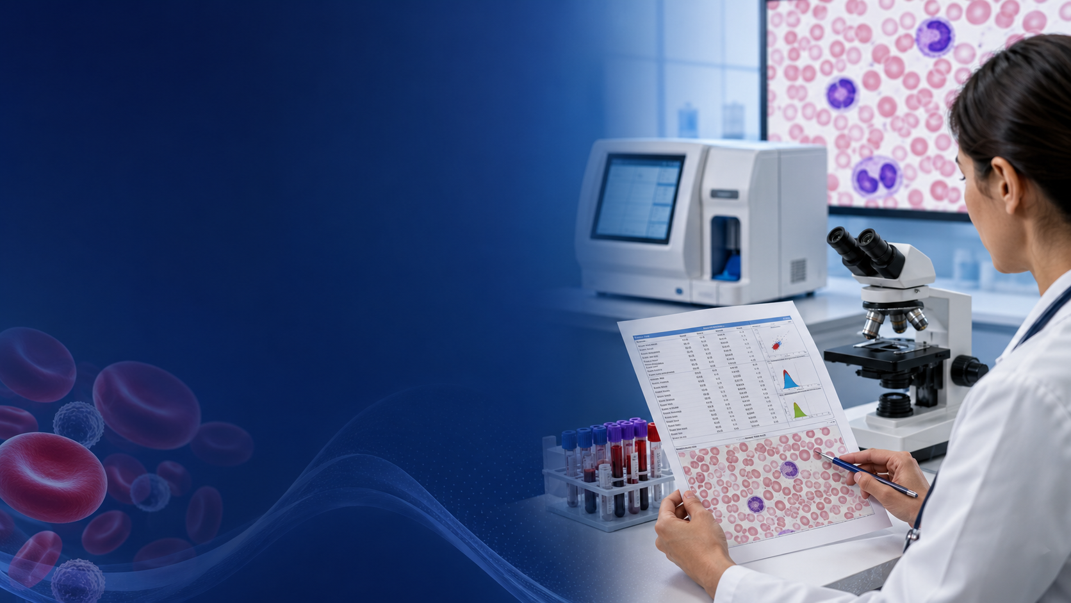
APPROACH TO A
PATIENT WITH ANAEMIA
A clinical reasoning framework for 5th Year MBBS students
History • Examination • CBC & smear • Differential diagnosis • Initial management
Dr. M. Morsed Zaman Miah
Associate Professor of Haematology, RMC
Notes:
Open with a bedside question: Is anaemia a diagnosis or a sign? Emphasize that the class focuses on a repeatable clinical algorithm.

Slide 4
Learning objectives
1. Recognise
2. Classify
3. Investigate
Identify symptoms, signs and red flags suggesting clinically significant anaemia.
Use MCV and reticulocyte response to build a focused differential diagnosis.
Choose rational first-line and second-line tests without shotgun testing.
4. Stabilise
5. Integrate
Recognise situations requiring urgent resuscitation, transfusion or referral.
Solve common ward and examination cases using a structured approach.

Slide 5
Anaemia: definition and clinical meaning
Anaemia = haemoglobin concentration below the appropriate reference threshold for age, sex, pregnancy status and context.
Not a final diagnosis
Hb ≠ oxygen delivery alone
Interpret the patient
It is a manifestation of reduced production, blood loss, increased destruction, or a combination.
Clinical impact depends on rapidity of fall, cardiopulmonary reserve, volume status and comorbidity.
A stable chronic Hb of 7 g/dL may look different from an acute fall to 9 g/dL.
WHO updated guidance emphasises population-specific interpretation and adjustment for relevant factors.

Slide 6
First question: is the patient unstable?
RED FLAGS
Syncope, confusion, chest pain or severe dyspnoea
Tachycardia, hypotension, shock or active bleeding
Acute haemolysis with haemoglobinuria / rapidly falling Hb
Severe anaemia with heart failure, pregnancy or major comorbidity
Suspected acute leukaemia, aplasia or pancytopenia
Immediate actions
ABC assessment
IV access + monitoring
CBC, group & crossmatch
Identify/stop bleeding
Urgent senior/haematology review
Transfuse only when clinically indicated

Slide 7
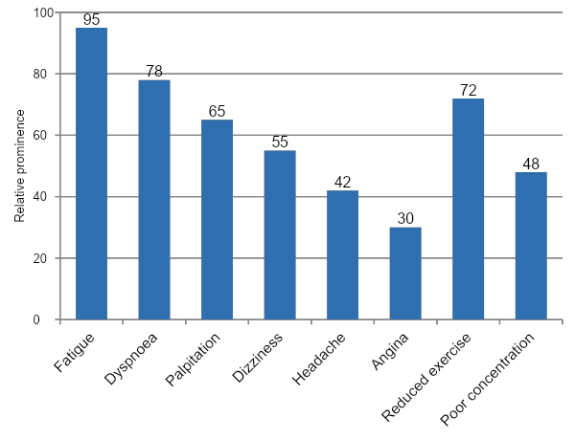
Clinical symptoms: think mechanism + severity
Rapid onset
More cardiovascular and neurological symptoms at a comparatively higher Hb.
Slow onset
Physiological adaptation may mask profound chronic anaemia.
Ask specifically
Bleeding, jaundice, dark urine, fever, weight loss, pica, neuropathy and drug exposure.
Chart is illustrative, not prevalence data.

Slide 8
Focused history: a high-yield checklist
Bleeding history
Nutrition & absorption
Chronic disease
Menorrhagia • GI blood loss • haematemesis/melaena • haematuria • epistaxis • surgery/trauma • blood donation
Dietary iron/B12/folate • pica • vegan diet • diarrhoea • gastrectomy • bariatric surgery • drugs affecting absorption
CKD • infection/TB • inflammatory disease • malignancy • liver/endocrine disease
Haemolysis clues
Drug & toxin exposure
Context
Jaundice • dark urine • gallstones • episodic attacks • family history • transfusion reactions
NSAIDs • anticoagulants • chemotherapy • antimetabolites • oxidant drugs • alcohol • lead
Age • pregnancy • ethnicity • travel • recurrent fever • renal symptoms • constitutional symptoms

Slide 9
Examination: look beyond pallor
General | Pallor, jaundice, fever, oedema, cachexia, lymphadenopathy
Cardiovascular | Pulse, BP, flow murmur, signs of heart failure
Skin/nails | Petechiae, bruising, koilonychia, leg ulcers
Mouth | Glossitis, angular cheilitis, oral ulcers
Neurology | Vibration/proprioception loss, neuropathy, cognitive change
Abdomen | Hepatomegaly, splenomegaly, masses, ascites
Rectal/pelvic | When indicated: occult bleeding or gynaecological cause
Examination aims to identify severity, cause and complications.

Slide 10
The core diagnostic framework
1. Confirm
2. Classify
3. Measure response
Repeat CBC if unexpected; review Hb, Hct, RBC count and other cell lines.
MCV: microcytic, normocytic or macrocytic.
Reticulocyte count / corrected reticulocyte index.
4. Examine morphology
5. Target the cause
Peripheral blood film directs targeted investigation.
Iron, B12/folate, renal/liver tests, haemolysis screen, marrow when indicated.

Slide 11
CBC interpretation: do not stop at haemoglobin
Parameter | Clinical use
MCV | Primary morphological classification
MCH/MCHC | Degree of hypochromia; consider spherocytosis when MCHC is high
RDW | Variation in red-cell size; often increased in iron deficiency or mixed deficiency
RBC count | Relatively high count may favour thalassaemia trait in microcytosis
WBC & platelets | Pancytopenia, marrow failure, inflammation or clonal disease
Analyzer flags | Blasts, NRBCs, agglutination, dimorphic population—confirm on film

Slide 12
Reticulocyte response: production or loss?
Appropriately increased
Blood loss or haemolysis; confirm with bilirubin, LDH, haptoglobin, DAT and smear.
RETICULOCYTE
COUNT
Low / inappropriately normal
Reduced marrow production: nutrient deficiency, CKD, inflammation, marrow failure or infiltration.
Correct for anaemia severity and reticulocyte maturation when interpreting the reticulocyte production index.

Slide 13
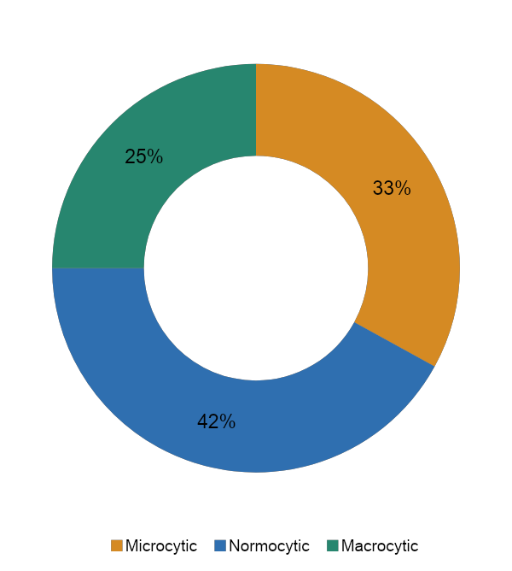
MCV-based classification
Microcytic (MCV < local lower limit)
Iron deficiency • thalassaemia • anaemia of inflammation • sideroblastic anaemia / lead
Normocytic
Acute blood loss • haemolysis • CKD • inflammation • marrow failure • mixed deficiency
Macrocytic
B12/folate deficiency • alcohol/liver disease • hypothyroidism • drugs • MDS • reticulocytosis
Pie proportions are illustrative only.

Slide 14
Microcytic anaemia: practical differentiation
Feature | Iron deficiency | Thalassaemia trait | Inflammation
RBC count | Low/normal | Normal or high | Low/normal
RDW | Often high | Usually normal/slightly high | Normal/slightly high
Ferritin | Low | Normal/high | Normal/high
TIBC/transferrin | High | Normal | Low/normal
Blood film | Microcytosis, hypochromia, pencil cells | Target cells, marked microcytosis | Mild microcytosis
Next step | Find source of iron loss | Hb analysis ± family study | Assess inflammatory/renal disease

Slide 15
Iron deficiency: diagnose the deficiency and its cause
Confirm iron deficiency
Identify source
Do not miss
Ferritin is the most useful first test; interpret cautiously in inflammation. Add transferrin saturation and CRP when needed.
Menstrual loss, GI blood loss, pregnancy, diet, malabsorption, parasites or repeated blood donation.
Adult male or postmenopausal woman: investigate occult GI blood loss unless a clear alternative exists.
Confirm
Find cause
Replace iron
Check response
A rise in reticulocytes and haemoglobin supports response, but failure requires reassessment of adherence, diagnosis, bleeding and absorption.

Slide 16
Normocytic anaemia: use the reticulocyte count
Reticulocytes high
Reticulocytes low
Normocytic anaemia
Acute blood loss
Haemolysis
Recovery after treatment
CKD/inflammation
Marrow failure/infiltration
Early nutrient deficiency
Confirm MCV and review smear / other cell lines.
Haemolysis screen
Production screen
Bilirubin, LDH, haptoglobin, DAT, urine, smear and clinical context.
Creatinine, CRP/ESR, iron/B12/folate, endocrine/liver tests; marrow if indicated.

Slide 17
Macrocytic anaemia: megaloblastic or non-megaloblastic?
Megaloblastic
Non-megaloblastic
Bone marrow / clonal
B12 deficiency
Folate deficiency
Antimetabolite drugs
Smear: macro-ovalocytes and hypersegmented neutrophils
May cause pancytopenia and raised LDH
Alcohol
Liver disease
Hypothyroidism
Reticulocytosis
Smear often shows round macrocytes or target cells depending on cause
Myelodysplastic syndrome
Aplastic or infiltrative disorders
Suspect with persistent cytopenias, dysplasia or unexplained macrocytosis
Neurological features strongly support B12 deficiency and may occur without severe anaemia.

Slide 18
Peripheral blood film: morphology gives direction
Microcyte
Macro-ovalocyte
Spherocyte
Target cell
Iron deficiency / thalassaemia
Megaloblastic anaemia
AIHA / hereditary spherocytosis
Thalassaemia / liver disease
Fragmented cells
Polychromasia
Blasts / leukoerythroblastosis
Schistocytes suggest microangiopathic or mechanical haemolysis—urgent correlation.
Usually reflects reticulocytosis and marrow response.
Requires urgent expert film review and often marrow assessment.

Slide 19
Haemolytic anaemia: confirm, then classify
Evidence of increased destruction
DAT positive
DAT negative
Reticulocytosis
Indirect bilirubin ↑
LDH ↑
Haptoglobin ↓
Polychromasia / specific morphology
Autoimmune haemolysis
Drug-induced immune haemolysis
Transfusion reaction
Membrane/enzyme defect
Haemoglobinopathy
MAHA/mechanical
Infection
Blood film clues
Spherocytes • schistocytes • bite cells • sickle cells • parasites • agglutination

Slide 20
When to think of bone marrow disease
Pancytopenia or bicytopenia
Blasts or marked dysplasia
Leukoerythroblastic film
Unexplained persistent macrocytosis
Constitutional symptoms + organomegaly
Failure of rational first-line evaluation
Bone marrow examination is not a routine test for every anaemic patient.
Use it when the clinical question cannot be answered by peripheral blood and targeted biochemical testing, or when marrow pathology is likely.
Discuss with haematology

Slide 21
Rational investigation panel
First-line in most patients | Second-line / targeted
CBC with indices + reticulocyte count | Ferritin, transferrin saturation, CRP/ESR
Peripheral blood film | B12, folate, thyroid and liver tests
Creatinine / eGFR | Haemolysis screen + DAT
Bleeding assessment | Hb analysis / G6PD / parasite testing when indicated
Clinical review of drugs and diet | Endoscopy, imaging or gynaecological assessment
Repeat/verify unexpected results | Bone marrow examination / molecular studies

Slide 22
A one-slide diagnostic algorithm
Low Hb confirmed
MCV
Reticulocytes
Blood film
Assess symptoms, bleeding and haemodynamic stability.
Micro / normo / macro
High vs low response
Confirm morphology
Microcytic pathway
Normocytic pathway
Macrocytic pathway
Ferritin ± CRP
Iron studies
RBC count/RDW
Hb analysis if indicated
Search for blood loss
Retic high → blood loss/haemolysis
Retic low → CKD/inflammation/marrow
Check other cell lines
B12/folate
Liver/thyroid/drugs
Reticulocytosis
MDS if unexplained cytopenia
At every step: integrate age, pregnancy, comorbidity, local epidemiology and pre-test probability.

Slide 23
Transfusion: treat the patient, not a number
Consider urgently
Individualise
Reassess
Haemodynamic instability, active major bleeding, myocardial ischaemia, severe symptoms or impending decompensation.
Hb threshold depends on context, trajectory, symptoms, cardiac disease, pregnancy and treatment goals.
Use the minimum effective dose; check response and monitor for reactions/volume overload.
Red-cell transfusion does not replace diagnosis or definitive treatment of iron, B12, folate deficiency, bleeding or haemolysis.

Slide 24
Case 1: young woman with fatigue
22-year-old student
Question 1
What is the most likely diagnosis?
Fatigue, exertional dyspnoea, pica and heavy menstrual bleeding.
Hb 8.1 g/dL
MCV 64 fL
RBC 3.8 ×10¹²/L
RDW high
Platelets 520 ×10⁹/L
Question 2
Which initial tests confirm it and what source must be addressed?
Expected reasoning
Microcytic anaemia + high RDW + pica + menorrhagia → iron deficiency; confirm ferritin/iron profile and evaluate bleeding.

Slide 25
Case 2: jaundice and dark urine
35-year-old man
Question 1
What broad mechanism is present?
Acute fatigue, jaundice and dark urine after a febrile illness.
Hb 7.6 g/dL
MCV 91 fL
Reticulocytes 12%
Indirect bilirubin and LDH high
Smear: spherocytes
Question 2
Which test separates immune from non-immune haemolysis?
Expected reasoning
Normocytic anaemia with strong reticulocyte response and haemolysis markers → haemolytic anaemia; perform DAT.

Slide 26
Case 3: macrocytosis with neurological symptoms
58-year-old woman
Most likely
Megaloblastic anaemia—vitamin B12 deficiency is particularly likely.
Progressive fatigue, glossitis, numb feet and unsteady gait.
Hb 8.9 g/dL
MCV 116 fL
WBC and platelets mildly reduced
Smear: macro-ovalocytes + hypersegmented neutrophils
Important pitfall
Do not give folate alone before excluding B12 deficiency when neurological signs are present.
Next tests
Serum B12/folate, cause assessment, haemolysis-like biochemistry and review for pernicious anaemia/malabsorption.

Slide 27
Common pitfalls in clinical practice
1
Starting iron without confirming deficiency or identifying blood loss
2
Calling every low ferritin “dietary” in an adult
3
Ignoring reticulocyte count and peripheral smear
4
Treating macrocytosis with folate before excluding B12 deficiency
5
Assuming normocytic anaemia is always “anaemia of chronic disease”
6
Ordering bone marrow examination before basic targeted tests

Slide 28
Bedside summary: the 6-step approach
1
2
3
4
5
6
Stabilise
Confirm
Classify
Respond
Morphology
Target
Recognise red flags and active bleeding
Verify Hb and review all cell lines
Use MCV and RDW
Interpret reticulocyte count
Review peripheral blood film
Order cause-directed tests and treat
Anaemia is a sign. The goal is to identify the mechanism, the cause, the urgency and the safest definitive treatment.

Slide 29
Quick knowledge check
1. A microcytic anaemia with a relatively high RBC count suggests what diagnosis?
2. Which single test best separates immune from non-immune haemolysis?
3. What smear finding is classically associated with megaloblastic anaemia?
4. Why can severe chronic anaemia produce fewer symptoms than acute anaemia?
5. When should bone marrow examination be considered?

Slide 30
Key references
Davidson’s Principles and Practice of Medicine. 24th ed. Elsevier; 2022. Sections on anaemia and haematological disorders.
Hoffbrand AV, Steensma DP. Hoffbrand’s Essential Haematology. 8th ed. Wiley-Blackwell; 2019.
Wintrobe’s Clinical Hematology. 15th ed. Wolters Kluwer. Chapters on approach to anaemia and red-cell disorders.
World Health Organization. Guideline on haemoglobin cutoffs to define anaemia in individuals and populations. Geneva: WHO; 2024.
Local hospital transfusion policy and national/departmental protocols should guide emergency and transfusion decisions.
Thank you • Questions and discussion

