Slide 1
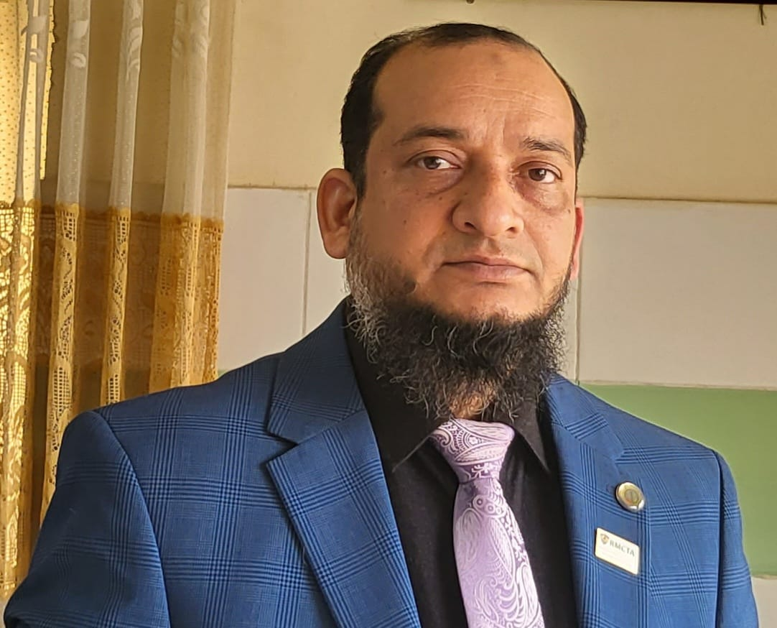
Dr.Morsed Zaman Miah
MBBS, MCPS
FCPS(Haematology)
Associate Professor & Head
Rajshahi Medical College.
www.drmzaman.com
With nearly 20 years of clinical, laboratory, teaching, and research experience, he specializes in Clinical Haematology, Hemato-Oncology, Haematopathology, Hemophilia, Thalassemia, and Advanced Hematology Diagnostics. He leads the Hemophilia Treatment Center (HTC) and Thalassemia Management Centre at RMCH and has published widely in national and international scientific journals. His research focuses on digital hematology, artificial intelligence, hematological malignancies, and laboratory innovation.

Slide 2
Haematological Aspect
of Purpura
Integrated Teaching - Phase IV | Topic: Purpura
Rajshahi Medical College
05 July 2026 | 20-minute session
Purpura = non-blanching bleeding into skin or mucosa
Haematological Aspect of Purpura
01
Notes:
Open by emphasizing that purpura is a clinical sign. The haematology task is to identify platelet, coagulation, marrow or vascular causes.

Slide 3
Learning objectives
By the end of this short session, students should be able to:
Recognize purpura as a sign, not a final diagnosis
Differentiate platelet/vascular bleeding from coagulation bleeding
Select first-line haematological investigations
Identify red flags requiring urgent referral or admission
Clinical reasoning pathway
Lesion pattern
CBC + smear
PT/APTT
Diagnosis + urgency
Haematological Aspect of Purpura
02
Notes:
Set expectations: a practical approach students can apply in ward and examination settings.

Slide 4
What exactly is purpura?
Non-blanching skin/mucosal bleeding due to extravasation of blood.
Petechiae
Purpura
Ecchymosis
< 2 mm
2-10 mm
> 1 cm
Increasing lesion size
Key clinical clue: petechiae + mucosal bleeding strongly suggest platelet or vascular disorder.
Haematological Aspect of Purpura
03
Notes:
Clarify the difference between petechiae, purpura and ecchymosis. Mention non-blanching nature.

Slide 5
Haematological framework
Think in four major buckets.
Platelet number
Thrombocytopenia: ITP, dengue, leukemia, aplasia, drugs, hypersplenism
Platelet function
Aspirin/clopidogrel, uraemia, Glanzmann, Bernard-Soulier, vWD
Coagulation factors
Hemophilia, liver disease, vitamin K deficiency, anticoagulants, DIC
Marrow / TMA
Acute leukemia, aplastic anemia, MDS, TTP/HUS, DIC
Purpura mechanisms
Platelet
Coagulation
Vascular
Haematological Aspect of Purpura
04
Notes:
Introduce the diagnostic compartments: platelet number, platelet function, coagulation factor and marrow/TMA processes.

Slide 6
Bleeding pattern clues
The bleeding pattern is often more informative than the rash alone.
Platelet or vascular disorder
• Petechiae, purpura
• Gum bleeding, epistaxis
• Menorrhagia
• Immediate bleeding after injury
Coagulation factor disorder
• Deep muscle bleeding
• Hemarthrosis
• Large ecchymosis
• Delayed bleeding after injury
Ask: skin/mucosa or deep tissue?
Haematological Aspect of Purpura
05
Notes:
Emphasize immediate mucosal bleeding points toward platelet/vascular problems, while delayed deep bleeding points toward coagulation factor deficiency.

Slide 7
First-line haematology work-up
Start simple, interpret quickly, escalate when red flags are present.
CBC + platelet count
Confirms thrombocytopenia, anemia, leukocytosis/pancytopenia
Peripheral blood film
Blasts, schistocytes, giant platelets, clumping, parasites
PT/INR + APTT
Screens extrinsic/intrinsic pathway abnormalities
Fibrinogen + D-dimer
When DIC or severe systemic illness is suspected
LFT/RFT + LDH/bilirubin
Liver disease, uraemia, hemolysis/TMA clues
Do not treat thrombocytopenia blindly - confirm with smear.
Haematological Aspect of Purpura
06
Notes:
Mention CBC, smear and coagulation screen as the minimum. Add fibrinogen/D-dimer when DIC is possible.

Slide 8
Peripheral blood film: a life-saving test
A quick smear can change the diagnosis and urgency.
Large platelets
ITP / inherited thrombocytopenia
Blasts
Acute leukemia - urgent
Schistocytes
TTP/HUS/DIC - emergency
Pancytopenia
Aplasia, leukemia, MDS, infiltration
Clumping
Pseudothrombocytopenia
Malaria parasite
Infection-associated thrombocytopenia
Haematological Aspect of Purpura
07
Notes:
Stress that blasts and schistocytes are emergency findings. Smear also detects pseudothrombocytopenia.

Slide 9
Important haematological causes not to miss
Focus on common and dangerous diagnoses.
ITP
Isolated thrombocytopenia; PT/APTT usually normal
Acute leukemia
Purpura with fever, anemia, bone pain, organomegaly or blasts
Aplastic anemia
Pancytopenia; infection + anemia + bleeding
DIC
Sepsis/obstetric/malignancy; low platelets, prolonged PT/APTT
Urgent
triage
TTP/HUS
Thrombocytopenia + MAHA; schistocytes; renal/neuro features
Haematological Aspect of Purpura
08
Notes:
Briefly describe ITP, leukemia, aplasia, DIC and TTP/HUS. These are high-yield for students.

Slide 10
Red flags: when purpura is an emergency
Admit, refer or discuss urgently when these features are present.
Platelet count <20 x 10^9/L or active mucosal bleeding
Fever, hypotension, sepsis or meningococcal picture
Blasts, pancytopenia or suspected acute leukemia
Schistocytes, renal failure or neurological symptoms
Prolonged PT/APTT with bleeding or suspected DIC
Pregnancy with hypertension, abnormal LFT or low platelets
Do not delay: CBC + film + coagulation screen can be lifesaving.
Haematological Aspect of Purpura
09
Notes:
Use this slide to emphasize triage and emergency referral. TTP, DIC, leukemia and sepsis must not be missed.

Slide 11
Practical diagnostic algorithm
A simple flow for bedside reasoning.
Non-blanching purpura
CBC + peripheral smear
Low platelets
ITP, dengue, drugs, leukemia, DIC/TTP
Normal platelets
Check PT/APTT + platelet function/vWD
Blasts/schistocytes
Urgent haematology action
Treat the cause + assess bleeding severity
Remember: purpura is the entry point; diagnosis comes from clinical pattern + targeted tests.
Haematological Aspect of Purpura
10
Notes:
Walk students through the algorithm. The first decision is platelet count and smear findings.

Slide 12
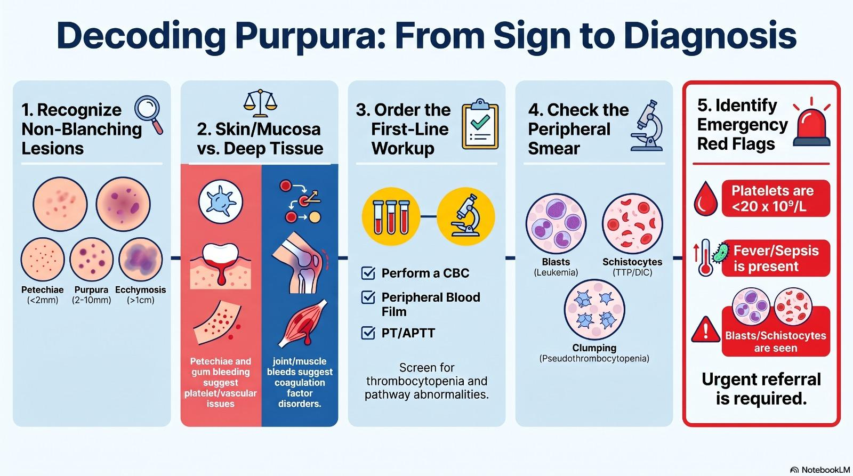

Slide 13
Management principles
Treat the underlying cause and bleeding severity - not the skin lesion alone.
Immediate safety
Assess airway/hemodynamics, active bleeding, CNS/GI bleeding, sepsis
Stop triggers
Avoid aspirin/NSAIDs; review anticoagulants, antiplatelets, antibiotics, herbal drugs
Blood products
Platelets/FFP/cryo according to cause, severity and lab results
Disease-specific care
ITP: steroid/IVIG when indicated; DIC: treat cause; TTP: urgent plasma exchange
Referral
Leukemia, TMA, DIC, severe thrombocytopenia or unclear diagnosis
In ITP, platelet transfusion is generally reserved for life-threatening bleeding.
Haematological Aspect of Purpura
11
Notes:
Keep management principle-based for students. Mention ITP treatment and emergency management of DIC/TTP.

Slide 14
Take-home messages
A structured approach prevents missed emergencies.
1
Purpura is a sign, not a diagnosis
2
Petechiae/mucosal bleeding = platelet or vascular pattern
3
Deep tissue/joint bleeding = coagulation factor pattern
4
CBC + peripheral smear + PT/APTT are first-line tests
5
Blasts, pancytopenia or schistocytes are urgent findings
6
Always manage according to cause and bleeding severity
Thank you
Questions and discussion
Haematological Aspect of Purpura
12
Notes:
End with six take-home points and invite discussion.

