Slide 1
"Updated Diagnosis & Management of Thalassemia "
Dr. M.Morsed Zaman Miah
Assistant Professor & Head.
Department of Haemaology
Rajshahi Medical College & Hospital.

Slide 2
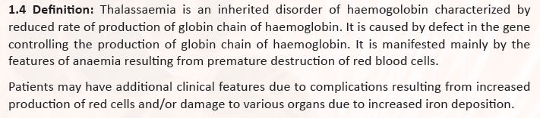

Slide 3
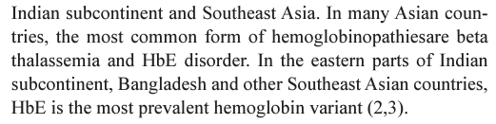

Slide 4
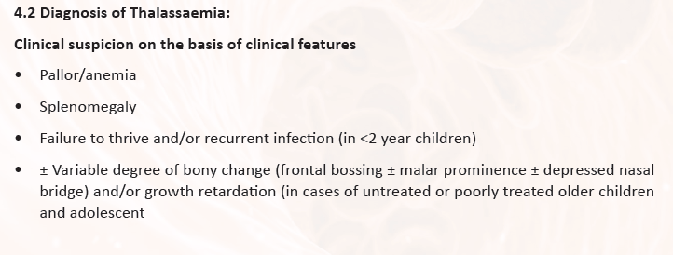

Slide 5
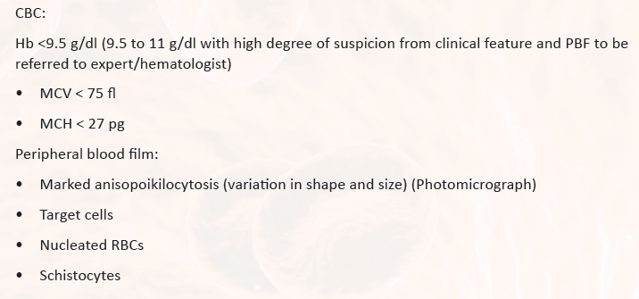

Slide 6
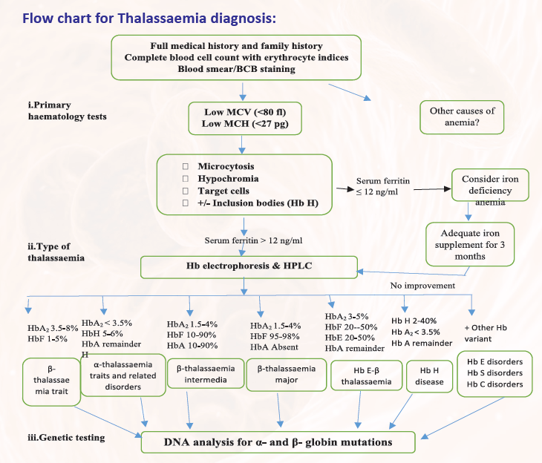

Slide 7
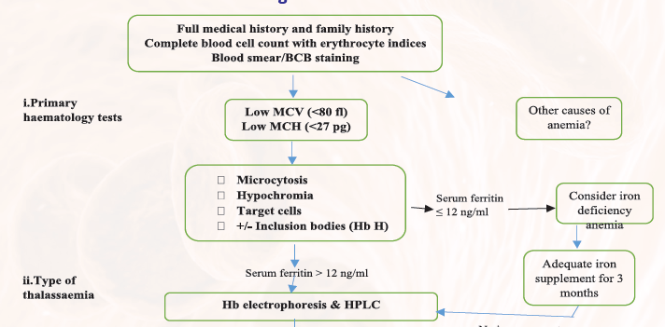

Slide 8
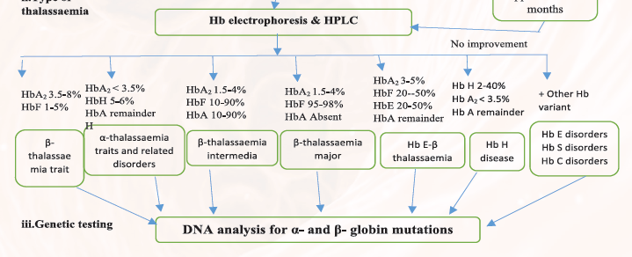

Slide 9
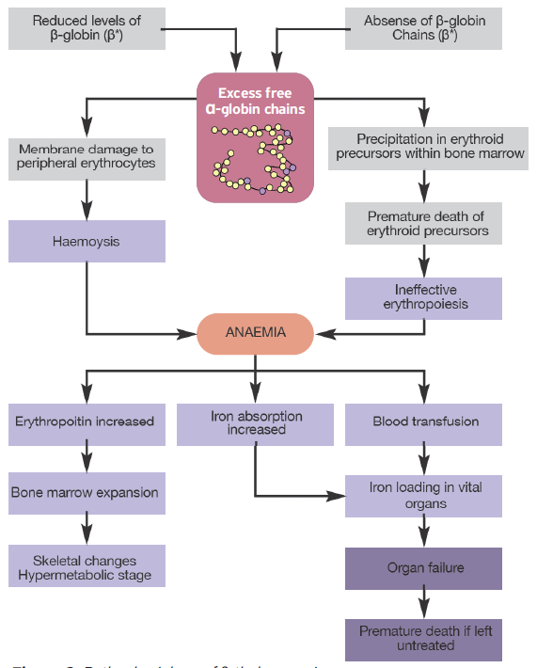

Slide 10
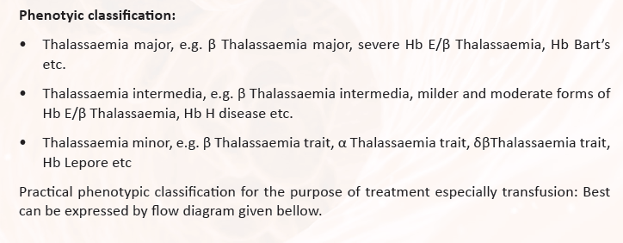

Slide 11
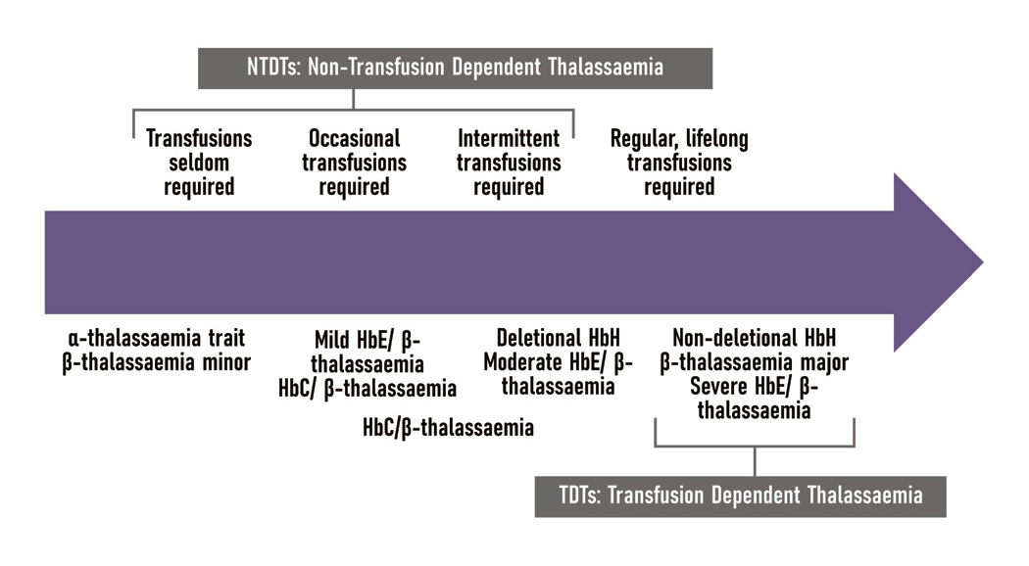
Phenotypic classification of thalassaemia syndromes based on clinical severity and transfusion requirement

