Slide 1
Leukaemia
Dr. M.Morsed Zaman Miah
MBBS,MCPS,FCPS
Assistant Professor & Head of Haematology
Rajshahi Medical College, Rajshahi.
www.drmzaman.com

Slide 2
Leukaemia
Leukemias are an uncommon and heterogeneous group of diseases characterized by infiltration of
the bone marrow,
blood, and
visceral organs by neoplastic cells of the
hemato­-poietic system

Slide 3
Q 1. Is leukaemia Curable ?
A. Yes
B. No
C. Some varieties are curable.

Slide 4
Q2. Which Type of Leukaemia is Curable?

Slide 5
Q3. Highest curable Treatment option of Leukaemia is
Bonemarrow Transplantation.
Is it available in Bangladesh?
A. Yes
B. No

Slide 6
Q4. Leukaemia Treatment available in
Rajshahi Medical College Hospital?
A. Yes
B. No

Slide 7
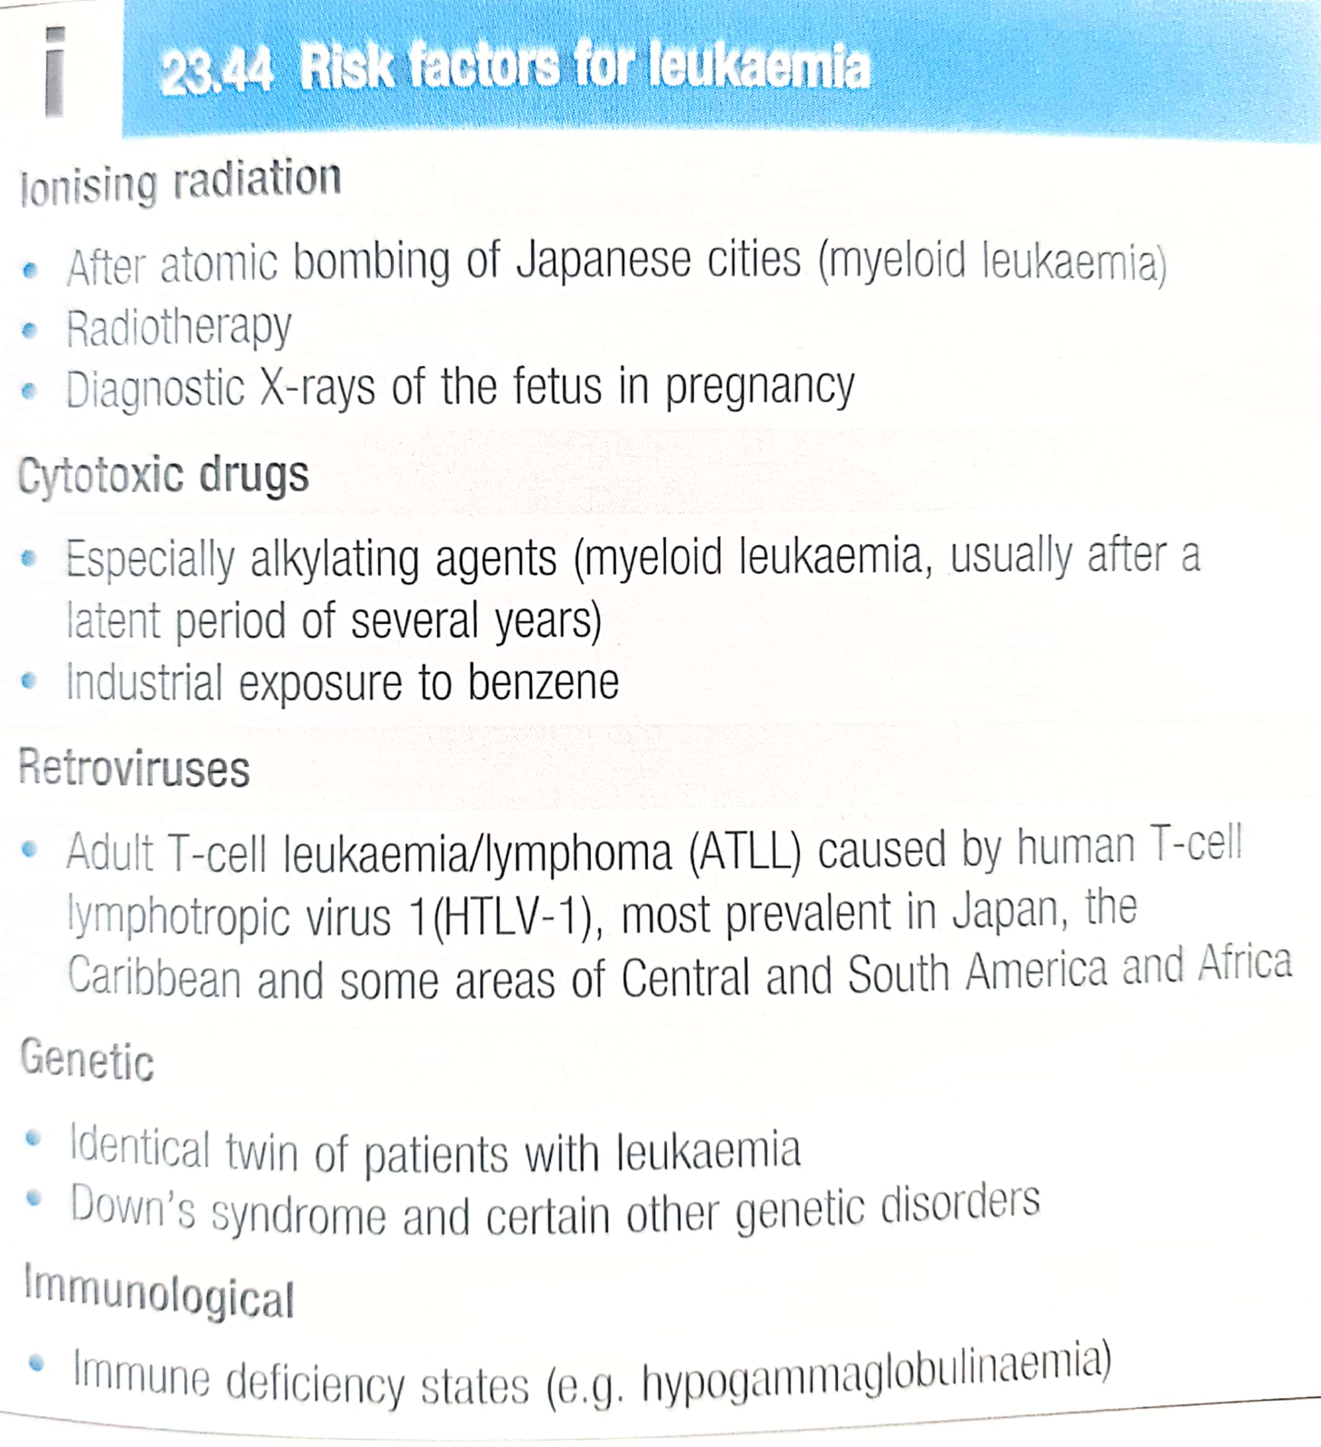

Slide 8
Clinical Features
Symptoms that reflect underlying bone marrow failure.

Slide 9
Clinical Features
Symp­toms reflecting anemia
Pallor, fatigue, weakness, palpitations,
or dyspnea on exertion.

Slide 10
Clinical Features
Symptoms of thrombo­cytopenia,
Ecchymosis, petechiae, epistaxis, and prolonged
bleeding after minor injury may also be seen.

Slide 11
Clinical Features
Neutropenia cause infec­tions.
Hyperleukocytosis can lead to leukostasis, a symptomatic rise in the blast count which leads to decreased tissue perfusion, due to increases in blood viscos­ity and cytokine release from high cellular metabolic activity.

Slide 12
Clinical Features
Systemic symptoms, including anorexia, weight loss, and low-grade fevers.

Slide 13
Classification
Acute Leukaemia
Chronic Leukaemia

Slide 14
Acute leukemia
Acute leukemia is diagnosed by the discovery of >20% blasts in the peripheral blood or bone marrow, although such stringent cutoffs may not accu­rately define the biology of the disease.

Slide 15
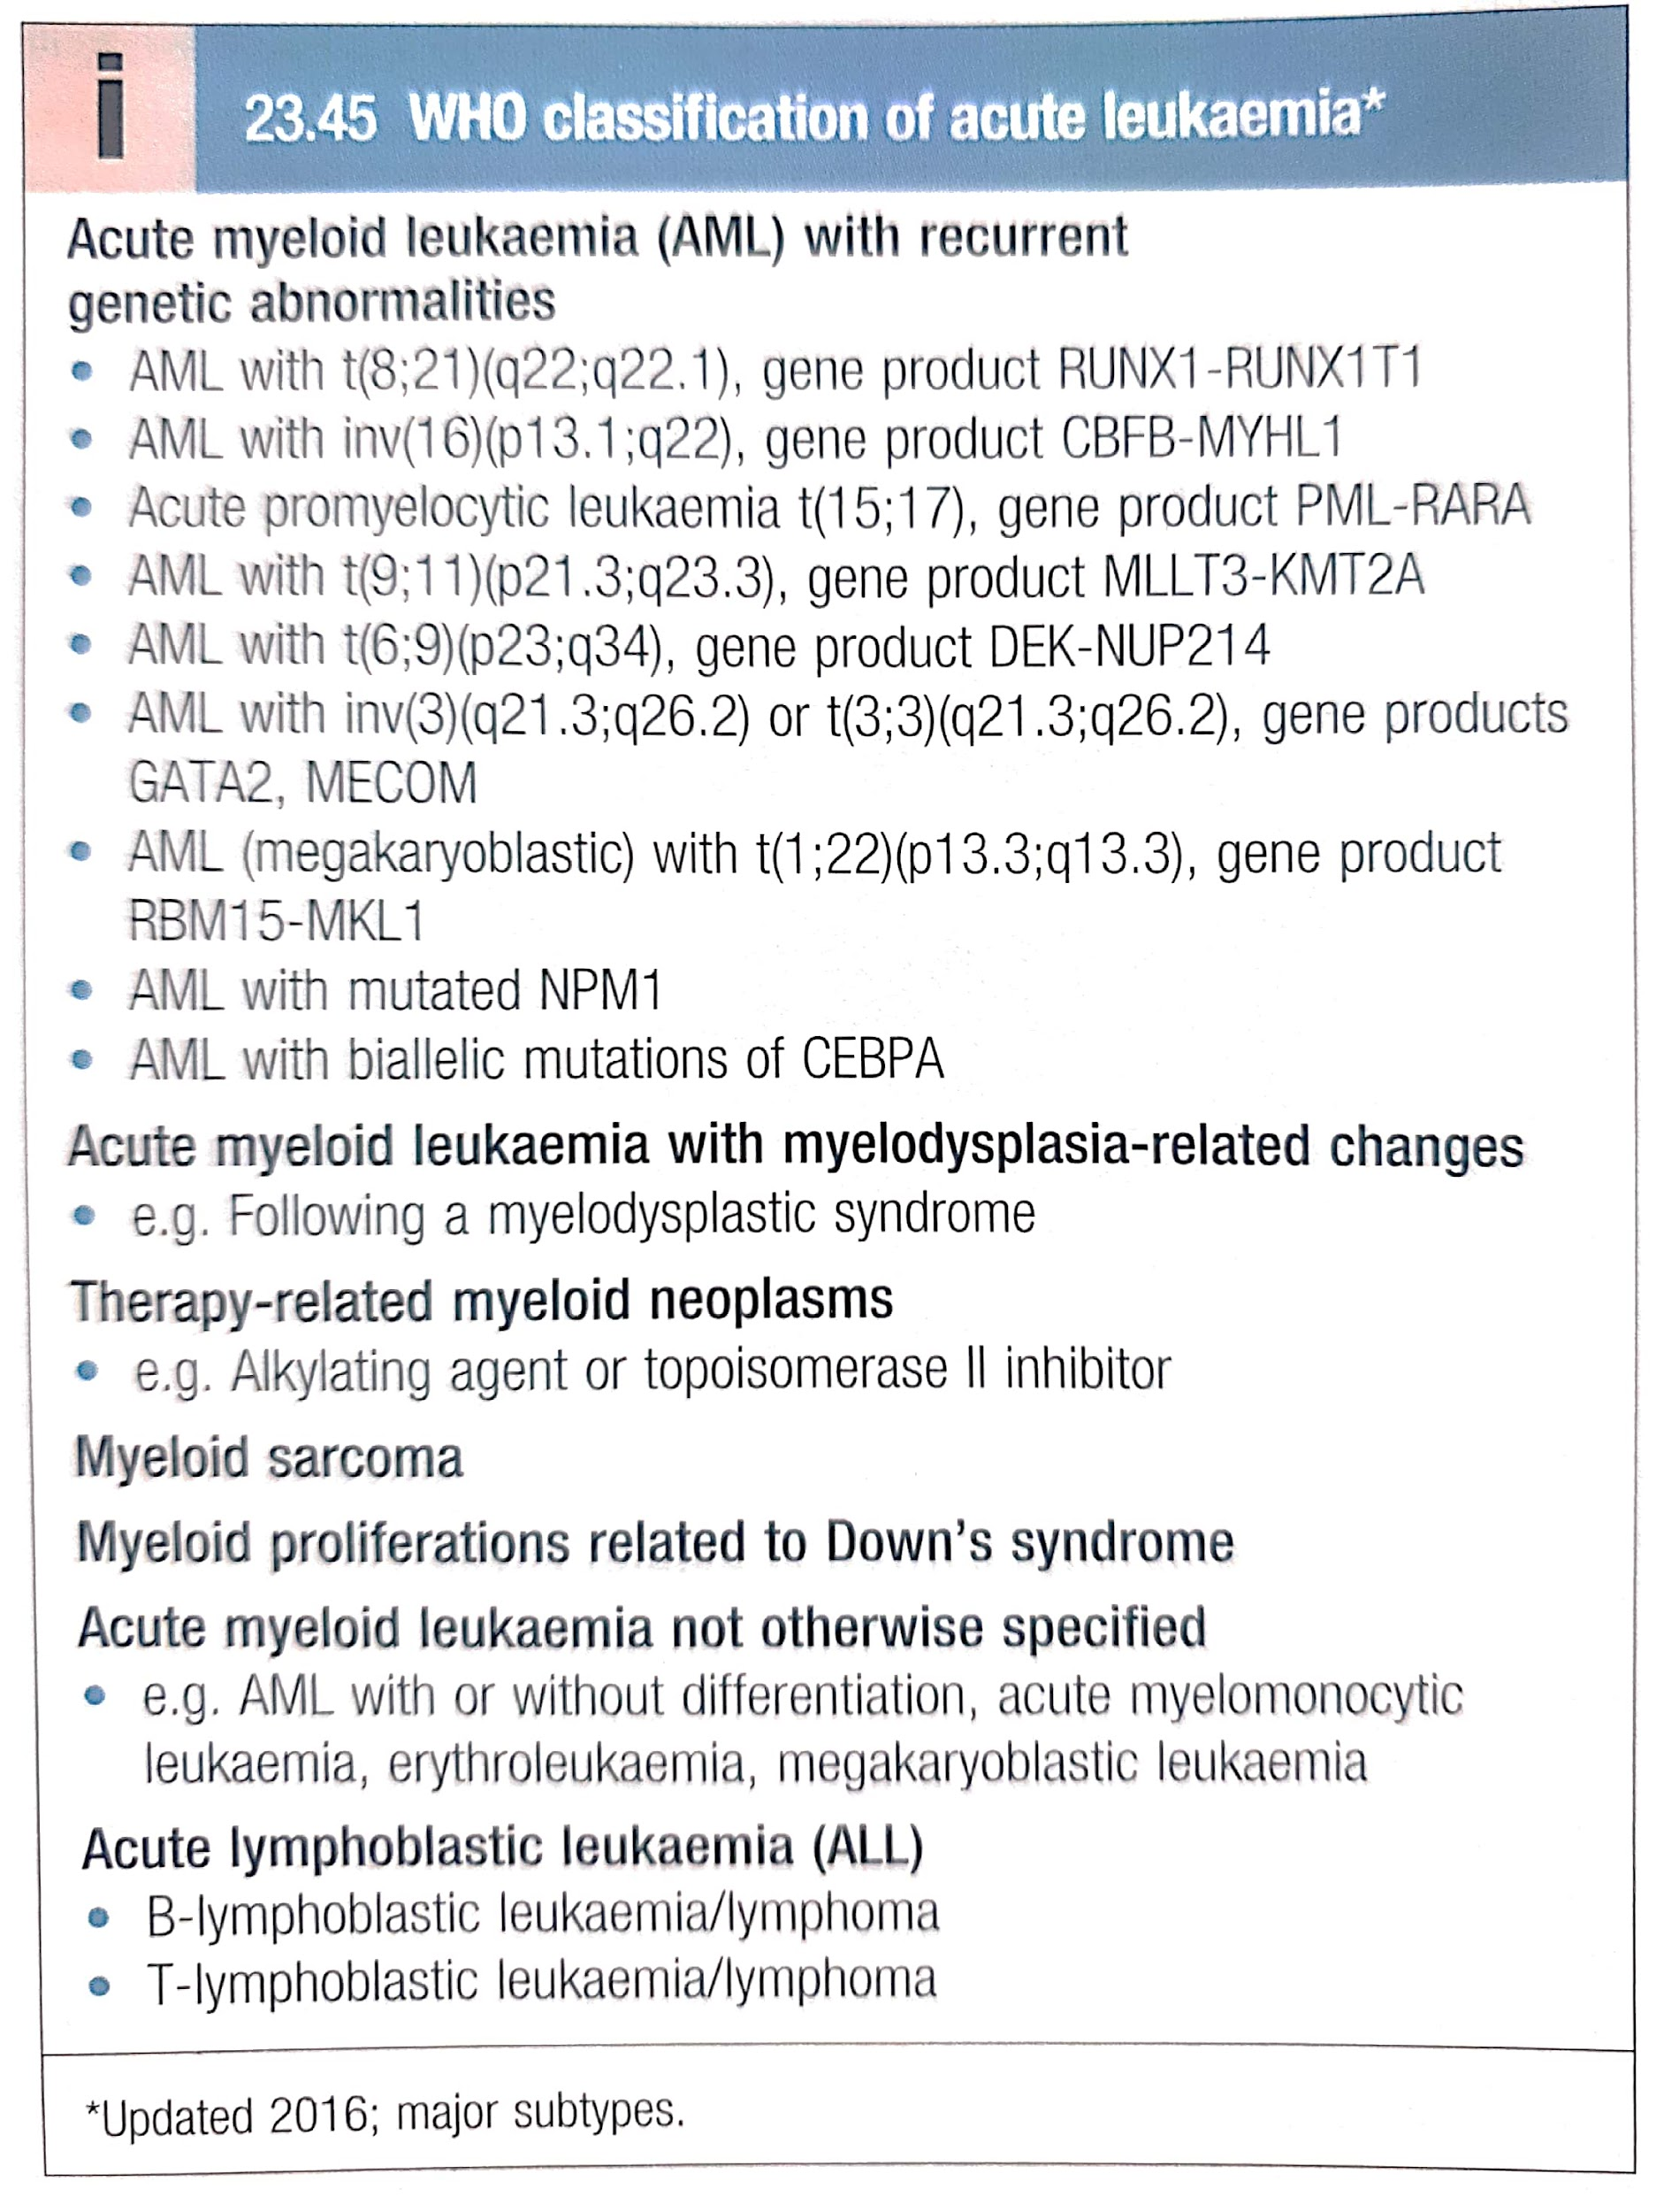

Slide 16
Approach to Diagnosis
Thorough history and physical exam, including evaluation of performance status .
CBC with platelets and differential . peripheral smear evaluation
Serum chemistries and liver function tests .
Disseminated intravascular coagulation (DIC) panel (D-dimer, fibrinogen, PT/aPTT, platelets)
Tumor lysis syndrome (TLS) labs [serum lactate dehydrogenase (LDH), uric acid, potassium, phos­phate, calcium]
Bone marrow analysis with aspirate and morphol­ogy review, cytogenetics/FISH, flow cytometry, and gene fusion panel
• Urinalysis
• Hepatitis B/C, HIV, and CMV antibody testing
• Pregnancy testing in females
• Evaluation of testicular involvement in male patients
• Fertility counseling
• Evaluation of cardiac function (e.g., transthoracic echocardiogram) CNS imaging as appropriate Lumbar puncture as per treatment protocol (diag­ nostic LP commonly performed at time of first

Slide 17
Classification Based on
Integrated results of morphol­ogy,
Immunohistochemistry,
Immunophenotyping by flow cytometry,
Cytogenetics (karyotyping),
FISH, and
Molecular studies of mutations

Slide 18
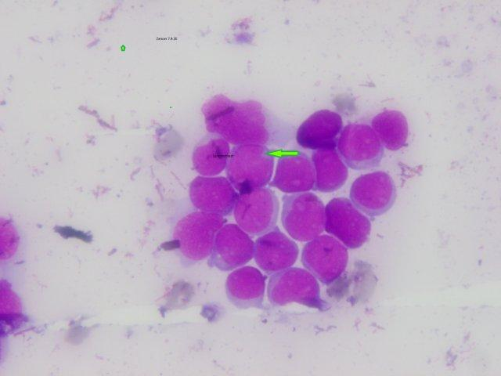
www.drmzaman.com

Slide 19
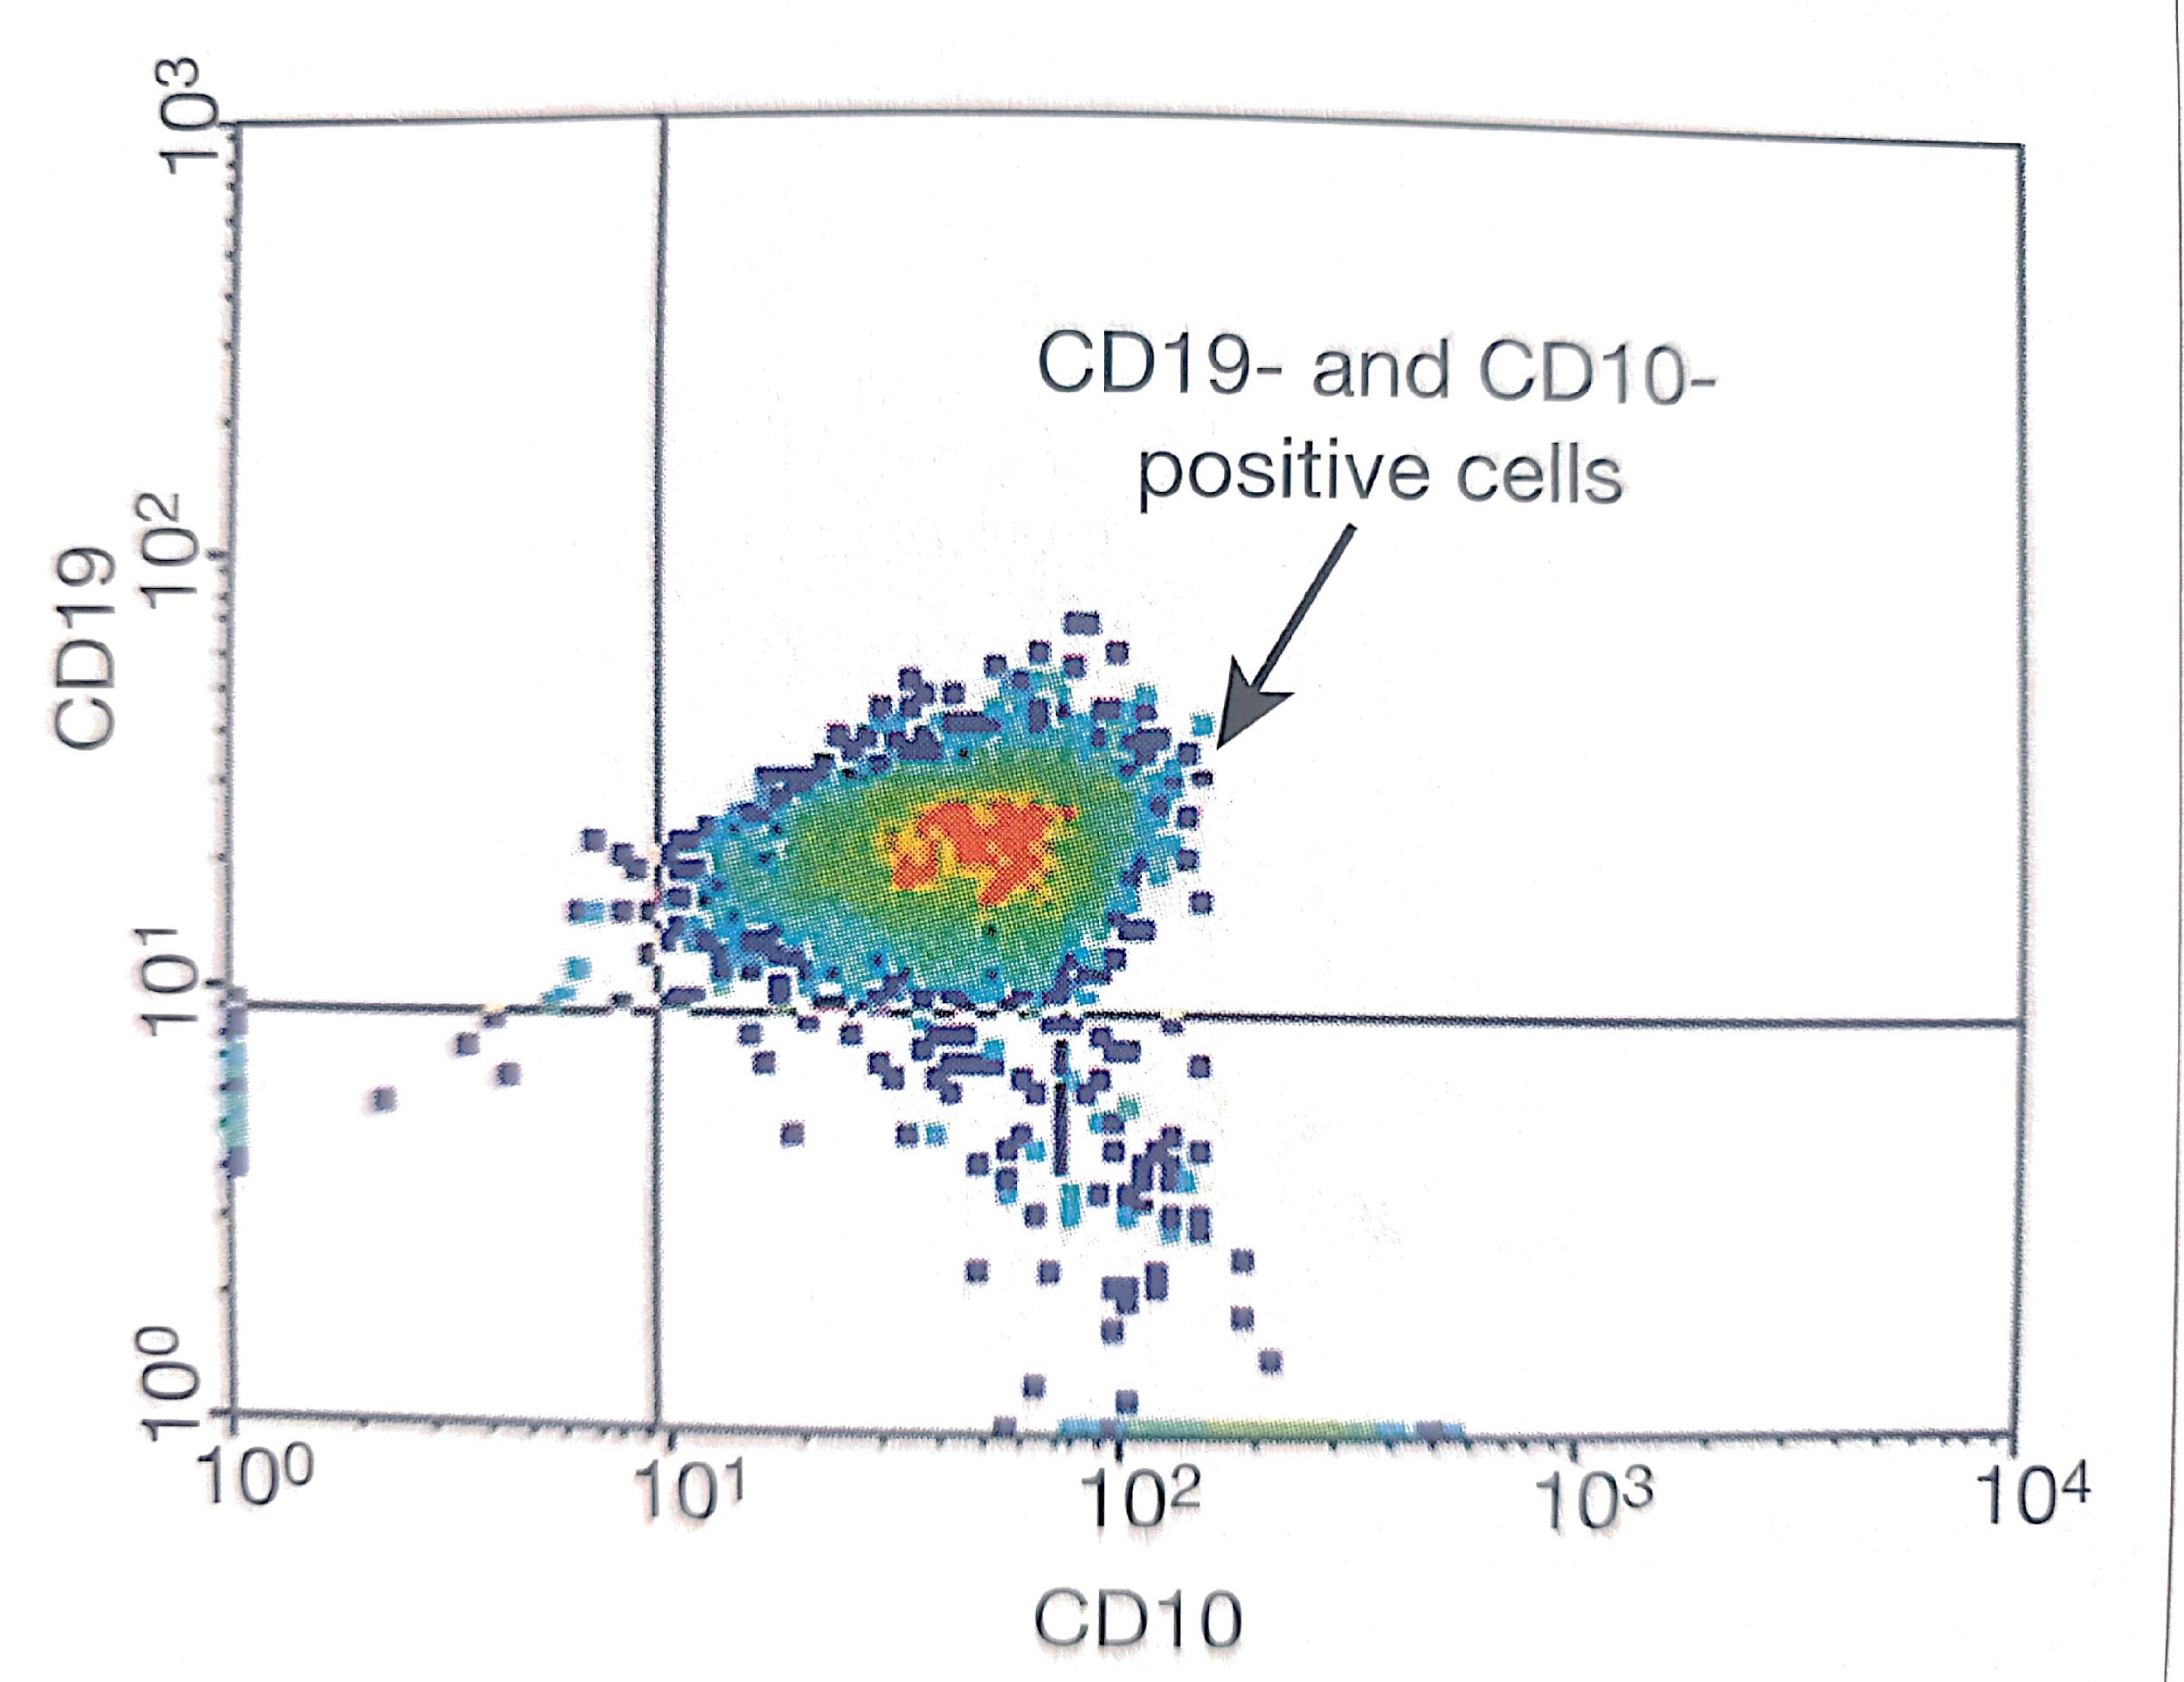
Immunophenotyping

Slide 20
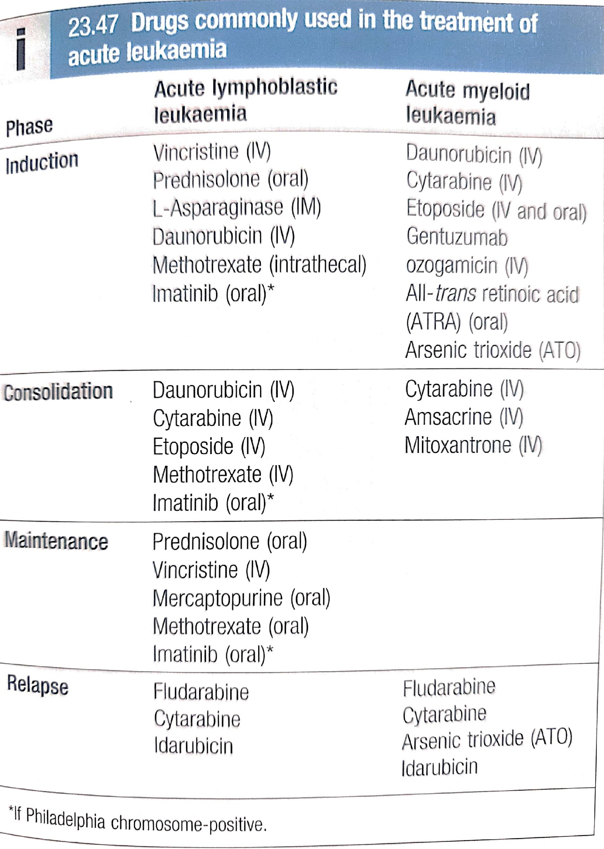

Slide 21
