Slide 1



Clinical Transfusion Practice
Dr. M.Morsed Zaman Miah
Assistant Prof. & Head
Department of Haematology
Rajshahi Medical College, Rajshahi, Bangladesh.

Slide 2
Introduction
It is well known that errors in blood transfusion practices can lead to serious consequences of morbidity and mortality.
These clinical transfusion guidelines describe protocols for the collection of blood samples for blood grouping and cross matching, and for the collection, storage and administration of blood and blood products.

Slide 3
Principles of clinical transfusion practice
The patient with acute blood loss should receive effective resuscitation (intravenous replace‐ ment fluids, oxygen and other medication) immediately and the need for transfusion is estimated thereafter.
The patient’s haemoglobin (Hb) value, although important, should not be the sole deciding factor in the decision to transfuse blood. This decision should be supported by the need to relieve clinical signs and symptoms and to prevent significant morbidity or mortality.
Clinicians should be aware of the risk of transfusion transmissible infections in blood products prescribed for patients.
Transfusion should be prescribed only when the benefits to the patient are likely to outweigh the risks.
Clinicians should clearly record the reason for ordering a transfusion (clinical diagnosis).
Trained staff should monitor a patient undergoing transfusion and respond immediately there are signs of an adverse effect.

Slide 4
Safe blood
Blood for transfusion is considered safe when it is:
Donated by a carefully selected, healthy donor
Free from infections that could be harmful to the recipient
Processed by reliable methods of testing, component production, storage and
transportation
Transfused only upon need and for the patient’s health and wellbeing

Slide 5
WHO Blood Safety Initiative
Establishment of a well‐organized blood transfusion service with quality system in all areas.
Collection of blood only from voluntary non‐remunerated donors from low‐risk populations, using rigorous procedures for donor selection
Screening of all donated blood for transfusion transmissible infections i.e. HIV, HBV, HCV, syphilis and malaria.
Good laboratory practice in all aspects of blood grouping, compatibility testing, component preparation and the storage and transportation of blood and blood products.
Reduction of unnecessary transfusions through the appropriate clinical use of blood and blood products and the use of simple alternatives to transfusion when possible.

Slide 6
Screening of Blood Donations
  Blood safety in the hospital setting
Low risk blood donor recruitment
Blood screening
Rational use of blood

Slide 7
Blood donor recruitment
Blood donors selection has two purposes:
Firstly, to protect donors from potential harm which may occur as a direct result of the donation process.
Secondly, to protect recipients of blood transfusion from adverse effects, such as transmission of infectious diseases or other medical conditions and unwanted effects caused by medication taken by the donor

Slide 8
Blood Donar requirement eligibility criteria
General appearance: the prospective donor shall appear to be in good physical and mental health.
Age: donors shall be between 18 and 60 years of age.
Haemoglobin: Hb shall be not less than 12.5 g/dL for males and 11.5 g/dL for females.
Weight: minimum 45 kg.
Blood pressure: systolic and diastolic pressures shall be normal (systolic: 100‐140 mm Hg and diastolic: 60‐90 mm Hg is recommended), without the aid of anti‐hypertensive medication.
Temperature: oral temperature shall not exceed 37.5ºC/99.5ºF
Pulse: pulse shall be between 60 and 100 beats per minute and regular.
Donation interval: the interval between blood donations shall be 3 to 4 months.

Slide 9
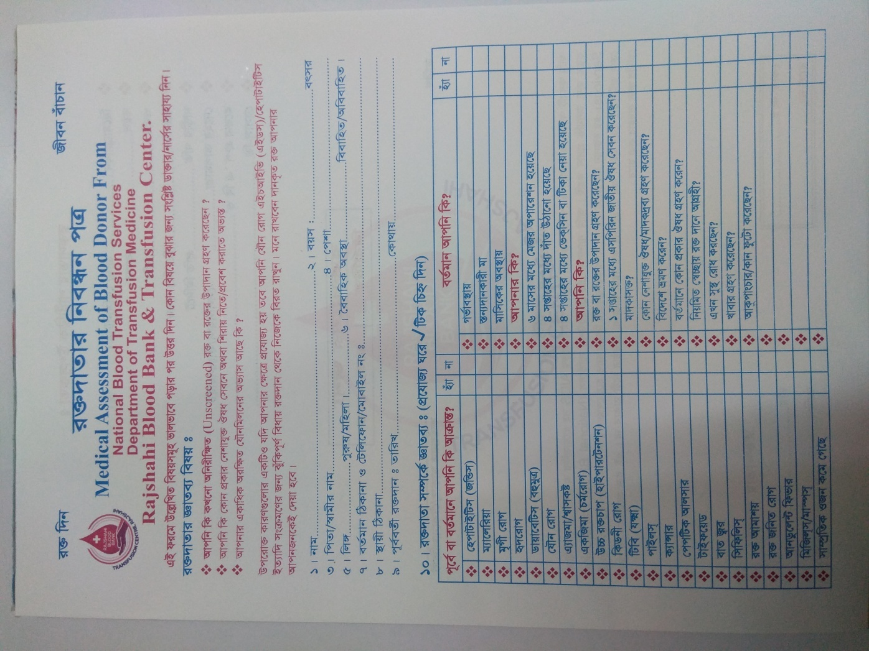

Slide 10
Blood collection
The donor should not be fasting before donation. If the last meal was taken more than four hours previously, the donor should be given something to eat and drink before donation.
Blood flowing into the bag is mixed with anticoagulant in a ratio of 1:7 (anticoagulant : blood). Total collection volume is from 405‐495 mL and usually, a volume of 450 mL blood is donated, this being approximately 12% of total blood volume or 10.5 mL/kg body weight.

Slide 11
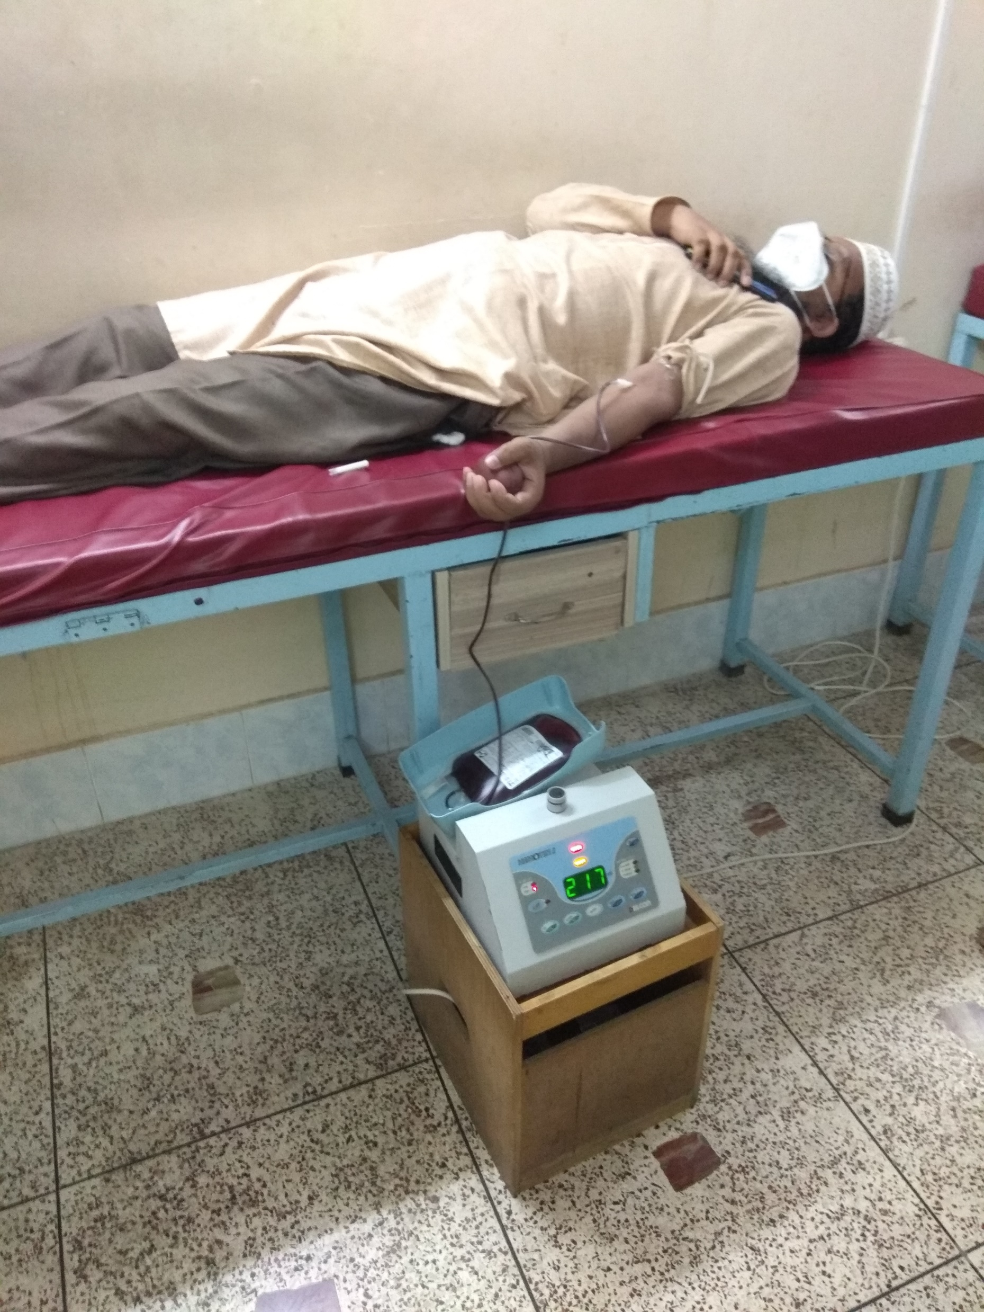
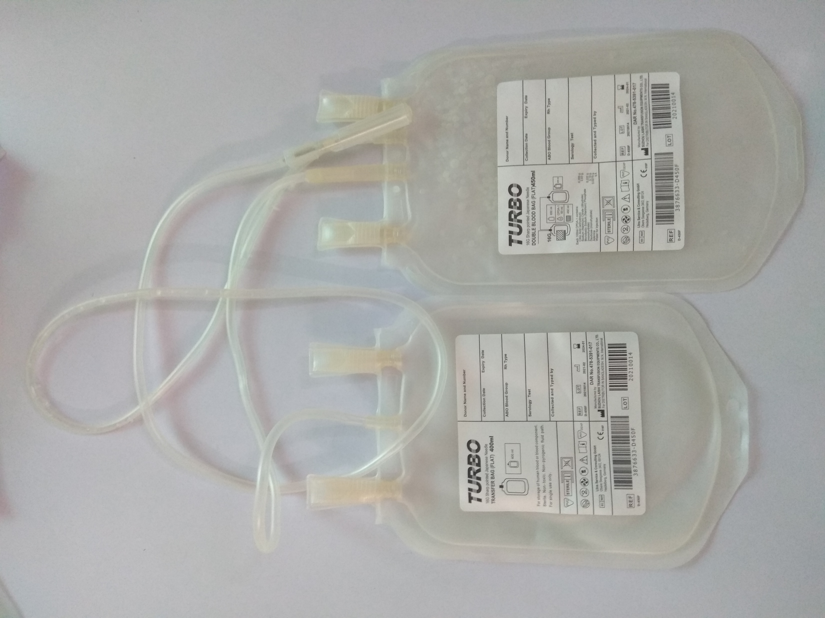
Blood collection

Slide 12
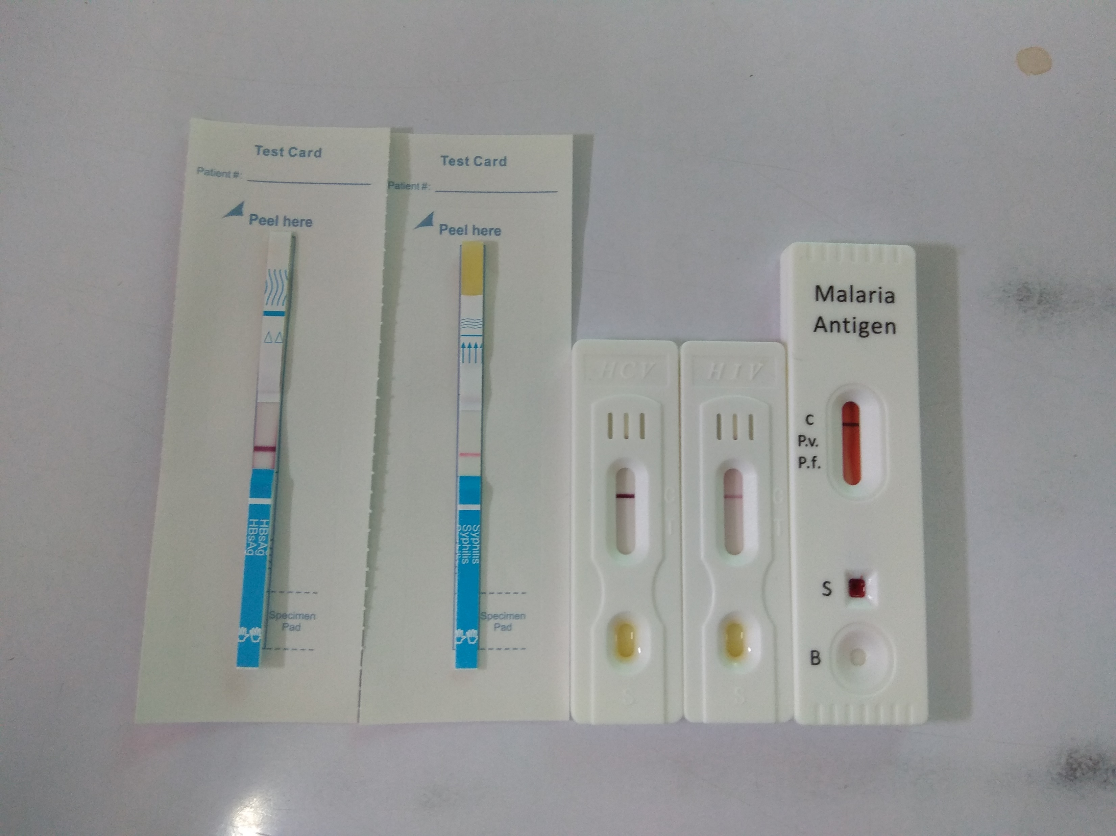
Blood Screening

Slide 13
Blood Components
A blood component is a constituent of blood, separated from whole blood, such as:
Red cell concentrate/ Packed cell
Plasma
Platelet concentrate, Lymphocyte, Neutrophil, Stem Cells
Cryoprecipitate, prepared from fresh frozen plasma; rich in Factor VIII and fibrinogen
A plasma derivative is made from human plasma proteins prepared under pharmaceutical manufacturing conditions, such as:
Albumin
Coagulation factor concentrates
Immunoglobulin
In Bangladesh, blood is generally collected in CPDA/CPDA1 blood bags that contain 63 mL anticoagulant solution which provides a shelf life for red cells of 35 days when stored at +2°C to +6°C.
For collection of blood components in Bangladesh, double or triple bags are used. Components are prepared using a centrifuge, a piece of equipment that is available in most blood transfusion departments of medical colleges

Slide 14
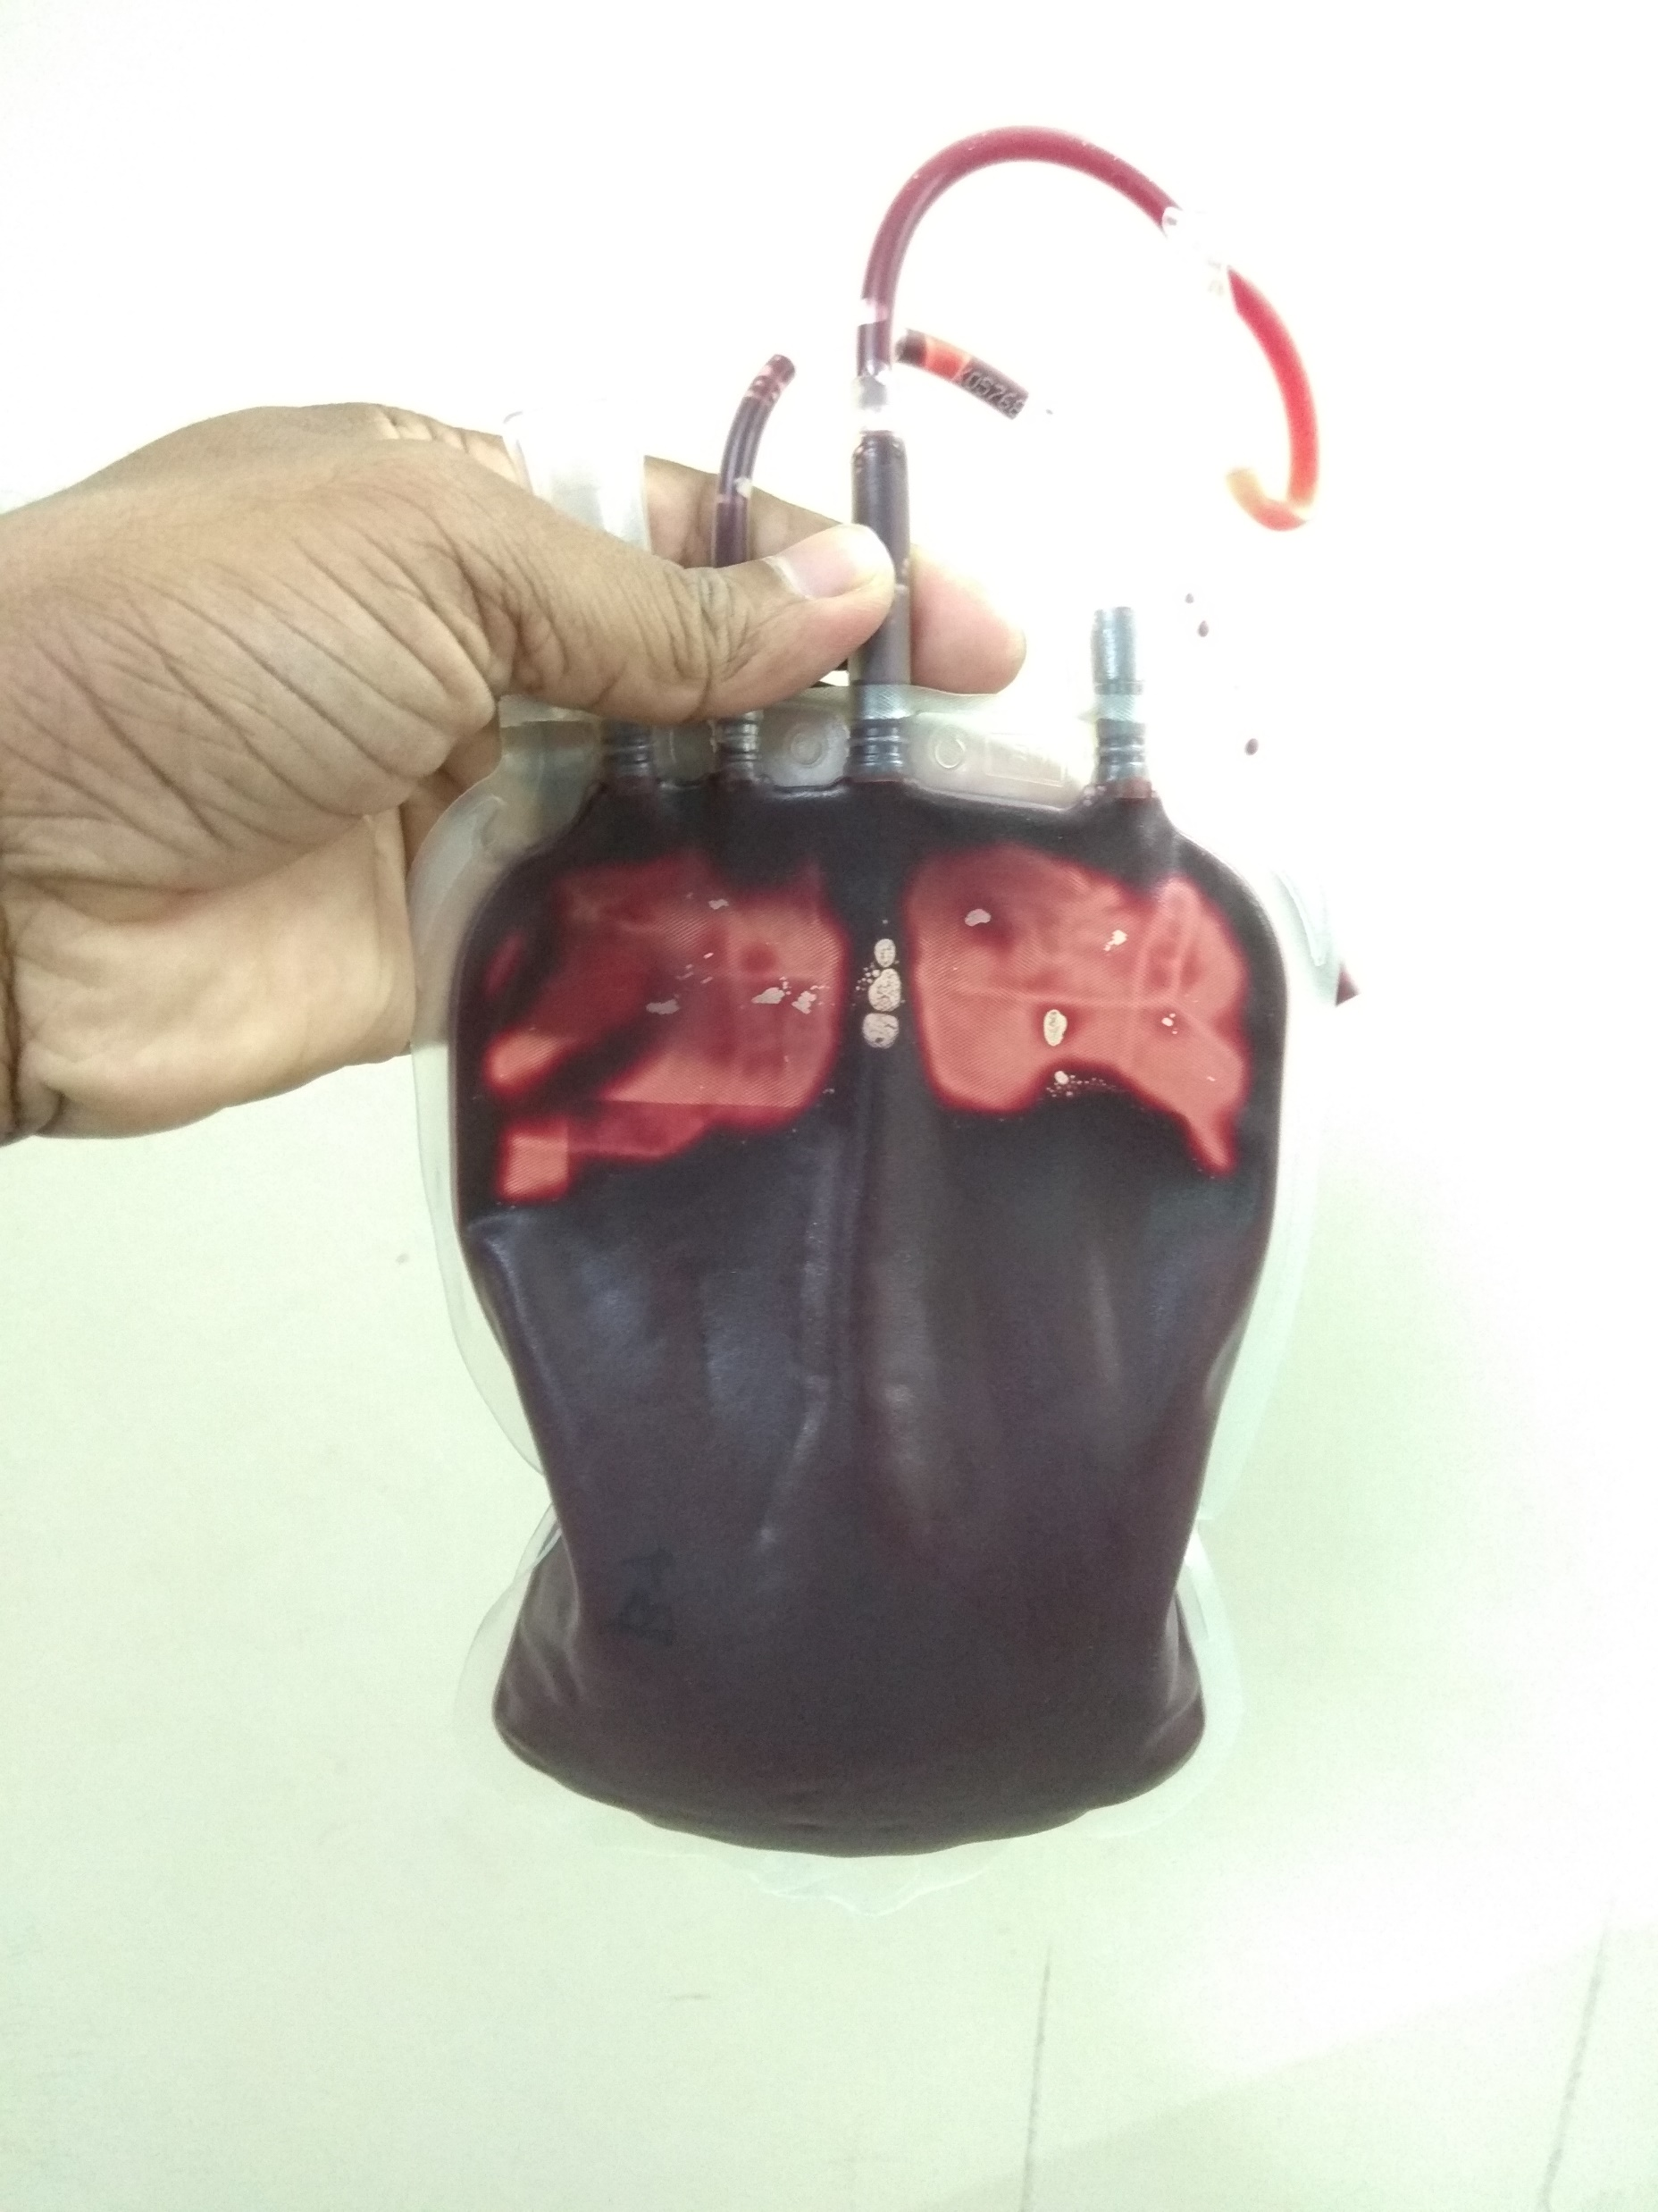
Whole Blood

Slide 15
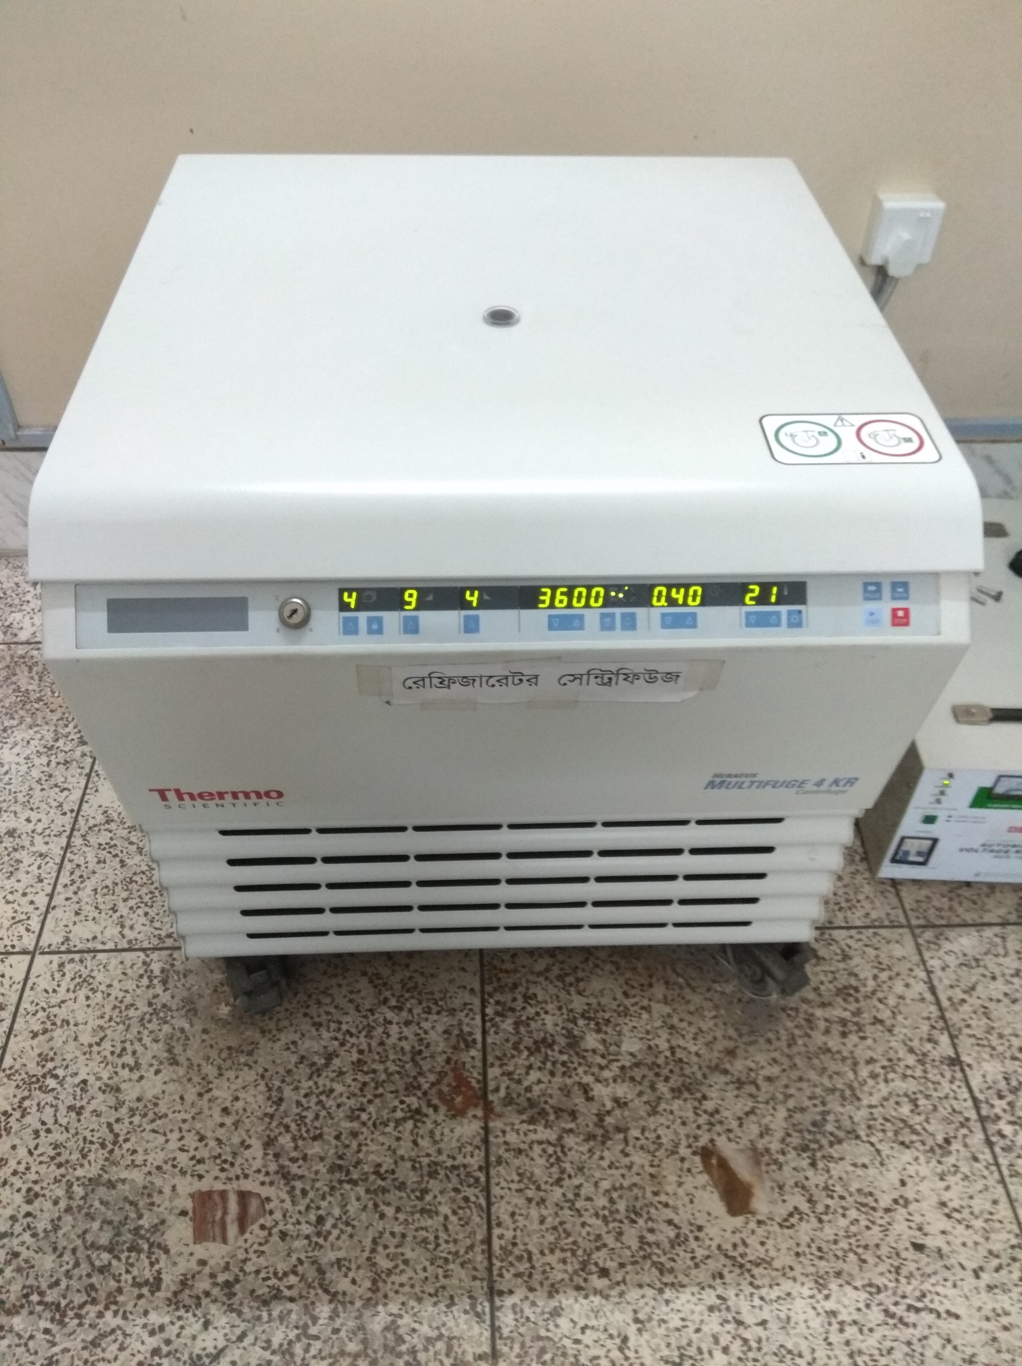
Centrifuse

Slide 16
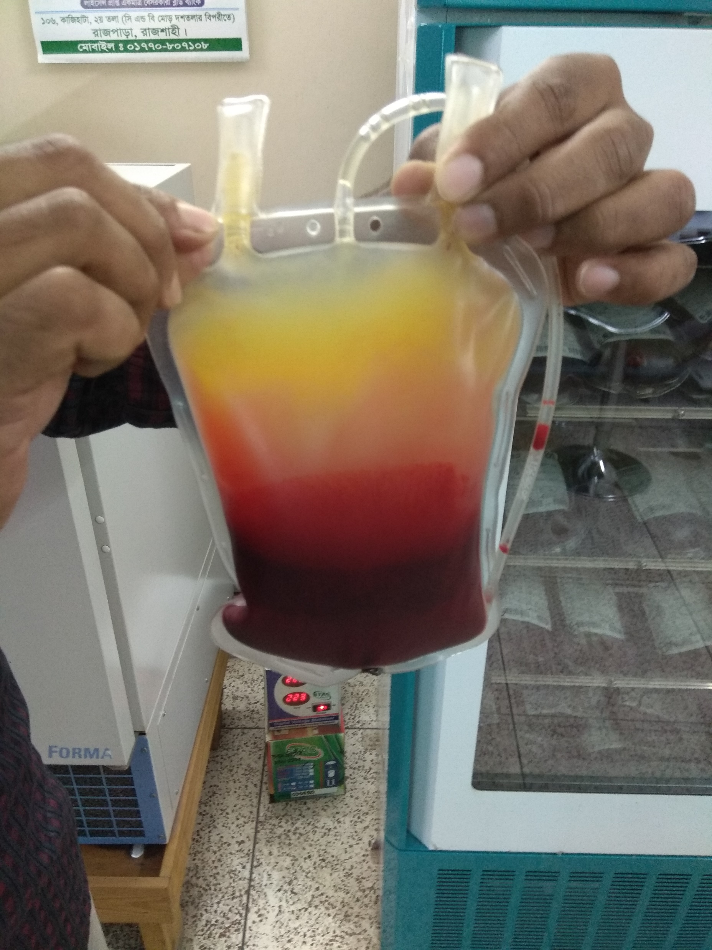
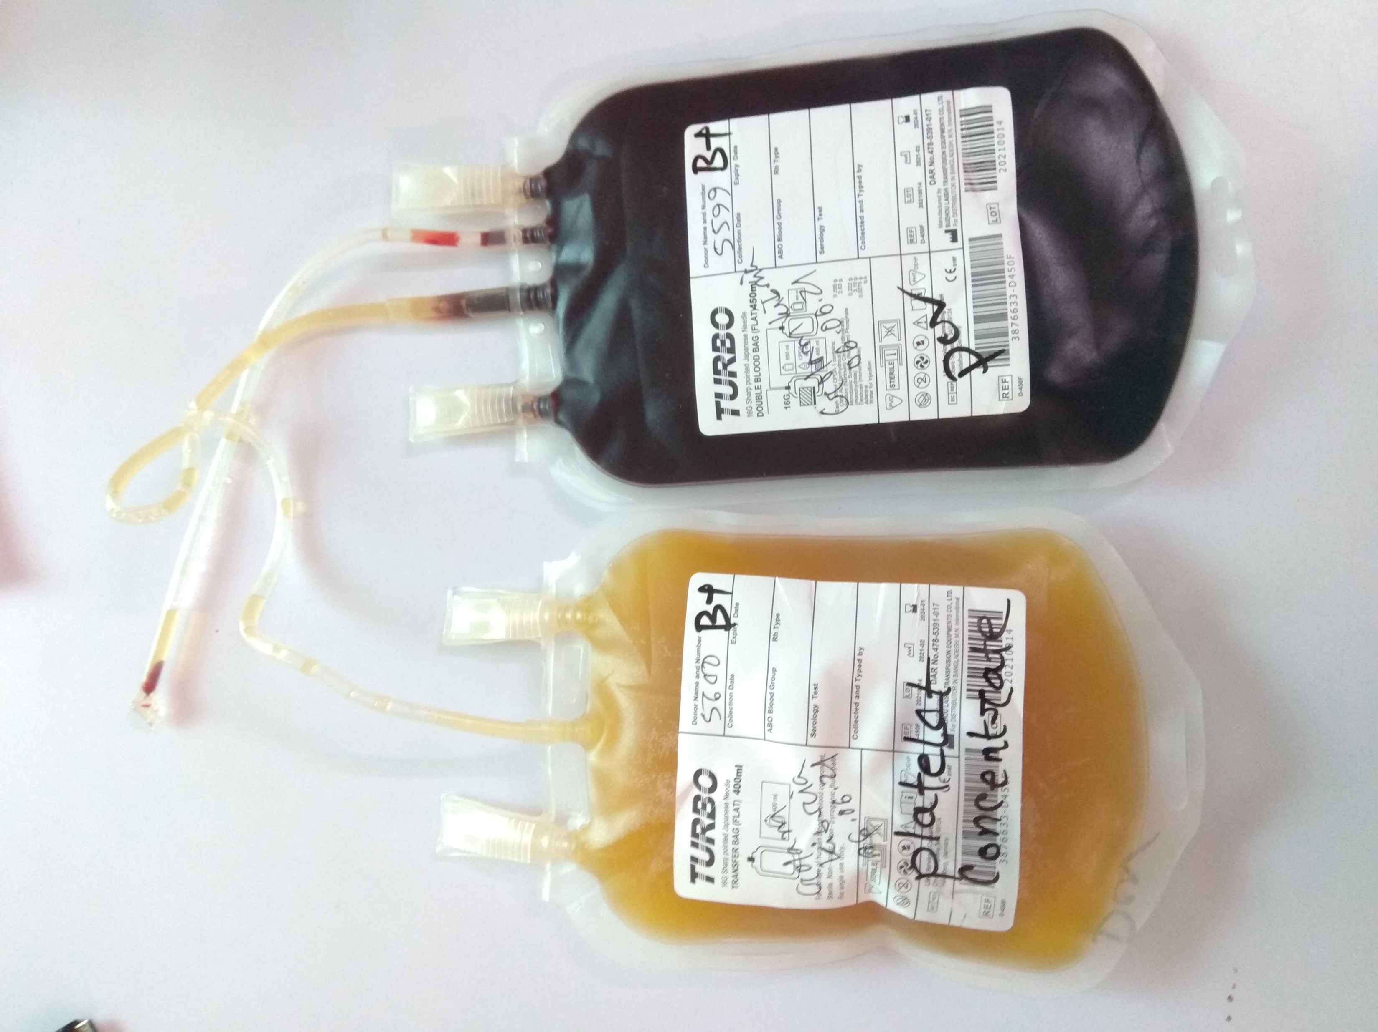
Blood Component Separation

Slide 17
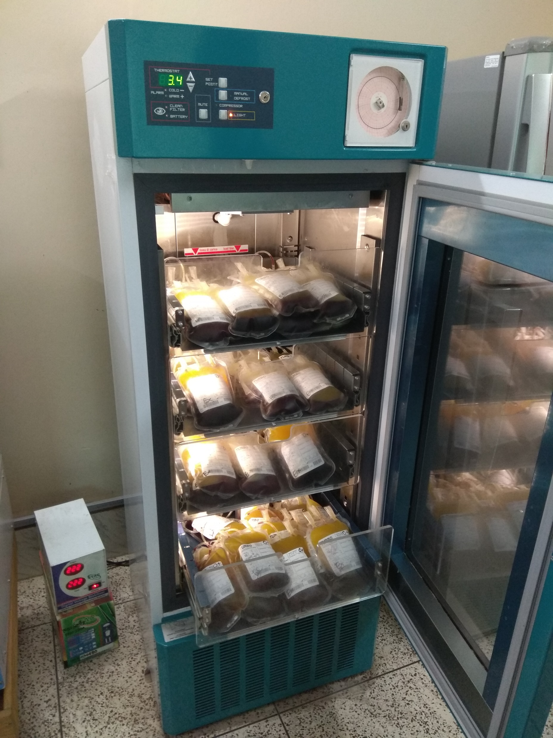
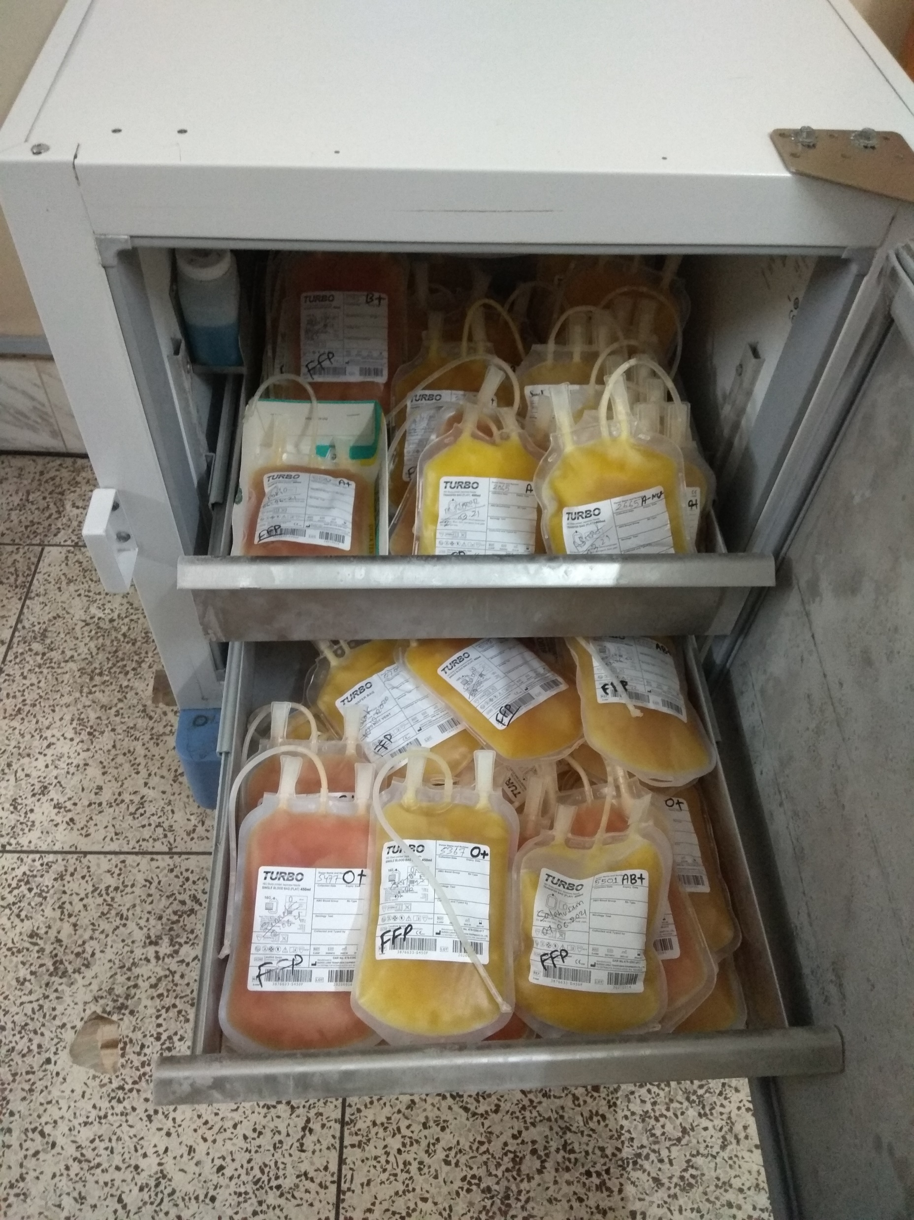
Store

Slide 18
Whole blood
Description:
450 mL whole blood in 63 mL anticoagulant‐preservative solution of which Hb will be approximately 1.2 g/dL and haematocrit (Hct) 35‐45% with no functional platelets or labile coagulation factors (V and VIII) when stored at +2°C to +6°C.
Infection risk:
Capable of transmitting an agent present in cells or plasma which was undetected during routine screening for TTIs, i.e. HIV, hepatitis B & C, syphilis and malaria.
Storage:
Between +2°C and +6°C in an approved blood bank refrigerator, fitted with a temperature monitor and alarm.

Slide 19
Whole blood
Indications:
Red cell replacement in acute blood loss with hypovolaemia.
Exchange transfusion.
Contraindications:
Risk of volume overload in patients with:
Chronic anaemia.
Incipient cardiac failure.
Administration:
Must be ABO and RhD compatible with the recipient.
Never add medication to a unit of blood.
Complete transfusion within 4 hours of commencement.

Slide 20
Red cell concentrates (RCC)/Packed Cell
Description:
150‐200 mL red blood cells from which most of the plasma has been removed. Hb concentration will be approximately 20 g/100 mL (not less than 45 g per unit) and Hct 55‐75%.
Infection risk: Same as for whole blood.
Storage: Same as for whole blood.
Indications: Replacement of red cells in anaemic patients.

Slide 21
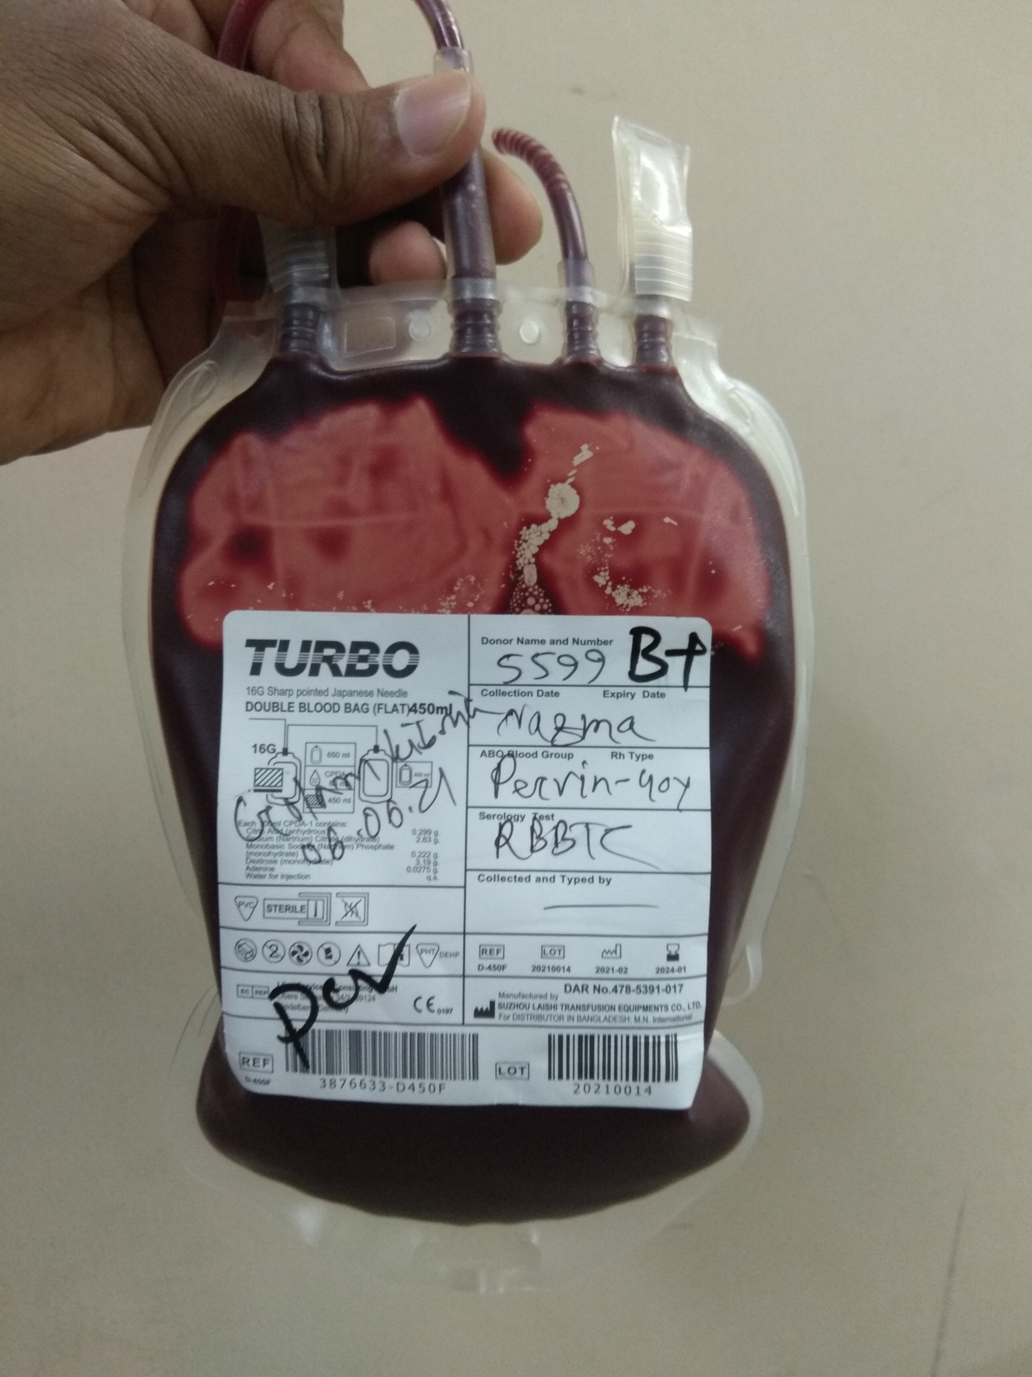
Red cell concentrates (RCC)/Packed Cell

Slide 22
Platelet concentrates (PC)
Description:
PCs are prepared from units of whole blood that have not been allowed to cool below +20°C. A single donor unit consists of 50‐60 mL plasma that should contain ≥55 x 10⁹ platelets.
Unit of issue
Platelets prepared from 4‐6 donor units containing at least 240 x 10⁹ platelets.
Infection risk: Bacterial contamination affects about 1% of pooled units.
Storage:
PCs may be stored for up to 5 days at +20°C to +24°C (with agitation). PCs require continuous agitation during storage, on a platelet shaker and in an incubator that maintains the required storage temperature.
Dosage:
1 unit of platelet concentrate/10 kg; for an adult of 60‐70 kg, 4‐6 single donor units containing at least 240 x 10⁹ platelets should raise the platelet count by 20‐40 x 10⁹/L. Increment will be less if there is splenomegaly, disseminated intravascular coagulation (DIC) or septicaemia.

Slide 23
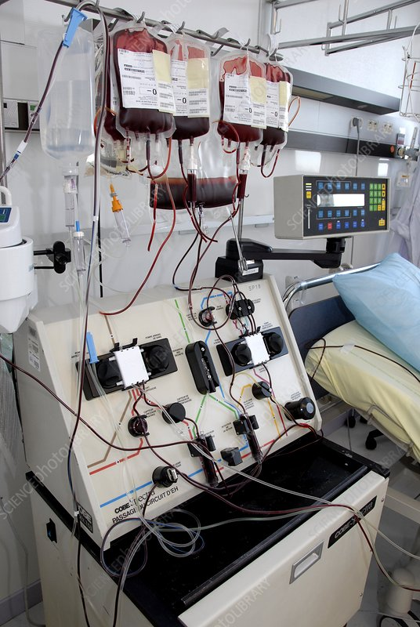
Blood Cell Separator / Apheresis

Slide 24
Platelet concentrates (PC)
Indications:
Thrombocytopenia.
Platelet function defects.
Prevention of bleeding due to thrombocytopenia as in bone marrow failure.
Contraindications:
Idiopathic autoimmune thrombocytopenic purpura (ITP).
Thrombotic thrombocytopenic purpura (TTP).
Untreated DIC.
Thrombocytopenia associated with septicaemia, or in cases of hypersplenism.
Use in bone marrow failure:
Treatment of bleeding, thrombocytopenic patients.
Prophylactic use in thrombocytopenic patients.
Maintain platelet count >10 x 10⁹/L in non‐bleeding, non‐infected patient.
Maintain platelet count >20 x 10⁹/L in infected/pyrexial patient.

Slide 25
Platelet concentrates (PC)
Use in DIC:
Use in massive blood transfusion:
Use in cardiopulmonary bypass surgery:
Prophylaxis for surgery:
Administration:
Platelet concentrates after pooling should be infused as soon as possible because of the risk of bacterial proliferation. Depending on the condition of the recipient, a unit should be infused over a period of not more than 30 minutes. Do not give platelet concentrates prepared from RhD positive donors to an RhD negative female with childbearing potential. Give platelet concentrates that are ABO compatible, whenever possible.
Complications:
Febrile non‐haemolytic and allergic urticarial reactions are not uncommon, especially in patients receiving multiple transfusions.

Slide 26
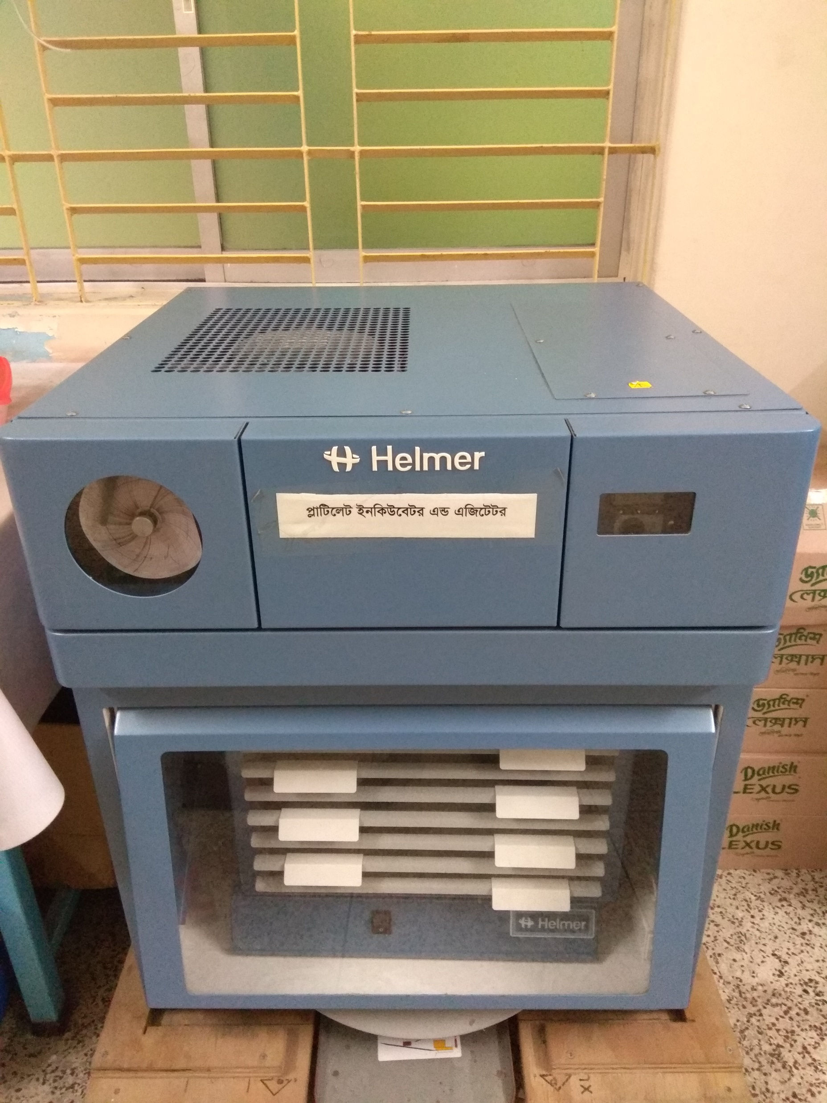
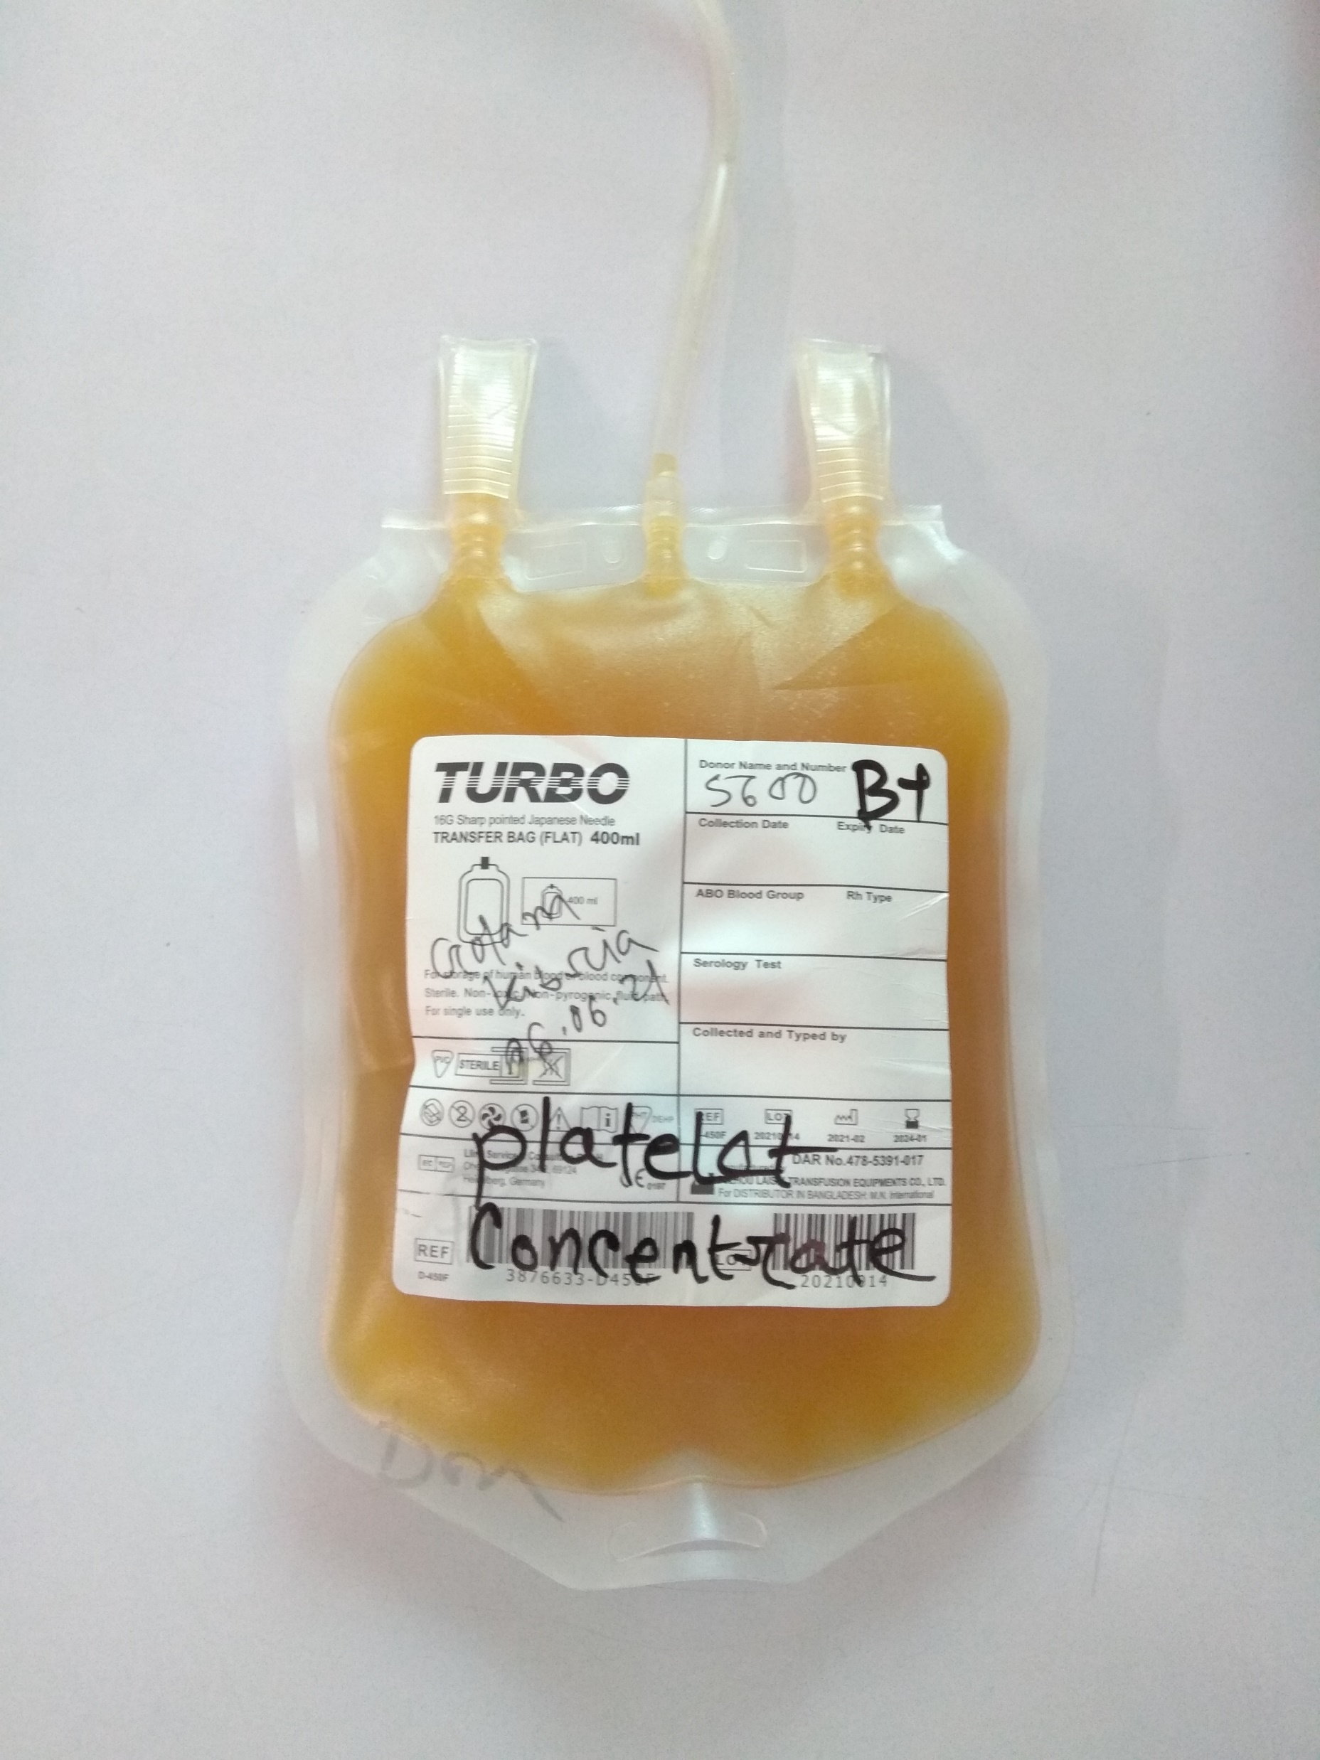
Platelet concentrates (PC)

Slide 27
Fresh Frozen Plasma (FFP)
Description:
FFP is plasma prepared from whole blood, either from the primary centrifugation of whole blood into red cells and plasma or from a secondary centrifugation of platelet rich plasma. The plasma is rapidly frozen to –25°C or colder within 8 hours of collection and contains normal plasma levels of stable clotting factors, albumin, immunoglobulin and Factor VIII at a level of at least 70% of normal fresh plasma.
Unit of issue: 200‐300 mL.
Infection risk:
Capable of transmitting any agent present in cells or plasma which was undetected by routine screening TTIs, including HIV, hepatitis B and C, syphilis and malaria.
Storage:
FFP is stored at –25°C or colder for up to 1 year. Before use, it should be thawed in the blood transfusion centre between +30°C and +37°C.
Definite indications:
Replacement of a single coagulation factor deficiency, where a specific or combined factor concentrate is unavailable or contraindicated.
Immediate reversal of warfarin effect where prothrombin complex concentrate is unavailable.
Thrombotic thrombocytopenic purpura.
Inherited coagulation inhibitor deficiencies where specific concentrate is unavailable.
C1 esterase inhibitor deficiency where specific concentrate is unavailable.

Slide 28
Fresh Frozen Plasma (FFP)
Conditional indications:
Massive blood transfusion.
Acute DIC if there are coagulation abnormalities and patient is bleeding.
Liver disease, with abnormal coagulation and bleeding – prophylactic use to reduce prothrombin time (PT) to 1.6‐1.8 x normal for liver biopsy.
Cardiopulmonary bypass surgery – use in the presence of bleeding but where abnormal coagulation is not due to heparin. Routine perioperative use is not indicated.
Severe sepsis, particularly in neonates (independent of DIC).
Plasmapheresis.
Precautions:
Acute allergic reactions are not uncommon, especially with rapid infusions.
Severe life‐threatening anaphylactic reactions occasionally occur.
Dosage: 15 mL/kg.
Administration:
Should be ABO compatible.
Infuse as soon as possible after thawing.
Labile coagulation factors rapidly degrade; use within 6 hours of thawing.
FFP may be beneficial if PT and/or partial thromboplastin time (PTT) >1.5 times normal.
FFP for volume expansion carries a risk of infectious disease transmission and other transfusion reactions (e.g. allergic) that can be avoided by using crystalloid or colloid solutions.

Slide 29
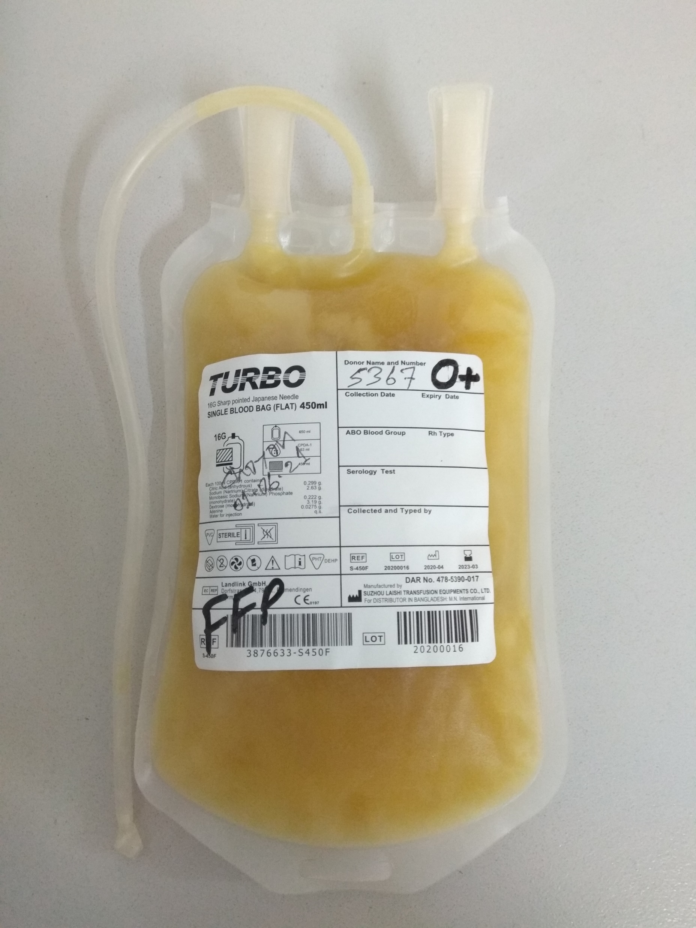
Fresh Frozen Plasma (FFP)

Slide 30
Cryoprecipitated
Description:
Cryo is prepared from FFP by collecting the precipitate formed during controlled thawing at
+4°C and re‐suspending in 10‐20 mL plasma. It is stored at –25°C or colder for up to 1 year after the date of phlebotomy. Cryo contains about half the Factor VIII and fibrinogen as a pack of fresh whole blood: e.g. Factor VIII: 80‐100 iu/ pack; fibrinogen: 150‐300 mg/ pack.
Infection risk: As for plasma, but a normal adult dose involves at least 6 donor exposures.
Storage: At –25°C or colder for up to 1 year.
Indications:
As an alternative to Factor VIII concentrate in the treatment of inherited deficiencies of:
von Willebrand Factor (von Willebrand’s disease).
Factor VIII (haemophilia A).
As a source of fibrinogen in acquired coagulopathies; e.g. DIC.
Can be used in isolated Factor XIII deficiency.
Ameliorate platelet dysfunction associated with uraemia.
Used topically as a fibrin sealant.
Administration:
ABO compatible product should be used.
After thawing, infuse as soon as possible.
Must be transfused within 6 hours of thawing.

Slide 31
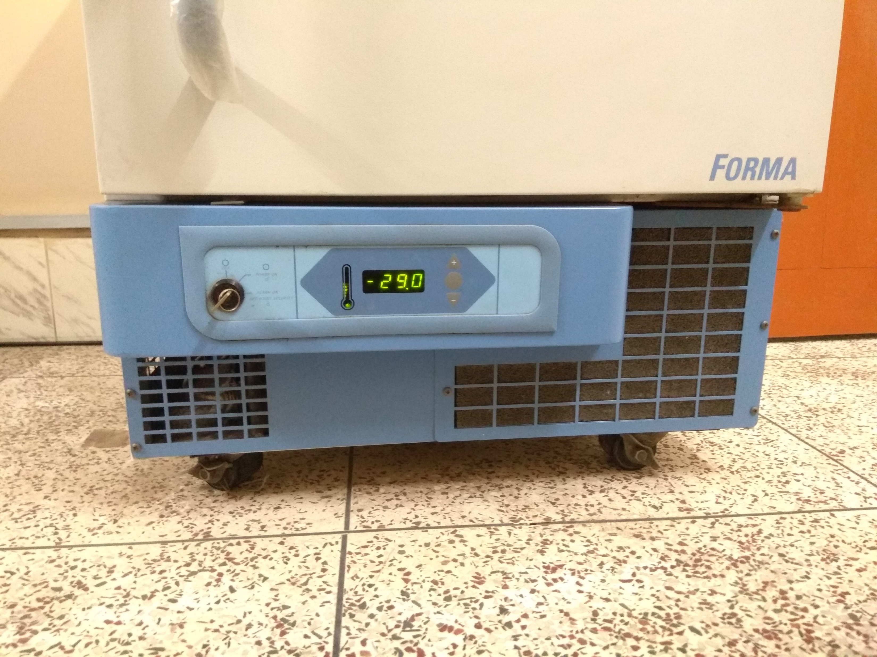
Store minus Temparature

Slide 32
Indications for blood transfusion
To increase the oxygen capacity of blood by giving red cells.
To restore the blood volume to maintain effective tissue perfusion.
To replace platelets, coagulation factors and other plasma proteins.

Slide 33
Responsibilities of attending physician
Assess patient’s clinical need for blood, and when required.
Inform patient and/or relatives about proposed transfusion and record in patient’s notes . Also record indications for transfusion in patient’s notes.
Select blood product and quantity required (i.e. whole blood/PRBC/FFP/PC) and complete request form accurately and legibly.
Enter the reason for transfusion on the form, so that the blood centre can check that the product ordered is the most suitable with regard to diagnosis.
Obtain and correctly label a blood sample for compatibility testing.
Send the blood request form and blood sample to the blood bank.
When the blood product that was ordered arrives, transfuse it as soon as possible to avoid having to store it. However, if the blood product is not used immediately, store it under the correct storage conditions.
Cross check the identity of the patient and the blood product:
  Patient and documentation.
Blood / blood products.

Slide 34
Administration of Blood Products
When blood is transfused, it is important to keep detailed records including the following in the patient’s notes:
Type and volume of each unit transfused.
Unique donation number of each unit transfused.
Blood group of each unit transfused.
Time at which the transfusion of each unit commenced.
Signature of the individual responsible for administration of the blood.
Monitor the patient before, during and on completion of the transfusion.
Record the time of completion of the transfusion.
Identify and respond immediately to any adverse effect, by stopping the transfusion.
Record the details of any transfusion reaction.
The process starts with the request for blood, followed by the selection of the correct blood product for compatibility testing and finally the issuing of compatible blood for infusion into the patient.

Slide 35
Blood request form
When blood is required for transfusion, the prescribing clinician should complete and sign a blood request form that is designed to provide all necessary information. All details requested on the blood request form must be completed accurately and legibly.
The blood request form should always be accompanied by the patient’s blood sample. The sample is placed in a sample tube that is correctly labelled and is uniquely identifiable with the patient.
The blood sample shall not be submitted in a syringe, as this could lead to errors when transferring to a test tube for grouping and compatibility testing. It may also cause haemolysis.
For a routine case, the sample and request form should be submitted to the transfusion department at least 24 hours before required, to make sure of the availability of blood.
Physicians may request those, who accompany the patient, to consider becoming blood donors if they are healthy and lead a healthy lifestyle.

Slide 36
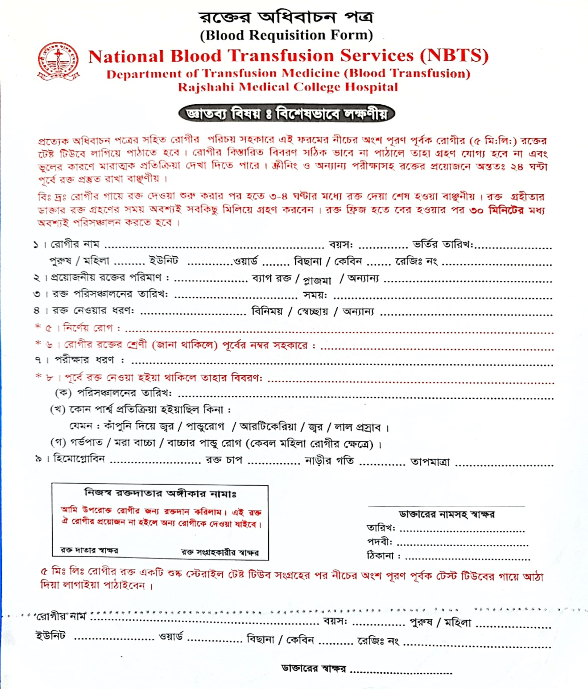

Slide 37
Blood samples
The taking of a blood sample from the patient needs supervision. If the patient is conscious at the time of taking the sample, ask him/her to identify himself/herself by given name and all other appropriate information.
A 5 mL blood sample should be collected into a dry test tube and then correctly and clearly labelled with the patient’s details, and submitted to the blood centre for testing. The specimen label must include the following information:
Patient’s full name, age and sex.
Registration number.
Ward/bed number.
Date and time specimen taken.
Phlebotomist’s signature/initials.
  Use positive patient identification to identify the patient. NEVER pre‐label the sample tube before phlebotomy.
  Use the blood product request form, write legibly and fill in all appropriate details.
  When taking a blood sample for cross match, complete the whole procedure before any other task is undertaken – it is important that there are no interruptions during the process.
  The signature of the individual who took the sample must appear on the specimen label.
Retention of blood samples:
Blood samples from recipient and donor(s) must be retained for 7 days at +2°C to +8°C after each transfusion.
Should another transfusion be necessary 72 hours after the earlier transfusion, a fresh sample shall be requested for cross match. Collection of a second 5 mL blood sample is required for re‐ checking and further cross matching and must be retained in case of investigation of transfusion reaction.

Slide 38

Blood samples label

Slide 39
  Red cell compatibility testing
The compatibility test includes:
ABO and RhD grouping on patient and donors.
Antibody screening on patient.
Cross matching between serum of patient and red cells of donor.

Slide 40
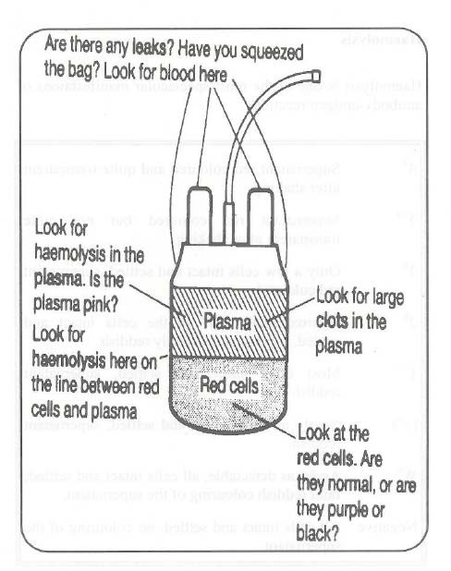
Check points for signs of deterioration in blood and plasma

Slide 41
Suggested rates of transfusion
Suggested rates of transfusion
Adults | Rate | Paediatric patients | Rate
Whole blood | 150‐200 mL/hour | Whole blood / PRBC | 2‐5 mL/kg/hour
PRBC | 100‐150 mL/hour | Platelets / plasma | 1‐2 mL/minute
Platelets / plasma | 150‐300 mL/hour

Slide 42
Duration times for transfusion
Blood products | Start transfusion | Complete transfusion
Whole blood / PRBC | Within 30 minutes of removing from refrigerator | ≤ 4 hours Discard unit if this period is exceeded
Platelet concentrate | Immediately | Within 30 minutes
FFP | As soon as possible | Within 30 minutes
Cryoprecipitate | As soon as possible | Within 30 minutes

Slide 43
Blood administration set
Use a new, sterile blood administration set containing an integral 170‐200µ filter.
Change the set at least 12‐hourly during blood transfusion.
In a very warm climate, change the set more frequently and usually after every four units of blood, if given within a 12‐hour period.
Use a fresh blood administration set or special platelet transfusion set, primed with saline. All blood components can be slowly infused through small‐bore cannulas or butterfly needles, e.g. 21 to 25 G. For rapid infusion, large‐bore cannulas, e.g. 14 G, are needed.

Slide 44
Monitoring the transfusion
It is essential to take baseline observations and to ensure that the patient is monitored during the transfusion in order to detect any adverse event as early as possible. Before commencing the transfusion, it is essential to encourage the patient to notify a nurse or doctor immediately if he or she becomes aware of any discomfort such as shivering, flushing, pain or shortness of breath or begins to feel anxious.
Ensure that the patient is in a setting where he or she can be directly observed.
For each unit of blood transfused, monitor the patient:
Before starting the transfusion (baseline observation).
15 minutes after starting the transfusion.
At least every hour during transfusion.
Carry out a final set of observations 15 minutes after each unit has been transfused.

Slide 45
Use of medication at time of transfusion
It is generally not recommended to routinely use pre‐medication like anti‐histamines, steroids or other medication before transfusion.
This practice may mask or delay the signs and symptoms of an acute transfusion reaction and therefore delay recognition and action to stop the transfusion.

Slide 46
Addition of medicine or other fluids with blood and blood components
      Medicines or other fluids should never be infused within the same line as blood and blood components. The exception is normal saline (sodium chloride 0.9%) which may be used in special circumstances, e.g. when the flow is slow due to increased Hct, or when saline is used to prepare washed red cells.
      Use a separate IV line if an intravenous fluid has to be given at the same time as blood transfusion.

Slide 47
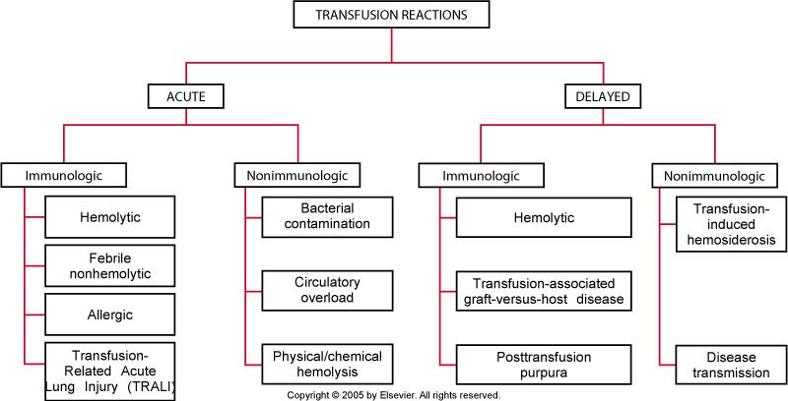

Slide 48
Guidelines for recognition and management of acute transfusion reactions
Signs | Symptoms | Possible cause
Localized cutaneous: Urticaria Rash | Pruritus | Hypersensitivity (mild)
Immediate management of Category 1: Mild reactions
Slow the transfusion.
Administer antihistamine IM.
If no clinical improvement within 30 minutes or if signs and symptoms worsen, treat as Category 2.
If improved, restart transfusion slowly.

Slide 49
Moderately severe reactions
Signs | Symptoms | Possible cause
Flushing | Anxiety | Hypersensitivity
Urticaria | Pruritus
Rigors | Palpitations
Fever | Mild dyspnoea
Restlessness | Headache
Tachycardia

Slide 50
Immediate management of Category 2:
Moderately severe reactions
Stop the transfusion and keep IV line open with normal saline in another site.
Return the blood unit with transfusion administration set, freshly collected urine and new blood samples (1 clotted and 1 anticoagulated), drawn from a vein opposite to the transfusion site, to the blood transfusion centre for laboratory investigations.
Administer antihistamine IM and oral or rectal antipyretic. Avoid aspirin in thrombocytopenic patients.
Give IV corticosteroids and bronchodilators if there are anaphylactoid features (e.g. broncho‐ spasm, stridor).
If clinical improvement occurs, restart transfusion slowly with new blood unit and observe carefully.
If no clinical improvement within 15 minutes or if signs and symptoms worsen, treat as Category 3.
Collect urine for next 24 hours for evidence of haemolysis and send for laboratory investigations
If available, a leucocyte reduction filter (WBC filter) may be used in repeated transfusion.

Slide 51
Category 3: Life‐threatening reactions
Signs | Symptoms | Possible cause
Rigor | Anxiety | Acute intravascular haemolysis
Fever | Chest pain | (mismatched blood transfusion)
Restlessness | Pain along the transfusion line | Bacterial contamination and
Hypotension (fall of 20% in | Respiratory distress/shortness | septic shock
systolic BP) | of breath | Fluid overload
Tachycardia (rise of 20% in | Loin/back pain | Anaphylaxis
heart rate) | Headache | Transfusion related acute lung
Haemoglobinuria (Hb in urine) | Dyspnoea | injury (TRALI)
Unexplained bleeding (DIC)

Slide 52
Immediate management of Category 3: Life‐threatening reactions
1. Stop the transfusion and keep IV line open with normal saline in another site.
2.Infuse normal saline to maintain systolic BP.
3.Maintain airway and give high flow oxygen by mask.
4.Give adrenaline (as 1:1000 solution) 0.01 mg/kg body weight by slow intramuscular injection.
5.Give IV corticosteroids and bronchodilators if there are anaphylactoid features.
6.Give diuretic: e.g. frusemide 1 mg/kg IV or equivalent.
7.Check a fresh urine specimen visually for signs of haemoglobinuria.
8.Notify the superior or senior doctor attending the patient, and the blood centre immediately.
9.Send blood unit with transfusion set, fresh urine sample and new blood samples (1 clotted and 1 anticoagulated), drawn from a vein opposite the infusion site, with the appropriate request form to the blood transfusion centre for investigation.

Slide 53
Immediate management of Category 3: Ctd.. Life‐threatening reactions
10.Start a 24‐hour urine collection and record all intake and output. Maintain fluid balance chart.
11.Assess for bleeding from puncture sites or wounds. If there is clinical or laboratory evidence of DIC, give platelets (adult: 4‐6 units) and either cryoprecipitate (adult: 12 units) or FFP (adult: 3 units).
12.Reassess. If hypotensive:
  Give further saline.
  Give inotrope, if available.
13.If urine output falls or there is laboratory evidence of acute renal failure (rising K+, urea, creatinine):
  Maintain fluid balance accurately.
  Give further diuretic: e.g. frusemide 1 mg/kg IV or equivalent.
  Consider dopamine infusion, if available.
  Seek expert help: the patient may need renal dialysis.
14.If bacteraemia is suspected (rigor, fever, collapse, no evidence of a haemolytic reaction), start a broad‐spectrum antibiotic IV.

Slide 54
Investigating acute transfusion reactions
Immediately take post‐transfusion blood samples (1 clotted and 1 anti‐coagulated) from the vein opposite the transfusion site and forward to the blood centre for investigation of the following:
  Repeat ABO and RhD group.
  Repeat antibody screen and cross match.
  Full blood count.
  Coagulation screen.
  Direct antiglobulin test.
  Urea and creatinine.
  Electrolytes.
Also return the following to the blood centre:
  Blood bag and transfusion set containing red cell and plasma residues from the transfused unit.
  Blood culture in a special blood culture bottle.
  First specimen of the patient’s urine following the reaction.
  Completed transfusion reaction report form.
After the initial investigation of the reaction, send patient’s 24‐hour urine sample to the blood transfusion centre for laboratory investigation.
Record the results of the investigations for future follow‐up, if required.

Slide 55
Guidelines for recognition and management of transfusion reactions
Haemolytic transfusion reaction.
Bacterial contamination and septic shock
Transfusion Associated Circulatory Overload
Anaphylactic reaction
Transfusion Related Acute Lung Injury

Slide 56
    Delayed haemolytic transfusion reaction
Signs appear 5‐10 days after transfusion:
      Fever.
      Anaemia.
      Jaundice.
      Occasionally haemoglobinuria.
Severe, life‐threatening delayed haemolytic transfusion reactions with shock, renal failure and DIC are rare.

Slide 57
Massive Blood Transfusion
Massive blood transfusion may be defined as the replacement of one blood volume (equivalent to 10 units of blood) in any 24 hour period, or half of the blood volume (5 units of blood) in any four‐ hour period in an adult.
Replacement of a blood volume equivalent within 24 hours.
>10 units within 24 hours.
Transfusion >4 units in 1 hour.
Replacement of 50% of blood volume in 3‐4 hours.
A rate of loss >150 ml/hour.
Massive transfusion occurs in settings such as severe trauma, ruptured aortic aneurysm, surgery and obstetric complications. The goals to the management of massive transfusion include early recognition of blood loss, maintenance of tissue perfusion, oxygenation by restoration of blood volume and Hb, and the cessation of bleeding by several means including early surgical or radiological intervention, and the judicious use of blood component therapy to correct coagulopathy.
Plasma undergoes progressive loss of coagulation factors during storage, particularly Factors V and VIII, unless stored at –30°C or colder.
Dilution of coagulation factors and platelets will occur following administration of large volumes of replacement fluids. Massive or large volume transfusions can therefore result in disorders of coagulation.

Slide 58
Thanks From

