Slide 1




LYMPHOMA
Dr. M. Morsed Zaman Miah
Assistant Prof. & Head
Department of Haematology, RMC
Bangladesh

Slide 2

INTRODUCTION
The term lymphoma identifies a heterogeneous group of biologically and clinically
distinct neoplasms that originate from cells in the lymphoid tissue.
They have been historically divided into 2 distinct categories : Hodgkin’s and Non- Hodgkin’s Lymphoma.
85% of lymphomas originate from mature B cells
10% to 15% derive from the T-cell lineage.

Slide 3

ANATOMY OF THE LYMPHOID SYSTEM
Lymphoid Tissues can be divided into 2 major categories :
1) CENTRAL or PRIMARY LYMPHOID TISSUES :
These are tissues in which the lymphoid precursor cells mature to a stage at which
they are capable of performing their function in response to an antigen
Includes Bone Marrow and Thymus
2) PERIPHERAL or SECONDARY LYMPHOID TISSUE
These are tissues in which antigen specific reactions occur
Includes Lymph Nodes, Spleen and Mucosa Associated Lymphoid Tissue

Slide 4

CENTRAL LYMPHOID ORGANS
  BONE MARROW
It is the site of generation of all circulating blood cells in an adult.
Gives rise to all cells of the immune system by a process called haematopoiesis.
It is of 2 types :
a) Red marrow
Contains haematopoietic tissue
Found in flat bones like skull, scapula, pelvic bone, vertebrae,ribs
Also found in epiphyseal and metaphyseal ends of long bones.

Slide 5

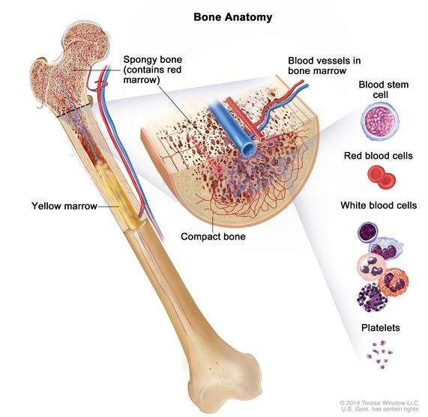
b) Yellow Marrow
Contains mainly fatty tissue
Present in diaphysis of long bones
As a person’s age advances, red marrow is converted into yellow marrow.
Process can be reversed if there is a need for haematopoiesis.

Slide 6

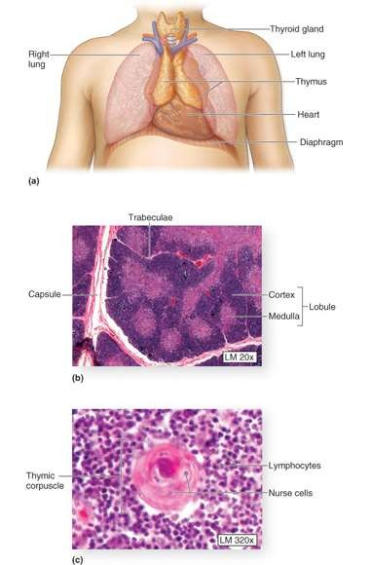
b) THYMUS
Bi-lobed gland situated in the thorax above the heart.
It increases progressively in size upto adolescence following which it atrophies.
Divided into a cortex and medulla
FUNCTION:
Site at which immature T cells , which migrate from the bone marrow undergo maturation and selection to naive T cells

Slide 7

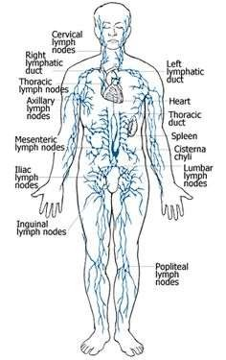
2) PERIPHERAL LYMPHOID TISSUES
a) Lymph Nodes
Bean shaped structures strategically positioned
at various sites throughout the body
They have afferent vessels entering at the periphery and efferent vessels emerging at the hilus.
Arranged in groups, along the blood vessels or
the flexural side of a joint
FUNCTION
To process antigens present in lymph fluid drained from tissues and organs via the afferent lymphatics.

Slide 8

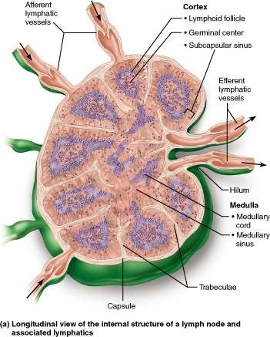
HISTOLOGY
Divided into a capsule, cortex, medulla and sinuses.
Sinuses are present at three sites : Subcapsular, cortical and medullary.
Sinuses contain numerous macrophages which filter the lymph fluid, identify and process antigens and present them to lymphocytes.
Cortex contains B cell follicles
Paracortex contains high endothelial venules and T cell zones.
Medulla contains medullary cords and sinuses.

Slide 9

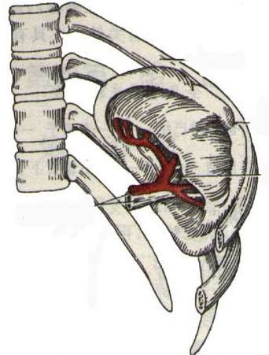
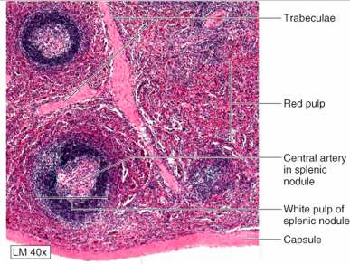
B) SPLEEN
Location
  Left epigastric region
  between 9th-11th rib
  in line of 10th rib
Largest lymphatic organ in the body.
Can vary considerably in size and weight
HISTOLOGY
Spleen has 2 major compartments
Red Pulp
White Pulp
Red pulp is a complex web of sinuses lined by phagocytic cells and functions as a filter for particulate antigens and formed elements of blood.
White pulp is identical to lymphoid tissue of the lymph node

Slide 10

FUNCTIONS OF SPLEEN
Important role in haematopoiesis during fetal development.
Mechanical filtration of pathogens located within cells or circulating in the plasma.
Recognizes and removes old, damaged or malformed RBCs.

Slide 11

MUCOSA ASSOCIATED LYMPHOID TISSUE(MALT)
Specialised lymphoid tissue , found in association with certain epithelia, in particular:
Naso and Oro-Pharynx : Adenoids, palatine tonsils
Gastro-Intestinal tract : Gut associated Lymphoid tissue, Peyer’s patches of distal ileum, mucosal lymphoid aggregates in colon and rectum.
Lung : Bronchus associated lymphoid tissue
HISTOLOGY
Prominent B cell follicles with germinal centers, mantle zones,broad marginal zones and discrete T cell zones(similiar to paracortex of LN)
FUNCTION
Response to intra-luminal antigens
Generation of mucosal immunity

Slide 12

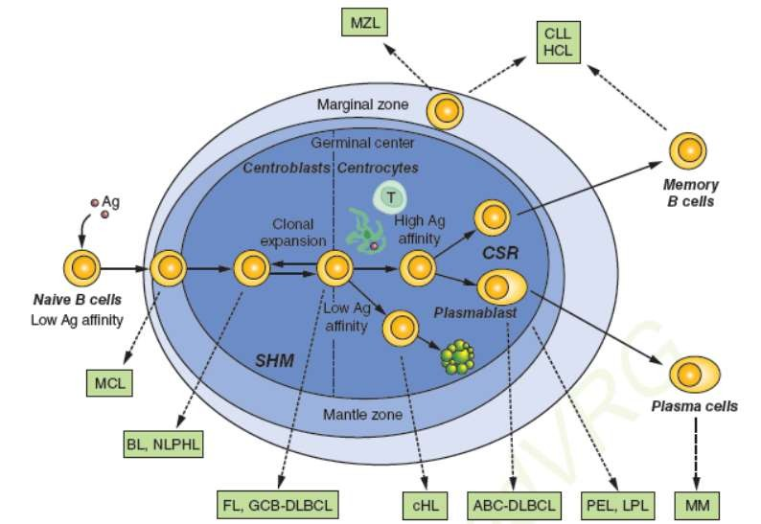
SCHEMATIC REPRESENTATION OF A LYMPHOID FOLLICLE

Slide 13

HODGKINS LYMPHOMA
Hodgkin lymphoma encompasses a distinctive group of neoplasms that are characterized by the presence of a Reed-Sternberg cell.
Arise in a single lymph node or chain of lymph nodes and typically spread in a stepwise fashion to anatomically contiguous nodes.
Two major sub-types are now recognized :
  Classic Hodgkins Lymphoma
  Nodular Lymphocyte predominant Hodgkins lymphoma

Slide 14

CLINICAL FEATURES
Hodgkins Lymphoma patients present with peripheral lymphadenopathy.
Involved nodes are non tender with no overlying skin changes,discrete and freely movable.
Characteristic clinical presentation is enlarged superficial lymph nodes in young adults.
Commonly involved lymph nodes are cervical and supraclavicular(60-80%), followed by axillary lymph nodes. Inguinal and femoral lymph node groups are less commonly involved.
Central lymphadenopathy is seen in some sub-types.

Slide 15

B SYMPTOMS :
A) FEVER (25-50%)
DRENCHING NIGHT SWEATS
WEIGHT LOSS
OTHER NON-SPECIFIC SYMPTOMS (pruritus, fatigue and pain after drinking alcohol)
SYMPTOMS OF EXTRA NODAL MANIFESTATION
  Involvement of Liver
    Abdominal swelling secondary to hepatomegaly or hepatosplenomegaly
    Jaundice and ascites

Slide 16

Signs of mediastinal involvement
  Retrosternal Chest pain
  Cough and shortness of breath
  Pleural and pericardial effusion

Slide 17

INVESTIGATIONS
DETAILED HISTORY WITH ATTENTION TO PRESENCE OR ABSENCE OF
CLINICAL SYMPTOMS
CAREFUL PHYSICAL EXAMINATION EMPHASIZING NODE CHAINS , WALDEYERS RING AND SIZE OF LIVER AND SPLEEN
ROUTINE LABORATORY TESTS
Complete Blood Cell Count
Erythrocyte Sedimentation Rate
Liver Function Test

Slide 18

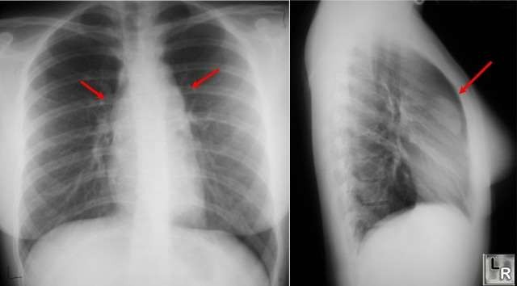
D. CHEST RADIOGRAPH
Low cost method for diagnosis and surveillance in Hodgkins Lymphoma
Useful for detecting mediastinal disease

Slide 19

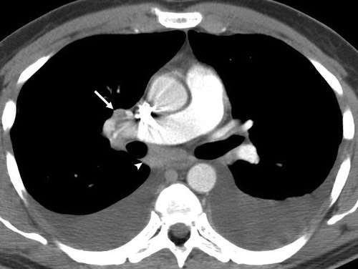
E. CT SCAN
Standard thoracic examination for patients with HL
Useful for determination of sites on initial involvement as well as extent of disease
Helps in classification of early stage patients into favourable or unfavourable prognosis.

Slide 20

F. ADEQUATE SURGICAL BIOPSY OF AFFECTED LYMPH NODES
E. STAGING LAPAROTOMY( to determine involvement of abdominal lymph
nodes)
( Staging laparotomy was extensively used when radiation therapy was preferred treatment for early stage Hodgkins lymphoma. It was mandatory to define the extent of abdominal involvement to determine whether there was an indication for chemotherapy. Nowadays, with availability of better imaging techniques and with with routine use of chemotherapy for early stage disease, staging laparotomy is not indicated as a routine procedure)

Slide 21

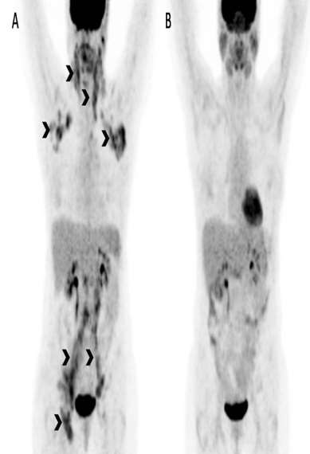
F. FDG-PET SCAN
Whole body PET using 18F-
fluorodeoxyglucose is a sensitive indicator for disease.
It is used in initial evaluation as well as in staging procedures after treatment to assess response to therapy.
Recommended when other diagnostic
modalities are inconclusive
FDG-PET more accurately identifies the correct pretreatment stage in HL compared with CECT (which tends to understage or overstage the disease)
FDG-PET is able to distinguish viable/active tumor cells from fibrosis or necrosis in a residual mass after treatment

Slide 22

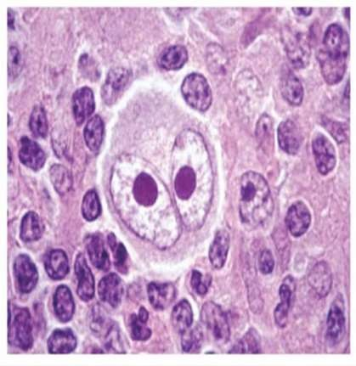
REED STERNBERG CELL
The sine qua non of Hodgkin lymphoma is the Reed Sternberg (RS) cell
These are different kinds of giant cells.
  Usually derived from B lymphocytes.
  Enormous bilobed or multilobate nucleus, exceptionally prominent nucleoli and abundant, usually slightly eosinophilic cytoplasm.
  Particularly characteristic are cells with two mirror-image nuclei , each containing a large acidophilic nucleolus surrounded by a clear zone, features that impart an “owl- eye” Appearance.

Slide 23

CLASSIC HODGKINS LYMPHOMA
Monoclonal Lymphoid Neoplasm, composed of mononuclear Hodgkins cells and multi- nucleated Reed Sternberg cells in an infiltrate containing a mixture of eosinophils, small lymphocytes , neutrophils and histiocytes.
Subtypes of Classic Hodgkins Lymphoma( cHL):
  Nodular Sclerosis type
  Mixed cellularity
  Lymphocyte Rich
  Lymphocyte Depleted

Slide 24
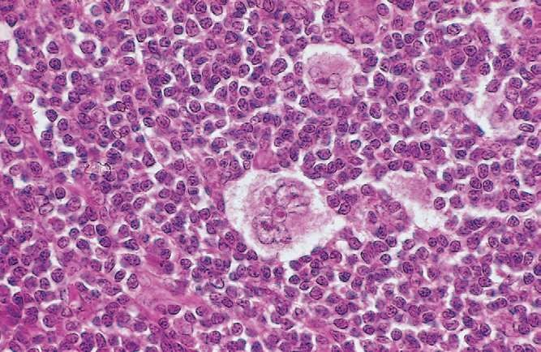
NODULAR SCLEROSIS TYPE
It is the most common subtype (of cHL)
Most common in adolescents and young adults
Mediastinum and other supra-diaphragmatic sites are commonly involved
PATHOLOGY :
Characterised by Collagen bands that surround at least one nodule
“ Lacunar” type Reed Sternberg cells
Background consists of lymphocytes, histiocytes, plasma cells, eosinophils and neutrophils.

Slide 25

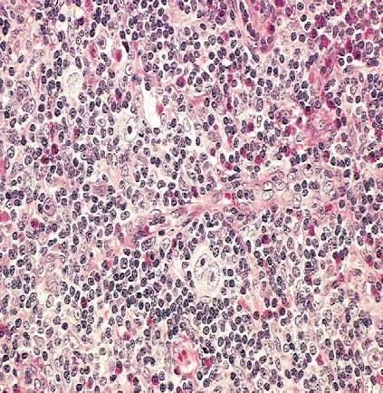
MIXED CELLULARITY TYPE
This subtype comprises 15-30 % of Hodgkins Lymphoma cases.
Can occur at any age.
Abdominal Lymph nodes and spleen are commonly involved.
PATHOLOGY :
Infiltrate is usually diffuse or vaguely nodular
Consists of lymphocytes, eosinophils, cells and histiocytes.
Reed Sternberg cells are of the classic, diagnostic type with bi-lobed, double or multiple nuclei.

Slide 26

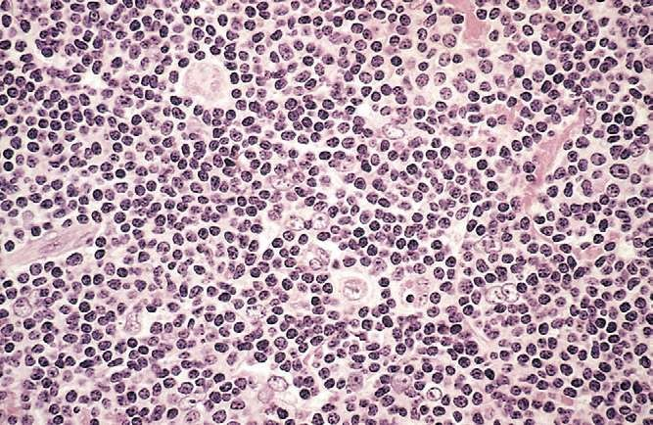
LYMPHOCYTE RICH TYPE
Comprises of 5 % cases of Hodgkins Lymphoma
Predominant in males.
Isolated cervical or axillary lymphadenopathy
Better prognosis than other sub-types of cHL
PATHOLOGY
Background infiltrate consisting predominantly of lymphocytes with almost no eosinophils
presence of lymphohistiocytic variant RS cells that have a delicate multilobed, puffy Nucleus (“ Popcorn cells”)

Slide 27

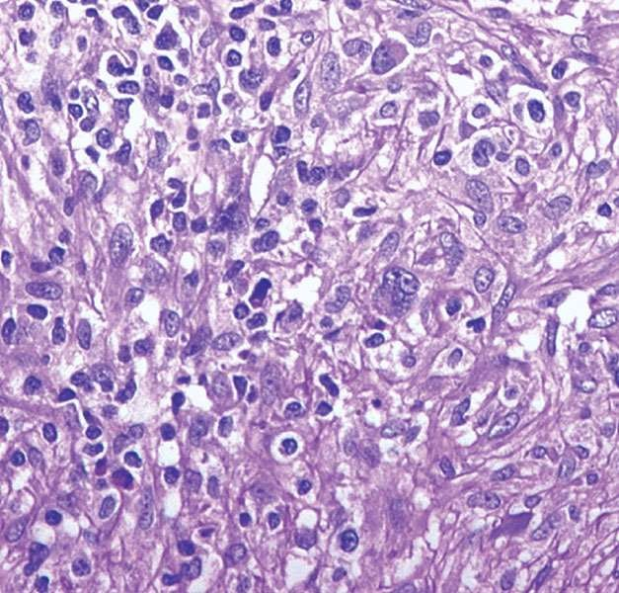
LYMPHOCYTE DEPLETED TYPE
Least common variant ( less than 1%)
Most common in older patients, HIV positive individuals
Abdominal lymphadenopathy with involvement of spleen and mesenteric nodes.
PATHOLOGY
Diffuse and hypocellular infiltrate.
Large number of RS cells with
“sarcomatous” variants.
Paucity of other inflammatory cells

Slide 28

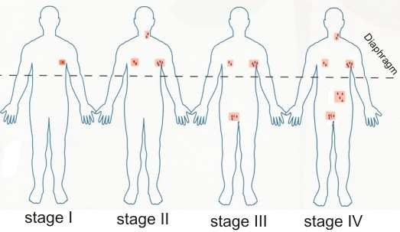
STAGING OF HODGKINS LYMPHOMA

Slide 29

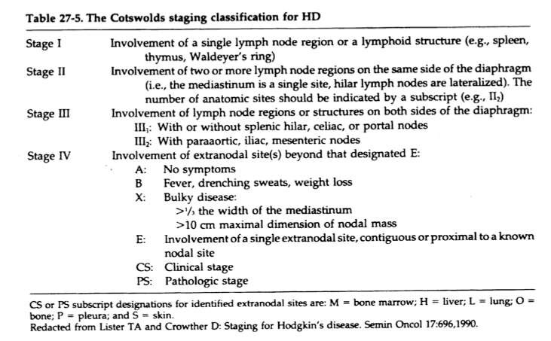
COTSWOLDS MODIFICATION OF ANN ARBOR CLASSIFICATION

Slide 30

TREATMENT METHODS
RADIOTHERAPY
CHEMOTHERAPY
COMBINED TREATMENT MODALITY

Slide 31

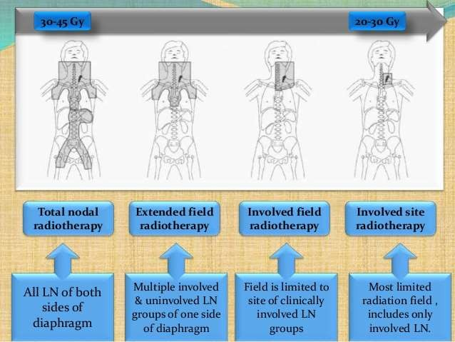
RADIOTHERAPY
Radiation therapy is the most effective single therapeutic agent for treating early
stage Hodgkins lymphoma.

Slide 32

EXTENDED FIELD RADIOTHERAPY
1)MANTLE FIELD•
The target volume for mantle field includes :
Occipital
Submental
Submandibular
Anterior and Posterior cervical
Infraclavicular
Axillary
Medial pectoral
Paratracheal
Mediastinal and hilar nodes

Slide 33
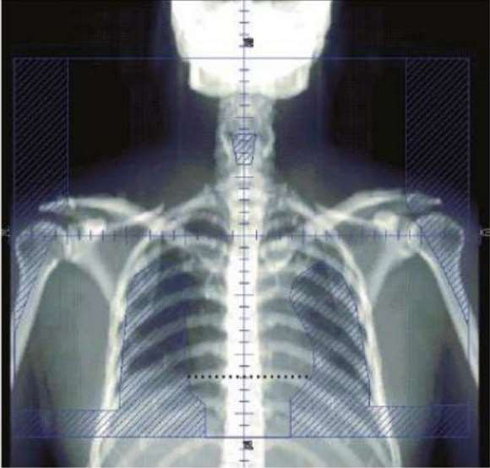
Treatment Field FOR MANTLE:
Superiorly:
Inferior portion of mandible bisecting the mastoid process
Laterally: Both the axillae Inferiorly:
T10-11 interspace
2) MINI MANTLE FIELD
MANTLE FIELD
Mantle without mediastinum and hilar lymph nodes
3) MODIFIED MANTLE FIELD
Mantle without axilla

Slide 34
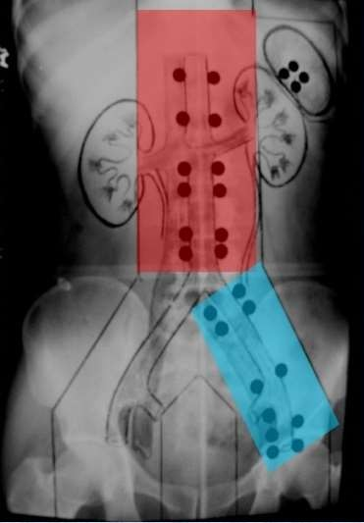
SUB-DIAPHRAGMATIC FIELD
Classic sub-diaphragmatic field is the Inverted Y
Target Volume :
Para-aortic node
Pelvic nodes
Spleen
B/L Inguinal nodes

Slide 35
INVOLVED FIELD RADIOTHERAPY:
Most commonly used technique
The main objective is to treat the involved site and immediately adjacent continuous sites.
The involved field is limited to the site of clinically involved lymph node groups.
Different involved fields include
Neck
Mediastinum
Axilla
Para aortic
Inguinal

Slide 36

DOSE:
EARLY STAGE :
IFRT 30Gy in daily 2Gy fractions over 2 to 3 weeks.
ADVANCED STAGE :
Radiotherapy for residual disease after chemotherapy includes doses of 30-34 Gy in
15-20 fractions of 1.8-2.0 Gy over 3 to 4 weeks.

Slide 37

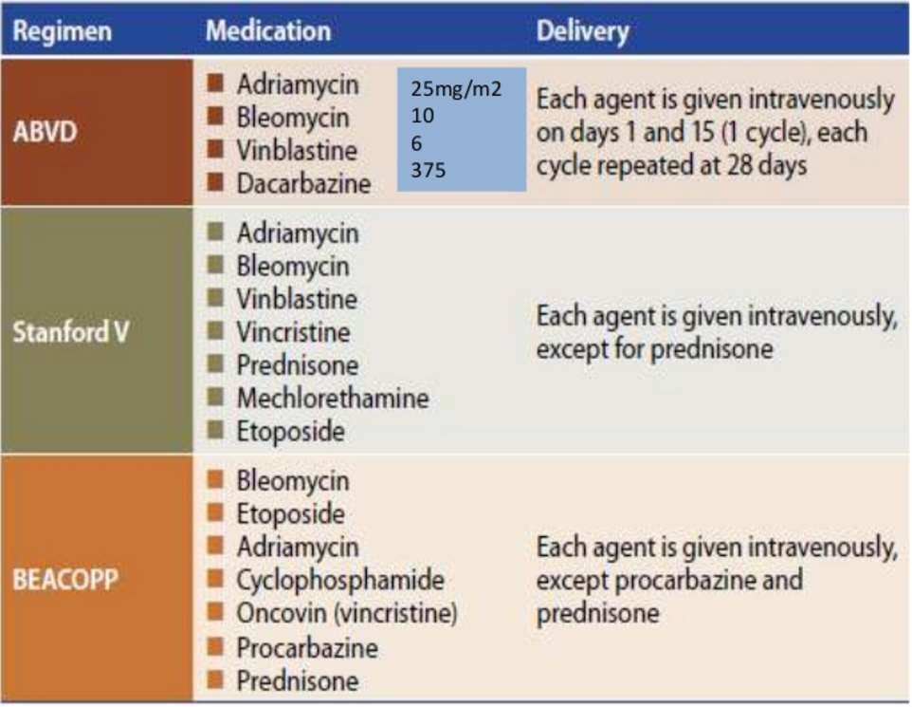
CHEMOTHERAPY

Slide 38

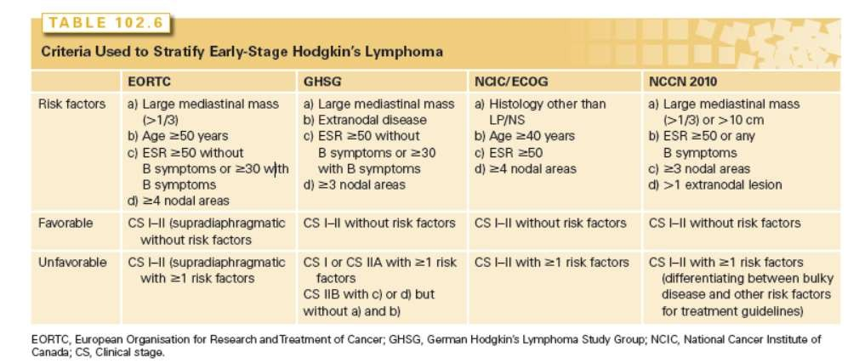
PROGNOSTIC GROUPS

Slide 39
EARLY FAVORABLE STAGES :
Treatment consists of a brief chemotherapy ( 2-3 cycles) plus IF-RT EARLY UNFAVORABLE STAGES :
Moderate amount of chemotherapy( around 4 cycles) plus IF-RT ADVANCED STAGES :
Extensive chemotherapy ( typically 8 cycles ) with or without radiotherapy

Slide 40

TREATMENT RELATED SIDE EFFECTS
A) PULMONARY COMPLICATIONS
Radiation pneumonitis typically occurs 1-6 months after completion of radiotherapy.
10-15% of patients with large mediastinal tumours who receive a combination of
chemotherapy and mantle field radiation therapy develop radiation pneumonitis.
CLINICAL FEATURES
Mild, non-productive cough
Low grade fever
Dyspnoea on exertion
RADIOLOGIC FEATURES
Formation of infiltrates confined to the original radiation fields.

Slide 41

B) CARDIAC COMPLICATIONS
a) Chemotherapy associated Cardiac Complications
Caused by anthracyclines
Presents as ECG changes, arrythmias or cardiomyopathy leading to congestive heart failure
Caused by direct damage to the cardiac myoepitheliem
Cardiotoxicity caused by doses greater than 500mg/m2 of body surface area
b) Radiotherapy associated Cardiac Complications
Wide spectrum of cardiac diseases such as coronary artery disease, myocardial dysfunction, valvular heart disease.
Radiation associated heart diseases usually present 10-15 years after exposure.

Slide 42

C) SECONDARY NEOPLASIA
Radiotherapy and certain chemotherapeutic agents such as nitrogen mustards, procarbazine, cyclophosphamide and etoposide are known to induce secondary malignancies.
Acute leukaemias are the commonest secondary malignancies, usually occuring within the first 10 years of initial treatment.
Secondary Non-Hodgkins Lymphomas after Hodgkins Lymphoma.

Slide 43

Incidence of secondary solid organ tumours increases with time.
Solid organs most at risk of developing a secondary malignancy are lung and breast.
Other secondary cancers that occur after succesful completion of treatment include sarcomas, melanomas and bone tumours.

Slide 44

GONADAL DYSFUNCTION
MALES
Post treatment gonadal damage is most often associated with chemotherapy regimens that include alkylating agents such as cyclophosphamide and procarbazine.
Rate of azoospermia after MOPP and ABVD regimens is high, ranging between
80% to 100%.
Cryoconservation of sperm should be offered to every young male before undergoing therapy for Hodgkins Lymphoma.

Slide 45

FEMALES
Alkylating agents cause gonadal damage in females also – premature ovarian failure
Premature ovarian failure is defined as amenorrhea for a period of at least 2 years following treatment with elevated levels of FSH.
Anti-Mullerian hormone is the most sensitive indicator of gonadal function and can be used for post- treatment assessment of ovarian reserve.

Slide 46

TREATMENT FAILURES
DIVIDED INTO 3 CATEGORIES:
A) PRIMARY PROGRESSIVE DISEASE : Patients who never achieved a complete
remission or relapse within 3 months after end of first line of treatment
B) EARLY RELAPSE
: Relapse occurs 3 to 12 months after the end of 1st treatment
C) LATE RELAPSE
: Relapse after a complete remission lasting at least 12 months

Slide 47
NODULAR LYMPHOCYTE PREDOMINANT HODGKINS LYMPHOMA
Rare sub-type accounting for 5 % of all the cases
Differ from cHL in terms of clinical features as well as immunophenotype
The RS cell variants( also called Lymphocyte Predominant RS cells or LP RS cells) express full program of B cell antigens.
More indolent clinical course.
Most often diagnosed in early stages

Slide 48

CLINICAL FEATURES
Male patient presenting with a single site of lymphadenopathy that has been enlarging for months to years.
Commonly presents in middle age
Most commonly presents with peripheral lymphadenopathy , cervical, axillary and inguinal
Mediastinal and retroperitoneal lymph node involvement is rare
Relative absence of B symptoms

Slide 49
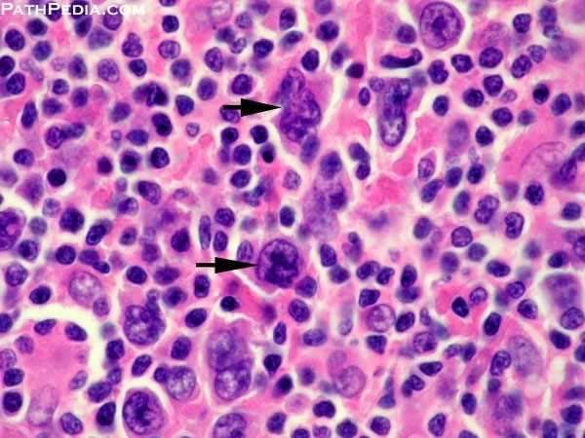
PATHOLOGY
Monoclonal B cell neoplasm characterised by a nodular and diffuse proliferation of
scattered large neoplastic cells known as LP RS cell variants.
LP cells have vesicular, poly-lobated nuclei and distinct but small, usually peripheral , nucleoli without perinuclear halos.
Absence of classic RS cells
Background consists of predominantly lymphocytes, clusters of epithelioid histiocytes may be present.

Slide 50

TREATMENT
A) EARLY FAVOURABLE STAGE
Radiotherapy is defined as the mainstay of treatment
Most large study groups recommend IF-RT as the standard of care for patients
with early favourable disease.
B) EARLY UNFAVOURABLE AND ADVANCED STAGES
Treatment plan is identical to that of cHL
Relapse rate is higher in NLPHL as compared to cHL

Slide 51

NON HODGKINS LYMPHOMA
INTRODUCTION
Non-Hodgkin’s lymphomas (NHL) are neoplastic transformations of mature B, T, and natural killer (NK) cells.
In children diffuse large B-cell lymphoma (DLBCL), Burkitt’s lymphoma (BL), and
lymphoblastic lymphoma are most common.
DLBCL is also the most common histologic subtype in adults.
Poorer prognosis as compared to Hodgkins Lymphoma as complete cure achieved
in less than 50% of patients(compared to over 80% in Hodgkins).

Slide 52

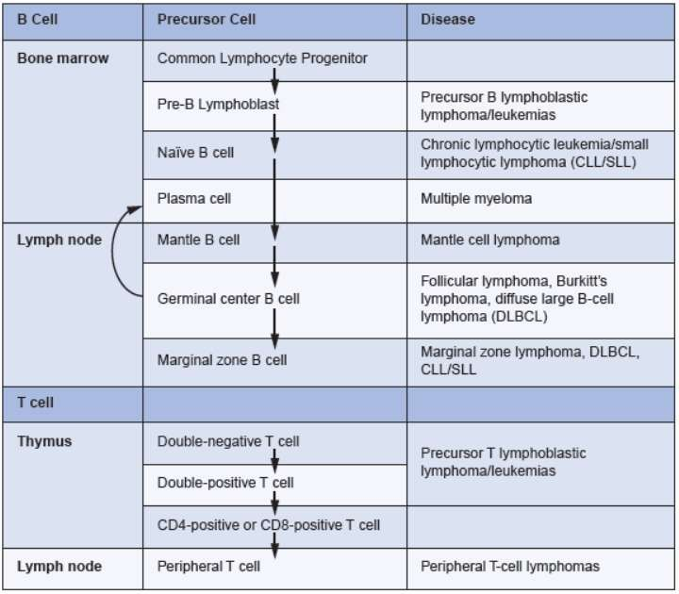
CELL OF ORIGIN OF DIFFERENT NHL’S

Slide 53

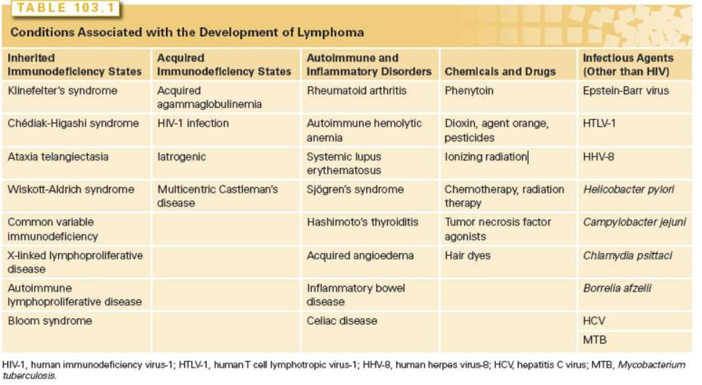
ETIOLOGY

Slide 54

CLINICAL FEATURES
NHLs have been divided into groups based on clinical behaviour
A) LOW-GRADE LYMPHOMAS
Peripheral adenopathy that is painless and slowly progressive.
Spontaneous regression of enlarged nodes may occur (waxing and waning LN’s)
Primary extra-nodal involvement and B symptoms are not common in patients
with low grade disease.
B) INTERMEDIATE OR HIGH GRADE
Peripheral lymphadenopathy
More than one third of patients present with extranodal involvement; the most common sites are the gastrointestinal tract , skin, bone marrow, sinuses, genitourinary tract, thyroid, and central nervous system .

Slide 55

Involvement of retroperitoneal, mesenteric, and pelvic nodes is common in most histologic subtypes of NHL.
Primary lymphomas of bone are very rare(5%)Most common sites are femur, pelvis and vertebrae.
Primary GI lymphomas often present with hemorrhage, pain, or obstruction
Most common site is the stomach. Common histological subtypes presenting are Diffuse Large B Cell Lymphoma, Mantle Cell Lymphoma and MALT Lymphoms.
B-symptoms are more common( 30-40% of patients)

Slide 56
Lymphoblastic lymphoma, a high-grade lymphoma, often manifests with an anterior superior mediastinal mass, superior vena cava (SVC) syndrome, and leptomeningeal disease with cranial nerve palsies.
Primary CNS lymphomas are high-grade neoplasms of B-cell origin. Most lymphomas originating in the CNS are large cell lymphomas or immunoblastomas, and they account for 1% of all intracranial neoplasms.
Symptoms of primary NHL of the CNS include headache, lethargy, focal neurologic symptoms, seizures, and paralysis.

Slide 57
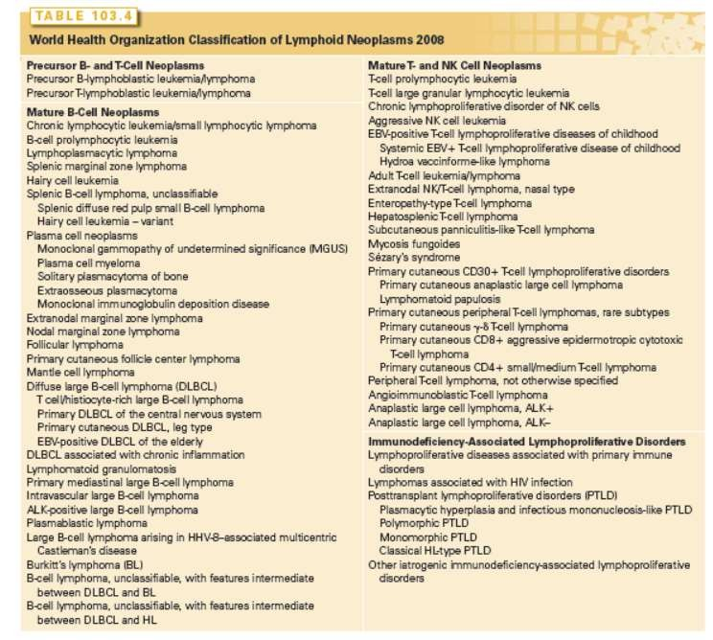
CLASSIFICATION

Slide 58

INVESTIGATIONS
A) BIOPSY
INDICATION : lymph node larger than 1.5 × 1.5 cm that is not associated with a documented infection and that persists longer than 4 weeks should be considered for a biopsy.
A biopsy should be performed immediately for patients with other findings suggesting malignancy
B) LABORATORY INVESTIGATIONS
Complete Blood Count
Liver Function tests
Serum Protein Electrophoresis
LDH and b-2 microglobulin

Slide 59

C) IMAGING
a) CT SCAN
Chest, abdominal and pelvic CT scans are done routinely.
Essential for accurate staging of the disease.
b) PET SCAN
18F-Fluorodeoxyglucose PET scan is highly sensitive for detecting both nodal
and extra-nodal disease.
Particularly useful for histologically aggressive lymphomas
PET scanning detects an actively metabolizing tumor in residual masses following or during chemotherapy, and persistent abnormal uptake predicts for early relapse and/or reduced survival.
c) MRI SCAN is useful in detecting bone, bone marrow, and CNS diseases in the brain and spinal cord.

Slide 60

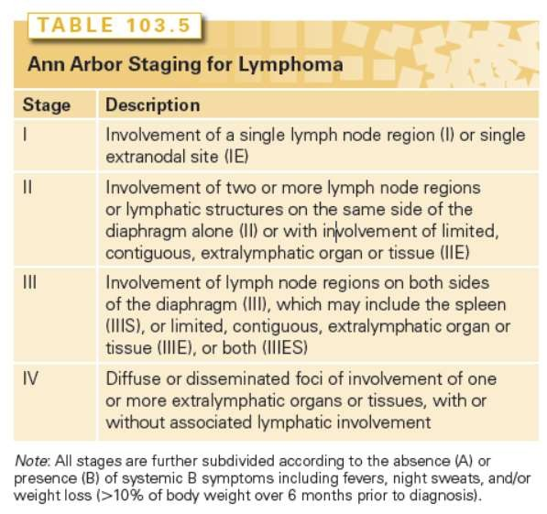
STAGING

Slide 61

Concept of staging has less impact in NHL than in HL
Prognosis is more dependent on histology and clinical parameters than the stage
at presentation.
Staging in NHLs, therefore, is done to identify the minority of patients who can be treated with local therapy or combined modality treatment.

Slide 62

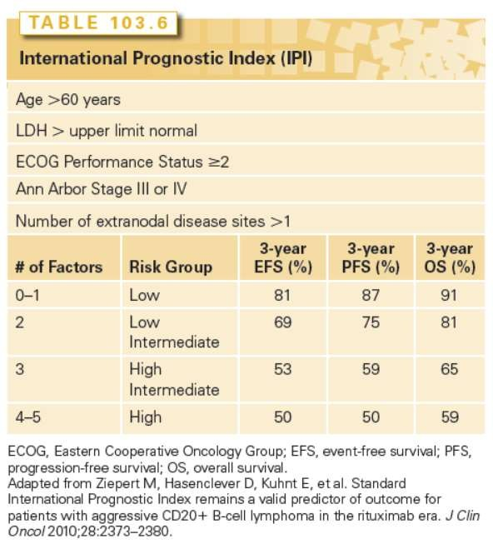
PROGNOSIS

Slide 63

FOLLICULAR LYMPHOMA
Second most common lymphoma
Comprises of 20 % of all NHL’s
PATHOLOGY
Follicular Lymphomas are malignant counterparts of normal germinal center B cells.
Neoplastic cells consist of a mixture of centrocytes and centroblasts.
The clinical aggressiveness of the tumor correlates with the number of centroblasts that are present.

Slide 64

PATHOLOGY CONTD..
WHO GRADING OF FOLLICULAR LYMPHOMAS
Grade 1 : 0-5 centroblasts per high powered field Grade 2 : 6-15 centroblasts per high powered field Grade 3 : >15 centroblasts per high powered field
3A : Predominantly centrocytes 3B : Sheets of centroblasts

Slide 65

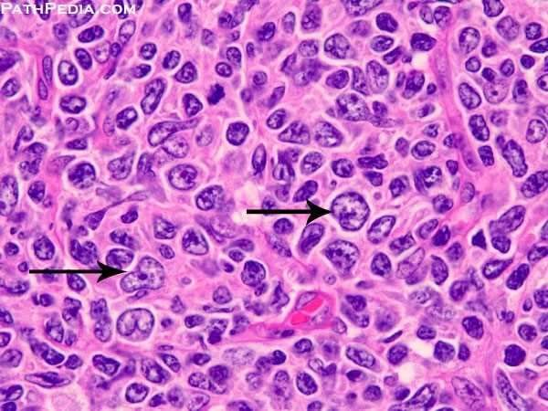
Small number of T cells and follicular
dendritic cells are also present
Involvement of the peripheral
blood with malignant cells is commonly
seen
Morphologically these cells have notches and hence referred to as buttock cells.

Slide 66

CLINICAL FEATURES
Long standing lymphadenopathy which waxes and wanes over the years
Bone marrow involvement is present in 70% of patients
Mean age at presentation is around 60 years with a female predominance.
Involvement of other non-lymphoid organs is uncommon.
Less than 20% of patients present with B symptoms

Slide 67
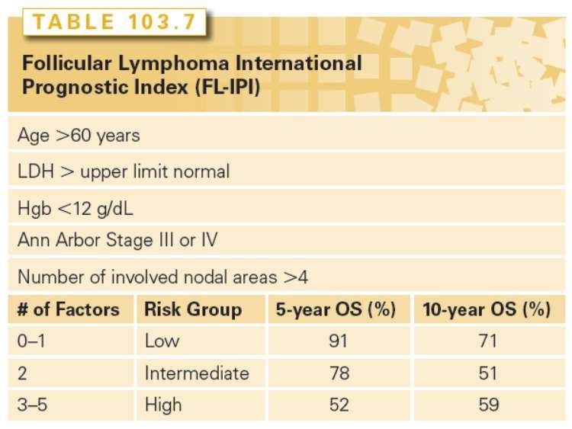
PROGNOSIS

Slide 68

TREATMENT
TREATMENT OF EARLY STAGE DISEASE
Early Stage Disease Includes Stage I,II and IIIA
Less than 10% of patients with FL present with early stage disease.
Radiotherapy is the treatment of choice( for early stage disease)
A dose of 24 to 30 Gy is highly effective, with no evidence of benefit for higher doses
Chemoradiotherapy improves Progression Free Survival as Compared To
Radiotherapy Alone, but has no impact on Overall Survival.

Slide 69

TREATMENT OF ADVANCED STAGE DISEASE
The majority of patients present with advanced disease at diagnosis.
Indications for treatment include symptomatic nodal and extranodal disease,
compromised end organ function, B symptoms, or cytopenias.
CHEMOTHERAPY REGIMENS
a) CHOP-R :
Cyclophosphamide, hydroxydaunorubicin, Oncovin ,
Prednisolone Rituximab
cyclophosphamide, vincristine, prednisone, and rituximab
Rituximab, fludarabine, and mitoxantrone Bendamustine, Rituximab
b) CVP-R
:
:
:
R-FM
BR

Slide 70

The BR regimen is commonly in use today due to lower toxicity and
favourable results.
Radioimmunotherapy has also been used as consolidation following conventional chemotherapy in patients with advanced stage disease.

Slide 71
DIFFUSE LARGE B CELL LYMPHOMA
DLBCL constitutes 31% of all NHLs, and is the most common histologic subtype
DLBCLs consist of a diffuse proliferation of large cells that have a high mitotic rate.
Cell of origin is usually Germinal Center and Post germinal center activated B cells.
Can prove to be rapidly fatal if left untreated.

Slide 72

CLINICAL FEATURES
Mean age at presentation is 64 years.
Patients present with rapidly enlarging masses, either nodal enlargement or
extranodal disease.
Extranodal sites are common, occurring in 40% of cases, including the GI tract, the testis, the bone, the thyroid, the skin and CNS.
DLBCL is highly invasive, with local compression of blood vessels, airways, involvement of peripheral nerves, and destruction of bone.

Slide 73

The disease presents as Stage I or Stage II in approximately 40 % of the cases.
Stage IV disease is seen in another 40% of cases.
B symptoms are present in around 40 % of patients.

Slide 74

TREATMENT
A) EARLY STAGE
This includes patients who present with localised disease.
Therapy of early stage Diffuse Large Cell Disease is controversial.
Recommended treatment is combination chemo-immunotherapy with additional IF-RT.
CHOP-R regimen : Cyclophosphamide, Hydroxydaunorubicin, Oncovin, Prednisolone and Rituximab ( usually given as first line therapy)
Addition of IF-RT also increases 5 year Progression Free Survival as well as
overall Survival( Total dose of 30-40 Gy)

Slide 75

B) ADVANCED STAGE DISEASE
Current recommendation for the treatment of advanced stage DLBCL is
combination chemotherapy with CHOP-R.
C) RELAPSED OR REFRACTIVE DISEASE
The majority of relapses from CHOP-R therapy are seen within the first 2 years
after the completion of treatment.
For patients with poor performance status, particularly elderly patients, the goal is often palliation.
The majority of patients with relapsed and refractory DLBCL receive high dose combination chemotherapy, often with rituximab.

Slide 76

MARGINAL ZONE LYMPHOMAS
MZLs are indolent NHLs that include three diseases arising from post-GC marginal zone B cells:
Nodal Marginal Zone Lymphomas
Splenic Marginal Zone Lymphoma
Extranodal Marginal Zone Lymphoma

Slide 77

A) NODAL MARGINAL ZONE LYMPHOMA(MZL)
Constitute less than 1% of all lymphomas
Disease process restricted to Lymph Nodes
PATHOLOGY
Within lymph nodes, there are collections of B cells in a parafollicular,
perivascular, and perisinusoidal distribution.
These cells may surround reactive-appearing GCs and mantle zones

Slide 78

CLINICAL FEATURES
Majority of patients present with Stage III/IV disease
Asymptomatic
The 5-year survival for patients with nodal MZL is 55% to 79%.
TREATMENT
Patients are frequently treated with chemoimmunotherapy
Regimens include either alkylating agents or purine analogs plus rituximab.

Slide 79

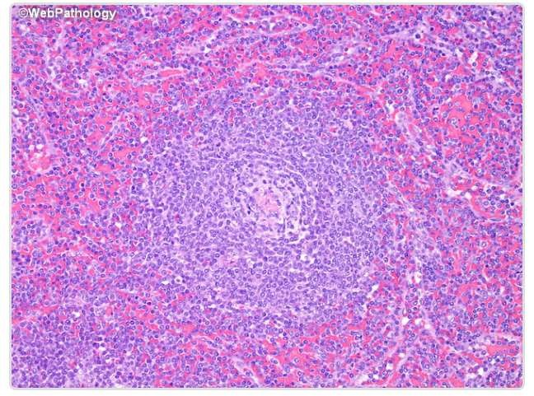
B) SPLENIC MARGINAL ZONE LYMPHOMA
Median age at presentation is 65-70 years
No gender predominance
Associated with viral infections like hepatitis C
PATHOLOGY
Expansion of marginal zones in the
spleen
Replacement of the lymphoid follicles of the white pulp with neoplastic cells.
Small darker lymphocytes in the center merging with pale staining cells in the periphery.

Slide 80

CLINICAL FEATURES
Patients typically present with splenomegaly and cytopenias
Lymphadenopathy is uncommon.
B symptoms and elevated LDH are uncommon.
More than 90% of cases have Stage IV disease at diagnosis.
Survival of patients is in excess of 70% at 10 years

Slide 81
TREATMENT
Asymptomatic patients without splenomegaly or cytopenias can be observed.
Splenectomy results in relief of symptoms and reversal of cytopenias.
For those patients with Hepatitis C, treatment of the infection results in regression of disease.
Radiation therapy is indicated in patients not fit for surgery
Total dose of 150cGy given to the entire spleen three times a week.

Slide 82

EXTRANODAL MARGINAL ZONE LYMPHOMA
Also known as MALT Lymphoma or Mucosa Associated Lymphoid Tissue
Lymphoma
The most common site is the stomach.
Associated with various chronic inflammatory and infectious conditions infections
like H. Pylori, Borrelia, Chlamydia, and Hepatitis C Virus
MALT lymphoma behaves indolently.
Associated with auto-immune conditions like Sjogren’s syndrome and autoimmune thyroiditis.

Slide 83

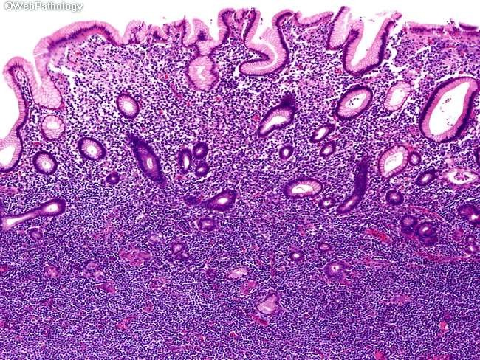
PATHOLOGY
MALT lymphomas are malignancies of antigen- stimulated B cells, which
normally reside in lymph nodes within the marginal zone
characterized by a monoclonal infiltrate of small- to medium-sized cells with abundant cytoplasm and irregular nuclear contours.
presence of lymphoepithelial lesions created by the invasion of mucosal glands and crypts by aggregates of lymphoma cells

Slide 84
CLINICAL FEATURES
Clinical presentation depends upon the site of disease.
a) Gastric and intestinal MALT lymphomas
Dyspepsia and vague abdominal pain
Bowel Obstruction
Rarely bleeding
b) Ocular Adnexa
Photophobia
Painless Conjunctival Injection

Slide 85

c) Bronchus associated Lymphoid Tissue( BALT)
Usually seen in older men
Present with cough, fever and weight loss
TREATMENT
Depends on stage and site of disease EARLY STAGE DISEASE
For H.Pylori positive Lymphomas, eradication of H.Pylori with antibiotics
Radiotherapy is indicated in patients with H.Pylori negative lymphomas , those unresponsive to anti- H. Pylori treatment
RT is also indicated in lymphoma of ocular adnexa

Slide 86

ADVANCED STAGE DISEASE
If patient is asymptomatic, then observation till symptoms appear.
Chemoimmunotherapy with alkylating agents like chlorambucil and cyclophosphamide, purine analogs like cladribine and bortezomib.

Slide 87

MANTLE CELL LYMPHOMA
MCL is a malignancy of small- to medium-sized B cells in the mantle zone
PATHOLOGY
Mantle cell lymphomas are neoplastic counterparts of naive Mantle zone cells.
Neoplastic cells are small- to medium-sized and have irregular nuclei and scant cytoplasm.

Slide 88

CLINICAL FEATURES
Constitutes 7% of all NHLs
Male predominance (75 % are males)
Mean age at presentation of 63 years
Typical sites of involvement are the lymph nodes, spleen, liver, Waldeyer’s ring.
Can occasionally involve the GI tract, presenting as polyposis.

Slide 89

TREATMENT
The majority of patients with MCL have a disseminated disease requiring treatment.
Chemotherapy is the primary treatment modality.
The treatment of MCL involves single alkylating agents as well as combination chemotherapy (CVP, CHOP).
The median survival of patients with MCL is 4 to 5 years.

Slide 90

REFERENCES
Devita, Hellman’s Concepts and Principles of Oncology
Robbins Basic Pathology
Sabiston’s Textbook of Surgery

Slide 91

THANK YOU

