Slide 1
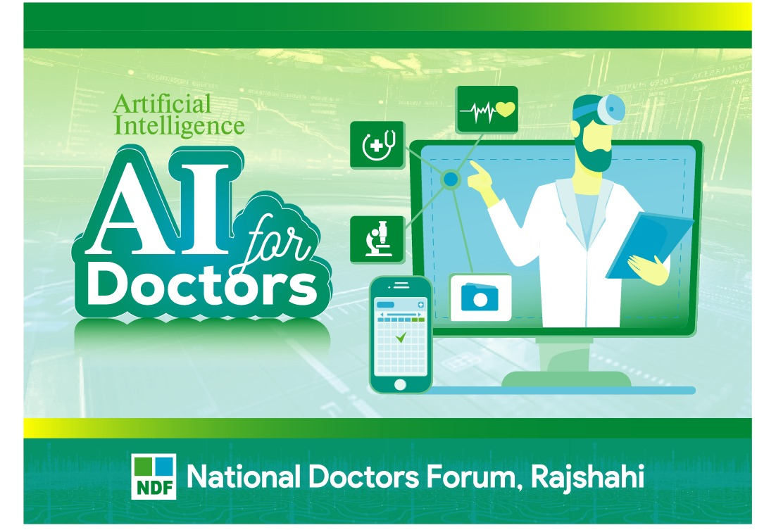

Slide 2
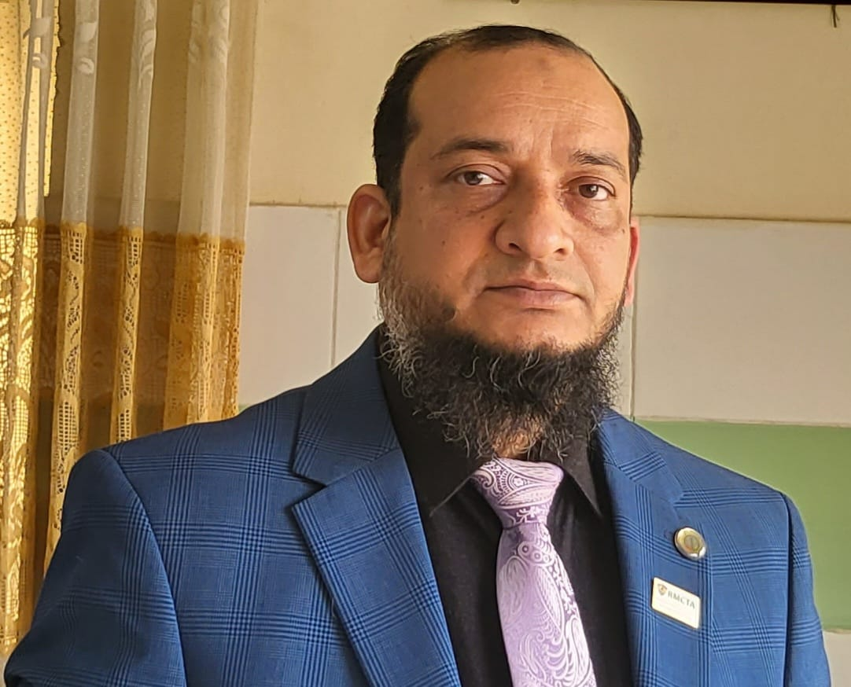
Dr.Morsed Zaman Miah
MBBS, MCPS
FCPS(Haematology)
Associate Professor & Head
Rajshahi Medical College.
www.drmzaman.com
Dr. Morsed Zaman Miah is associate professor and the head of the department of Haematology, Rajshahi Medical College, Rajshahi, Bangladesh. He has been graduated (MBBS) from Rajshahi Medical College, Rajshahi. He obtained his FCPS (Haematology) and MCPS (Clinical Pathology) degree from Bangladesh College of Physicians and Surgeons, Bangladesh. Dr. Morsed Zaman Miah served as Registrar in the department of Haematology, Rongpur Medical College Hospital and Rajshahi Medical College, Bangladesh. He is a registered member of Bangladesh Medical and Dental Council, Bangladesh College of Physicians and Surgeons (BCPS), Haematology Society of Bangladesh, Bangladesh Medical Association, World Federation of Hemophilia (WFH), Bangladesh Red Crescent Society, National Heart Foundation,Rajshahi.

Slide 3

Nobel Winners Geoffrey Hinton & John Hopfield

Slide 4


Slide 5


Slide 6


Slide 7


Slide 8


Slide 9
Introduction & Context
The Rise of AI in Healthcare – What’s changing and why it matters now.
Healthcare in Bangladesh: Challenges and Opportunities – Workforce shortages, rural access, and digital transformation.
Why Doctors Should Care About AI – How AI complements rather than replaces clinical expertise.

Slide 10
AI Fundamentals for Clinicians
Understanding AI and Machine Learning in Medicine – Concepts simplified for clinical application.
Types of AI Used in Healthcare – Diagnostic, predictive, and administrative systems.
How AI Learns: Data, Algorithms, and Validation – Transparency and reliability in AI tools.

Slide 11
Clinical Applications
AI in Diagnostics: Imaging and Pathology – Radiology, dermatology, and pathology examples.
AI in Predictive Medicine – Early detection of disease and hospital readmission prevention.
AI in Treatment Planning – Personalized medicine and dosage optimization.
AI in Primary Care and Telemedicine – Chatbots, virtual assistants, and remote diagnostics.
AI in Surgery and Robotics – Precision and safety in modern operations.
AI in Patient Monitoring and Wearables – Real-time analytics improving chronic care.

Slide 12
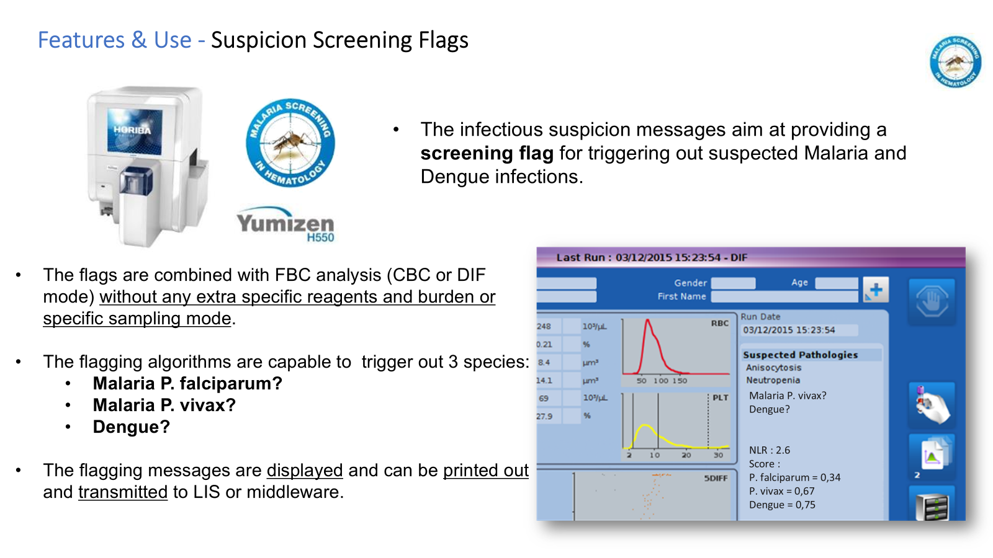

Slide 13
Implementation & Practice
Practical AI Tools Available for Doctors – EHR systems, imaging tools, and open-source platforms.
Integrating AI into Daily Clinical Workflows – Steps, training, and minimal disruption.
Cost and Accessibility in the Bangladeshi Context – Local startups and low-cost AI solutions.
AI and Data Privacy in Healthcare – Security, patient consent, and legal frameworks.

